Slide 1
LU Decomposition
Xinjie Zhuang

Slide 2
A=LU
The goal of LU decomposition,is to write a square matrix a as a product of matrix L(lower triangular matrix and Upper triangler matrix).
For example, for a 3 × 3 matrix A, its LU decomposition looks like this:

Slide 3
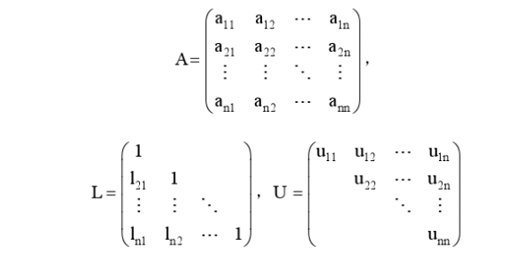
A=LU
A must be able to be reduced to a row-echelon form without exchanging any rows in U.
diagonal in L is all 1

Slide 4
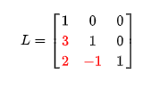

Slide 5
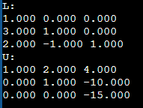

Slide 6
The matrix A is decomposed into a unit lower triangular matrix L and upper triangular matrix U through the equal elements on both sides of the equation. E.g

Slide 7
1: By comparing the first row and the first column on both sides of the equation, we can get:
2: It can be obtained by comparing the second row and second column on both sides of the equation
U(1,j)=a(1,j)(j=1…n)
L(i,1)=a(i,1)/U(1,1)(i=2,..,n)
U(2,j)=a(i,2)-l(2,1)*U(1,j) j=2,..,n
L(i,2)=(a(i,2)-l(i,1)*U(1,2))/U(2,2) i=3,…,n

Slide 8
Therefore, we can get by analogy:

Slide 9
Go to the nth step in turn to find all the elements in the matrix L and the matrix U.
After obtaining LU, the original equations AX=b can become the form of LUX=b. Let UX=Y.
All the original formulas can become: LY=b, and UX=Y. Two linear equations. And because LU is the lower triangular matrix and the upper triangular matrix respectively, Y can be obtained by direct d substitution method, and then X can be obtained by back substitution method.

Slide 10
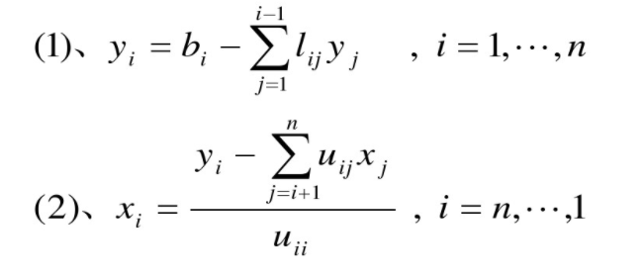

Slide 11
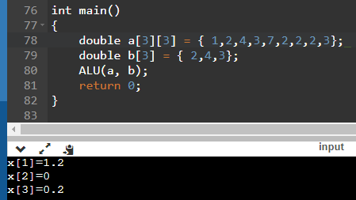
output

Slide 12
LU decomp will not be faster than Gaussian elimination. Indeed, the decomposition algorithm is very similar to the elimination algorithm, and the speed is not fast.

Slide 13
Advantage of LU decomposition
The advantage of LU decomposition is that when you will get matrix A, the equation you want to solve is Ax=b for multiple different given vectors b. Gaussian elimination needs to start from scratch, and each solution will take the same amount of time. In the LU decomposition, you can store the generated matrix L and the matrix U calculated for the first time, which can greatly speed up the solution speed b of subsequent equations using different vectors.

