Slide 1
Interpolation with scattered data
Xinjie Zhuang

Slide 2
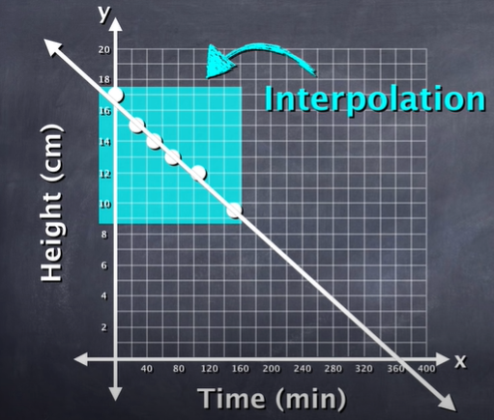
Making Predictions
An interpolation is a prediction between the given data points.
Notes:
extra is less reliable to the interpotlation because we can strech willing to the future into the the past. the further we move from the actual data points

Slide 3
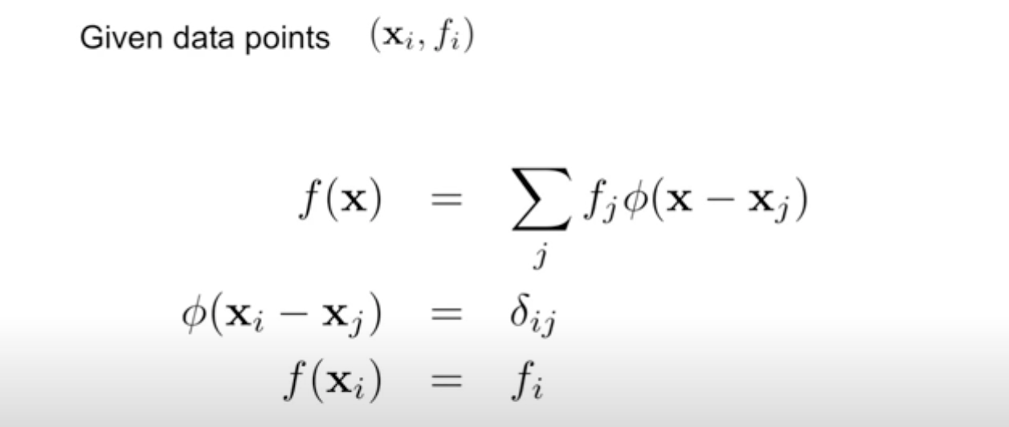

Slide 4
Radial Basis Function Interpolation
The strong point of this radial basic function
easy to use
calculating quickly
various basis function

Slide 5
We used to deal with 1-d or 2-d interpolation. Now we X can be N values data point if doing N dimensional interpolation.

Slide 7
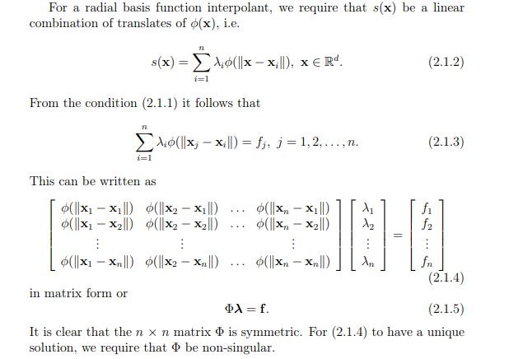

Slide 9
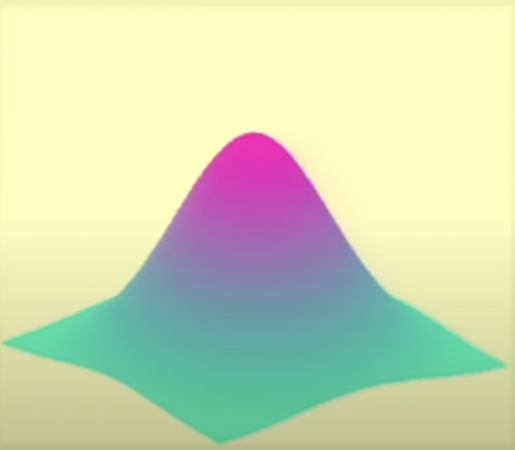
A point in the data set will affect the nearby points more than it affects the far away points.That is what radial basis function is.
This is Xn.
The influence of Xn goes down when it is far away from the center.

Slide 10
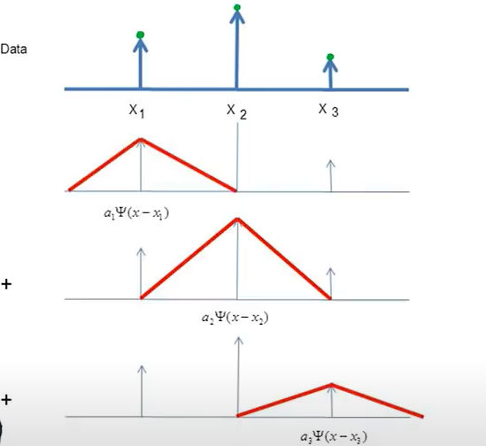
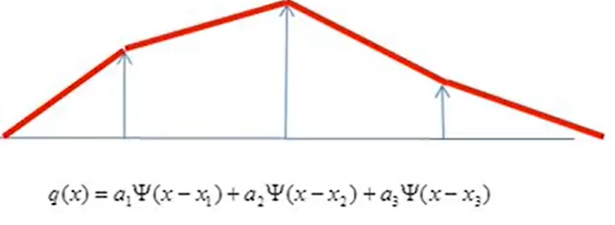
3 data points
It increase or decrease monotonically towards centre

Slide 11
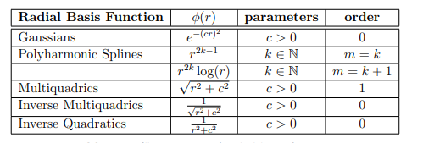
Type of radial function

Slide 12
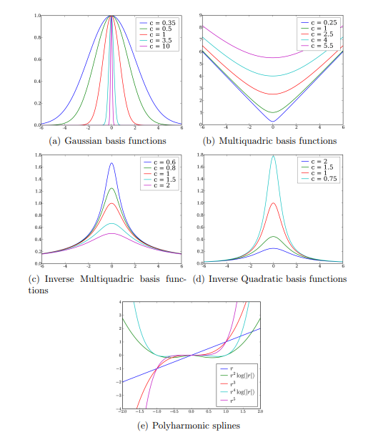

Slide 13
Radial Basis function interpolation is equivalent to the use of universal kriging, both are based on the use of a conditionally positive definite function. There are a couple of practical and theoretical differences, RBF explicitly gives an interpolating function whereas the interpolating function is implicit in kriging. The literature on RBF devotes little space to the question of choosing or determining the radial basis function whereas this is an important aspect of using kriging.

Slide 14
Reference
Radial Basis Function Interpolation by Wilna du Toi\
Radial basis function - 1 by NPTEL-NOC IITM

