Slide 1
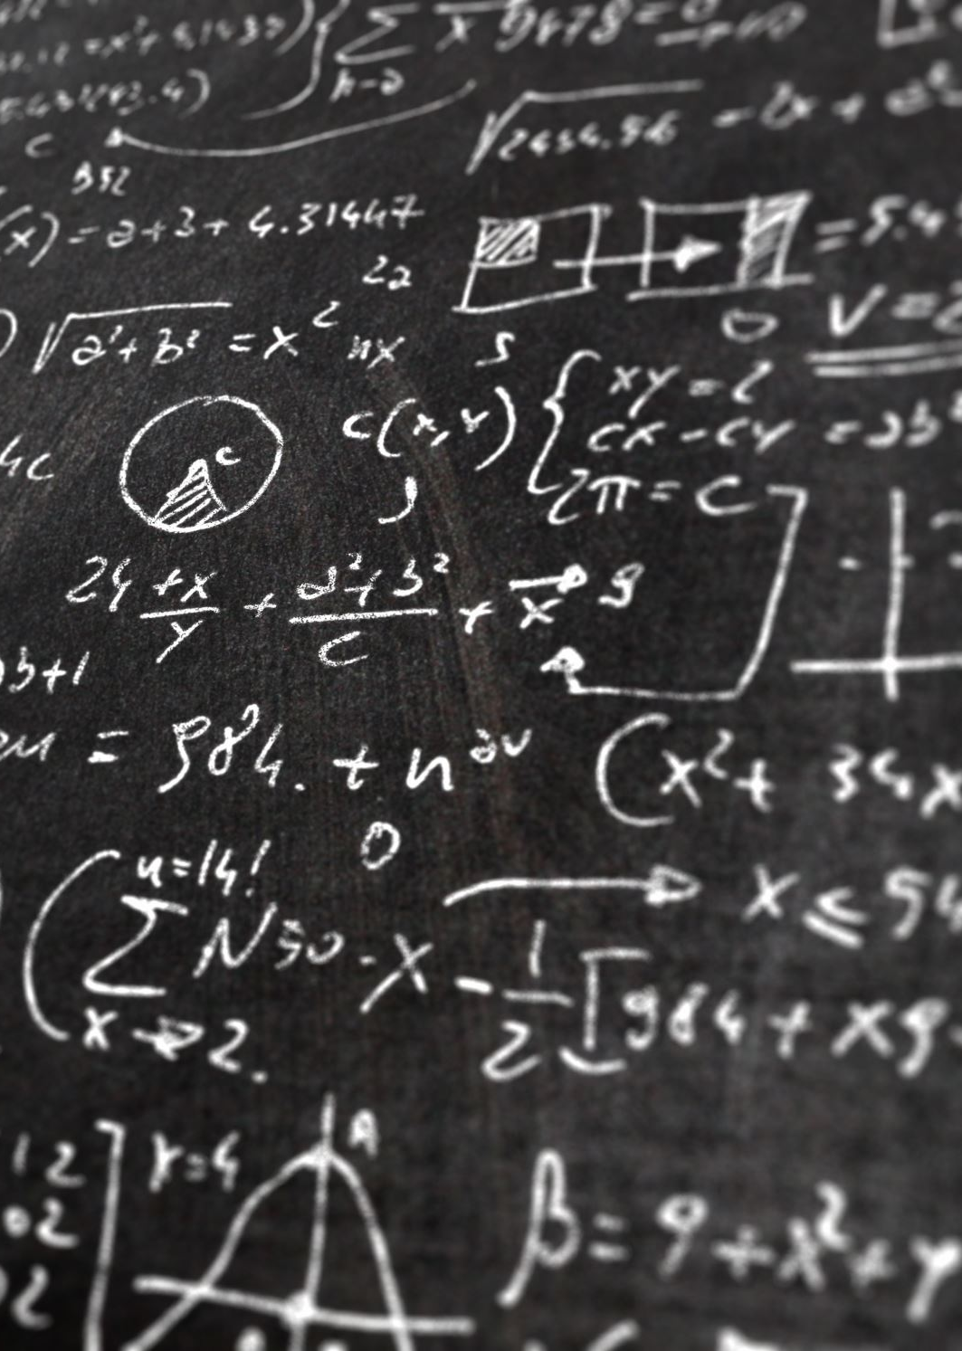
Conjugate Gradient methods 10.8
Daniel Wall

Slide 2
Conjugate gradient
Method for multidimensional minimization
Any function can be broken down into its Taylor series, which can then be approximated by the following equation:

Slide 3
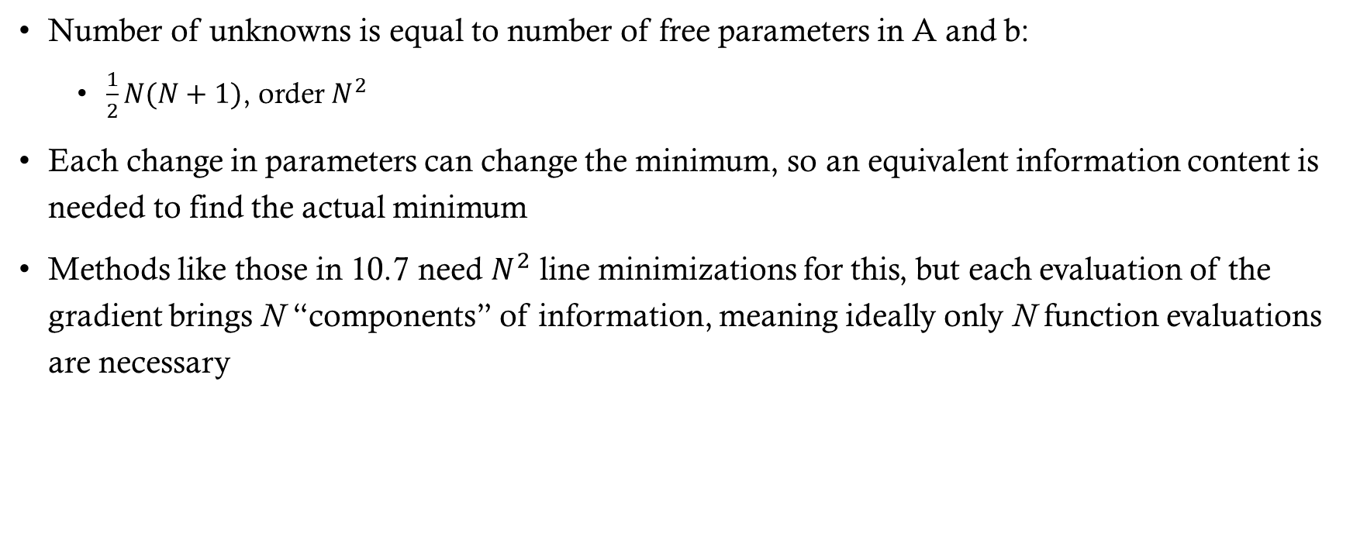
Improved efficiency
Number of unknowns is equal to number of free parameters in A and b:
$\frac{1}{2}N(N+1)$, order $N^{2}$
Each change in parameters can change the minimum, so an equivalent information content is needed to find the actual minimum
Methods like those in 10.7 need $N^{2}$ line minimizations for this, but each evaluation of the gradient brings N “components” of information, meaning ideally only N function evaluations are necessary

Slide 4
Steepest descent
Inefficient method of incorporating gradient information
The inefficiency with this method is that if you follow the direction of the gradient at a calculated minimum, you can only move in right angle turns
We should instead proceed in a direction conjugate to previous gradient as well as all other directions traversed

Slide 5

Derivation of the method
Based on conjugate gradient method for solving linear equations (2.7.6)
Start with arbitrary initial vectors $g_{0}=h_{0}$
Construct two sequences of vectors from:

Slide 6
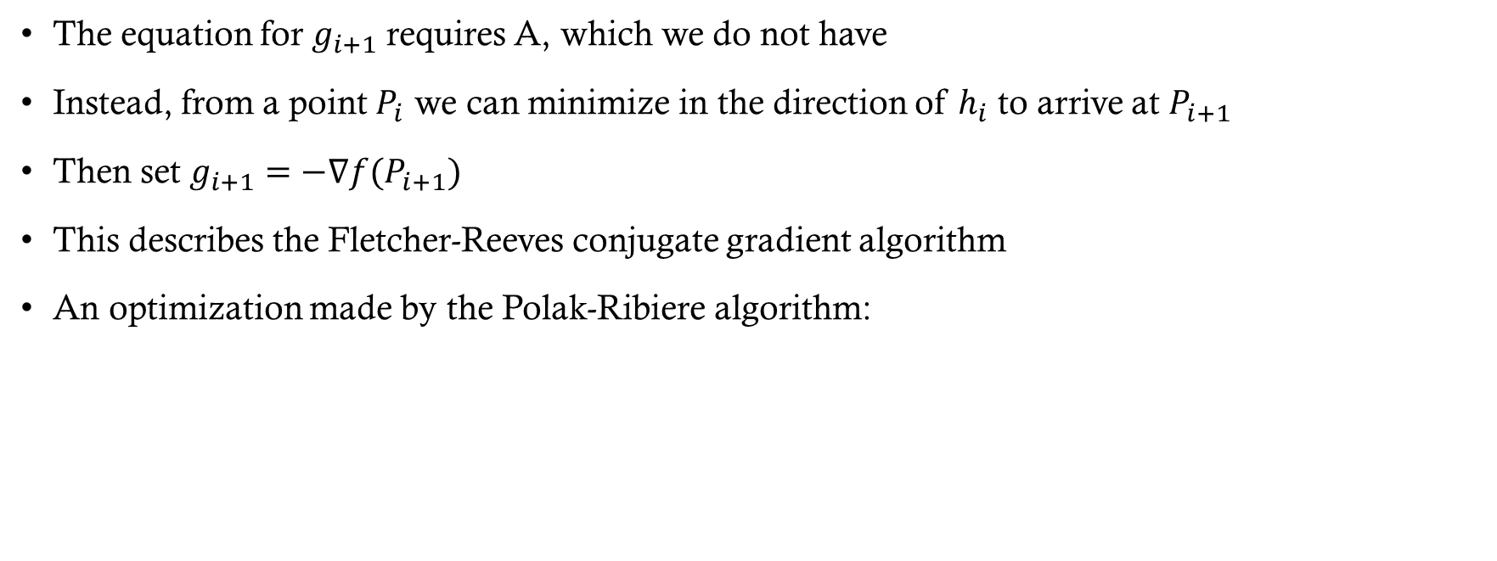
Derivation of the method
The equation for $g_{i+1}$ requires A, which we do not have
Instead, from a point $P_{i}$ we can minimize in the direction of $h_{i}$ to arrive at $P_{i+1}$
Then set $g_{i+1}=−\text{∇}f(P_{i+1})$
This describes the Fletcher-Reeves conjugate gradient algorithm
An optimization made by the Polak-Ribiere algorithm:

