Slide 1
Tridiagonal and Band Diagonal Systems of Equations

Slide 2
Overview
Definition
Tridiagonal Matrix: a band matrix that has non-zero elements on the main diagonal, the first diagonal above the main diagonal (superdiagonal) and the first diagonal below the main diagonal (subdiagonal) only.

Slide 3
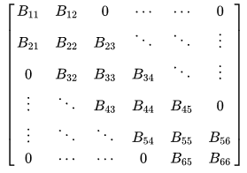
Tridiagonal Example Matrix
The only non-zero elements in a tridiagonal matrix or on the diagonal, superdiagonal, and subdiagonal.
The Main Diagonal elements are B11 - B66
The superdiagonal has elements B12 - B56
The subdiagonal has elements B21 - B65

Slide 4
Overview
Definition
Band Diagonal Matrix: a band matrix that has non-zero elements on the main diagonal, but is more relaxed in definition vs tridiagonal. Non-zero elements are allowed anywhere below or above the main diagonal.

Slide 5
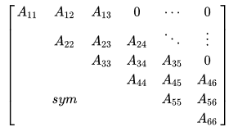
Band Diagonal Example Matrix
The only non-zero elements in a Band diagonal matrix or on the main diagonal, and either below (to the left of) the main diagonal m₁ ≥ 0
or above (to the right of) the main m₂ ≥ 0.
The Main Diagonal elements are A11 - A66
The m₁ ≥ 0 has no listed elements
The m₂ ≥ 0 has elements A12 - A56
and A13 - A46

Slide 6
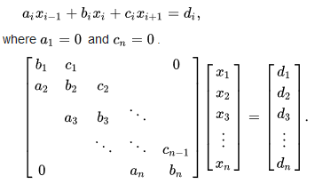
Tridiagonal Matrix Algorithm (Thomas Algorithm)

Slide 7
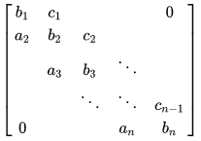
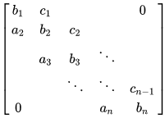
Tridiagonal Matrix Algorithm (Thomas Algorithm)
Given a Tridiag Matrix, work the Forward Sweep Computations:

Slide 8
Tridiagonal Matrix Algorithm (Thomas Algorithm)
Given a Tridag Matrix, work the Forward Sweep Computations:

Slide 9
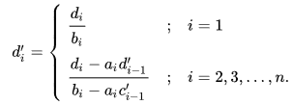
Tridiagonal Matrix Algorithm (Thomas Algorithm)
Given a Tridag Matrix, work the Forward Sweep Computations:

Slide 10
Tridiagonal Matrix Algorithm (Thomas Algorithm)
After the Forward Sweep, the Solution is gained by Back Substitution:

Slide 11
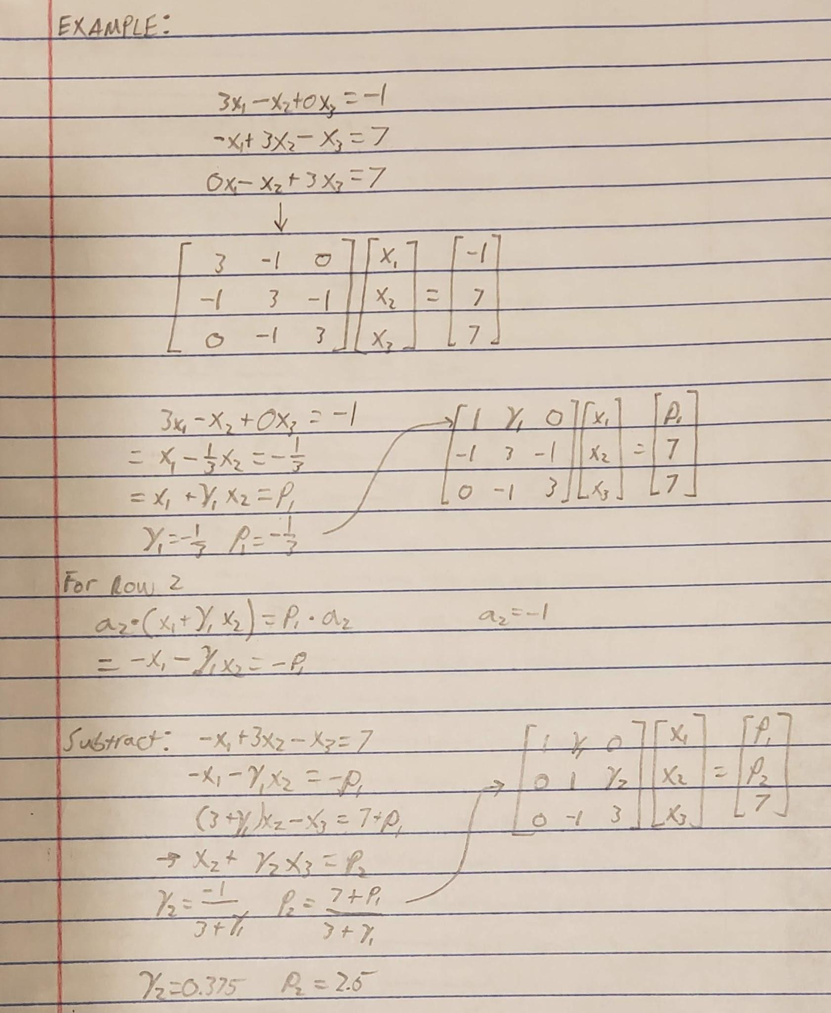
Tridiagonal Matrix Algorithm (Thomas Algorithm)
Example Problem:

Slide 12
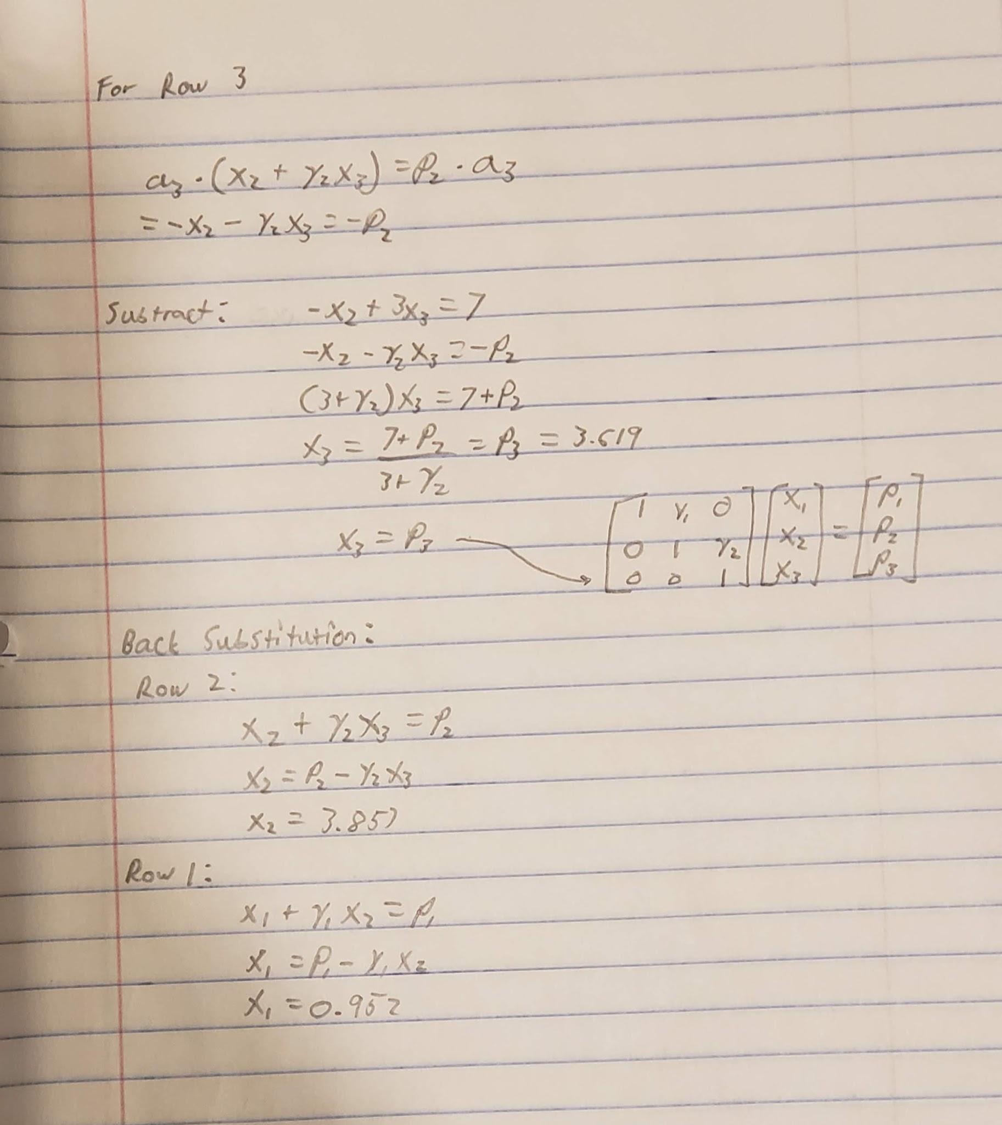

Slide 13
Questions?

