Slide 1
Modeling of data
CSE 5400
Joy Moore

Slide 2
Basic goals of modeling
Want to summarize data by fitting it to a model
A figure of merit function measures the agreement between the data and the model
Parameters of the model are then adjusted to find an extremum in the merit function, yielding best-fit parameters
It is a minimization problem in many dimensions
The merit function is not always unimodal with a single minimum, so we might look for global instead of local minima
Data itself is subject to measurement errors and likely will never exactly fit the model
Goodness of fit test is used to determine whether the model is appropriate

Slide 3
3 things needed
1. parameters
2. error estimates of the parameters or a way to sample from their probability distribution
This is to know the accuracy with which parameters are determined by the data set
3. a statistical measure of goodness-of-fit

Slide 4
Frequentist vs Bayesian
According to the frequentist definition of probability, only repeatable random events (like the result of flipping a coin) have probabilities.
Frequentists don’t attach probabilities to hypotheses or to any fixed but unknown values in general.
In the Bayesian viewpoint, you can use probabilities to represent the uncertainty in any event or hypothesis
the newly collected data makes the probability distribution over the parameter narrower around the parameter’s true (unknown) value
Numerical recipes uses the Bayesian viewpoint

Slide 5
Bayes’ theorem

Slide 6
Maximum likelihood
Assuming the data has a normal distribution,
We want to maximize this equation by minimizing the negative logarithm of it
The most probable model is found when the parameters are derived this way

Slide 7
Maximum likelihood (cont.)
From Bayes’ theorem,
We define the probability of the data given the parameters as the likelihood of the parameters given the data.

Slide 8
Chi-square fitting
Chi squared is a merit function that we want to minimize
this is a sum of N squares of normally distributed quantities, each normalized to unit variance.
It has ν = N-M degrees of freedom
N is the number of data points
M is the number of model parameters

Slide 9
Chi-square fitting (cont.)

Slide 10
Fitting data to a straight line

Slide 11
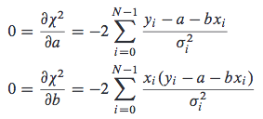
Fitting data to a straight line (cont.)

Slide 12
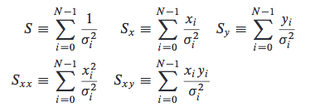
Fitting data to a straight line (cont.)
the following sums are defined to make the problem more compact:
thus the partial derivative equations become:

Slide 13
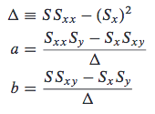
Fitting data to a straight line (cont.)
Solving that system of equations, we have our parameters:
Where the errors in a and b are calculated as:

Slide 14
Goodness-of-fit (correlation)
The coefficient of correlation between the uncertainty in a and the uncertainty in b is a number between -1 and 1, defined by
Positive value indicates that the errors in a and b are likely to have the same sign
Negative value indicates that the errors are anticorrelated
This is the square root of the “R squared” value, which is used as a goodness-of-fit test in linear regression

Slide 15
Fitab
The structure Fitab has 2 constructors, one with the error in the data points:
And one without it:
When these errors are unknown, Fitab assumes equal values of σ for each point.

