Slide 1
Wavelet Transform (Section 13.10.6-13.10.8)
Michael Phipps
Vallary S. Bhopatkar

Slide 2
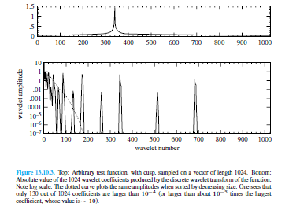
Truncated Wavelet Approximation
The most useful thing about wavelet transform is that it can turned into sparse expansion i.e. it can be truncated
Arbitrary chosen test fnct, smooth except over square root cusp
Vector components after performing DAUB4 DWT

Slide 3
This kind of truncation makes the vector sparse, but still of logical length 1024
To perform truncation on wavelet, it is very important to consider the amplitude of the components and not only the positions
Hence, whenever we compress the function, we should consider both the values i.e. amplitude as well as the position of the non zero coefficient.
There are two types of wavelets namely compact (unsmooth) and smooth (non compact)
Compact wavelets are better for lower accuracy approximations and for functions with discontinuities, which makes it good choice for image compression.
Smooth wavelets are good for achieving high numerical accuracy and hence it is best for fast solution of integral equations.
In real applications of wavelets to compression, components are not starkly “kept” or “discarded.” Rather, components may be kept with a varying number of bits of accuracy, depending on their magnitude

Slide 4
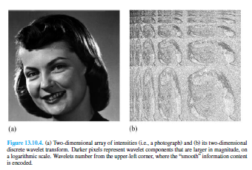
Wavelet Transform In Multidimensions
A wavelet transform of a d-dimensional array is most easily obtained by transforming the array sequentially on its first index (for all values of its other indices),then on its second, and so on. Each transformation corresponds to multiplication by an orthogonal matrix M
For d = 2, the order of transformation is independent. And it similar to the multidimensional case for FFTs.

Slide 5
Compression of Images
This is an application of multidimensional transform.
The procedure is to take the wavelet transform of a digitized image, and then to “allocate bits” among the wavelet coefficients in some highly non uniform, optimized, manner.
Large wavelet coefficient quantized accurately, while small one quantized coarsely with bit- or two or else truncated completely.
To demonstrate front end wavelet encoding with simple truncation: Set the threshold value such that all small wavelet coefficients are set to zero and then by varying threshold we can vary the fraction of large wavelet coefficient.

Slide 6
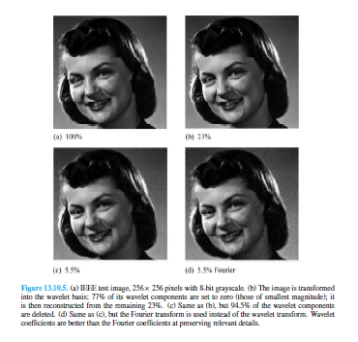
Sometimes image b choose over a as a superior image, because the “little bit” of wavelet compression has the effect of denoising the image

