Slide 1
FFT Convolution
Michael Phipps
Vallary S. Bhopatkar

Slide 2
Convolution theorem
Convolution theorem for continuous case:
h(t) and g(t) are two functions and H(f) and G(f) are their corresponding Fourier Transform, then convolution is defined as
Where g*h is in time domain and then convolution theorem is given by
g*h ↔ G(f) H(f)
Fourier transform of the convolution is just the product of the individual Fourier transform

Slide 3
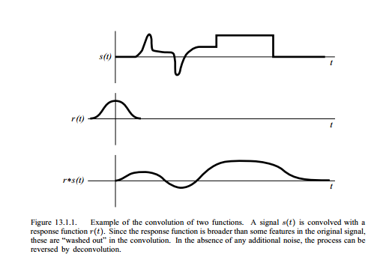
Convolution of two function is equal to the their convolution in opposite order
s*r =r*s
If s(t) is function represents signal then r(t) is response function and their convolution smears the signal s(t) in time according to response function r(t)

Slide 4
Discrete case:
If signal s(t) is represented by its sampled values at equal time interval sj , rk is discrete set of numbers corresponds to response function then rk tells what multiple of the input signal is copied into identical output channel.
Therefore, the discrete convolution with response function of finite duration M is given by
If response function is non-zero in some range where M is very large even integer, then response function is called as finite impulse response (FIR)

Slide 5
The discrete convolution theorem
If signal sj is periodic with period N, then its discrete convolution with response function of finite duration N is member of the discrete Fourier transform pair

Slide 6
Zero Padding
Discrete convolution considered two assumptions:
Input signal is periodic
Duration of response function is same as the period of the data i.e. N
To work on these two constrains, zero padding method is used.
For response function M which shorter than N, can be expanded to length N by padding it with zeros.
i.e. define rk = 0 for M/2 ≤ k ≤ N/2 and also for –N/2 + 1 ≤ ≤ -M/2 +1

Slide 7
The first assumption pollute the first output channel (s*r)0 with some wrapped- around data from the far end
To make this pollution zero, we nee to set the buffer zone of zero padded values at the end of the sj vector.
Number of zero should be equal to most negative index for which the response function is non zero.

Slide 8
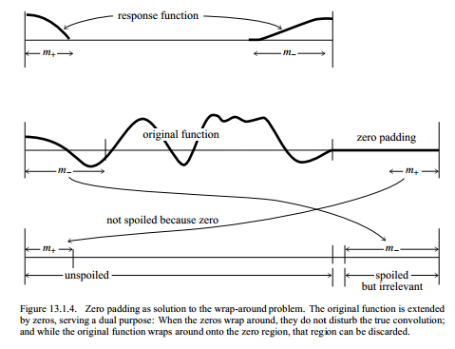

Slide 9
Use of FFT for convolution
After considering the zero padding for real data, the discrete convolution can be calculated using FFT algorithm.
First compute the discrete Fourier transform of s and r, and then multiply these two transform component by component
Take inverse discrete FT of the product in order to get convolution r*s

Slide 10
Deconvolution
This is a process of undoing smearing in a data set that has occurred under the influence of known response function
Now left hand side is know for deconvolution
In order to get transform of deconvolution signal, will divide transform of known convolution by the transform of response function

Slide 11
Drawbacks of this method
It can go mathematically wrong if response function has zero value
It is sensitive to the noise in the input data and the to the accuracy of the response function

Slide 12
Convolving or deconvolving very large data set
If the data set is very large, we can break it up into small section and convolve each section separately
This method cause wraparound effect at the end and to overcome this problem, there are two solutions:
1. Overlap-save method
2. Overlap-add method

Slide 13
1. Overlap-save method
Pad only beginning of the data with zeros to avoid wraparound pollution
Convolve the section and throw out the points at each end that are polluted
Choose next section such that the first points should overlap the last points of the preceding section
It should overlap in such away that the end of section should recomputed as first section of unpolluted output points of subsequent section

Slide 14
2. Overlap-add method:
In this method, distinct sections are considered and zero pad it from the both ends
Take convolution of each section and then overlap and add these sections outputs
Therefore, output points near end of one section will have response due to the input points at the beginning of the next section and data is added properly.

Slide 15
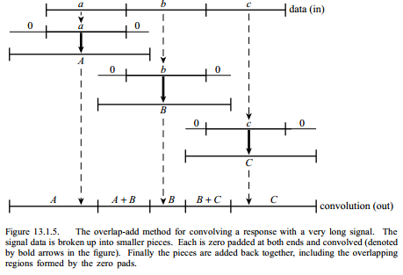

Slide 16
Resources
Numerical recipes

