Slide 1
Fast Solution of Linear Systems

Slide 2
The basic idea is to regard an integral operator (a large matrix) as a digital image.

Slide 3
Suppose that the operator compresses well under a two-dimensional wavelet transform, i.e., that a large fraction of its wavelet coefficients are so small as to be negligible. Then any linear system involving the operator becomes a sparse system in the wavelet basis.

Slide 4
To solve
$A∙x=b$ (13.10.17)
we first wavelet-transform the operator A and the right-hand side b by
$\tilde{A}≡W∙A∙W^{T}$, $\tilde{b}≡W∙b$ (13.10.18)
where W represents the 1-dimensional wavelet transform, then solve
$\tilde{A}∙\tilde{x}=\tilde{b}$ (13.10.19)
and finally transform to the answer by the inverse wavelet transform
$x=W^{T}∙\tilde{x}$ (13.10.20)

Slide 5
A typical integral operator that compresses well into wavelets has arbitrary (or even nearly singular) elements near its main diagonal, but becomes smooth away from the diagonal. An example might be
$A_{ij}=\left\{\begin{aligned}−1 \\ {\left|i−j\right|}^{−1/2}\end{aligned}\right. {if i=j \atop otherwise}$ (13.10.21)

Slide 6
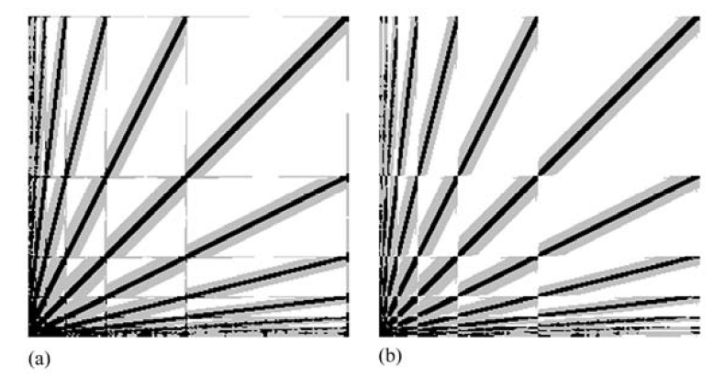
The number of nonnegligible elements in a matrix like that in Figure 13.10.6 scales only as N, the linear size of the matrix;
It’s about $10N\log_{10}{(1/ε)}$, where ϵ is the truncation level, e.g., ${10}^{−6}$.
Figure 13.10.6 Wavelet transform of a 256x256 matrix, represented graphically.

Slide 7
Various numerical schemes can be used to solve sparse linear systems of this “hierarchically band-diagonal” form.

