Slide 1
Direction Set (Powell’s) Methods in Multidimensions
Shi

Slide 2
We know (10.2 –10.4) how to minimize a function of one variable. If we start at a point P in N-dimensional space, and proceed from there in some vector direction n, then any function of N variables f(P) can be minimized along the line n by our one-dimensional methods.
Different methods will differ only by how they choose the next direction n to try.

Slide 3
linmin
The line minimization routine linmin is a black-box subalgorithm, whose definition is

Slide 4
A simple method for general multidimensional minimization
Take the unit vectors $e_{0}, e_{1}… e_{N−1}$as a set of directions. Using linmin, move along the first direction to its minimum, then from there along the second direction to its minimum, and so on, cycling through the whole set of directions as many times as necessary, until the function stops decreasing.

Slide 5
drawback
For some functions this simple method will be very inefficient, Consider a function of two dimensions whose contour map (level lines) happens to define a long, narrow valley at some angle to the coordinate basis vectors.
(example figure in next slide)

Slide 6
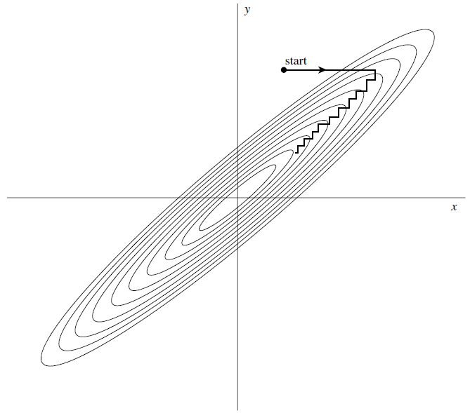
Figure 10.7.1 from NR book

Slide 7
We need a better set of directions than the $e_{i}$’s.
All direction set methods consist of prescriptions for updating the set of directions as the method proceeds, attempting to come up with a set that either (i) includes some very good directions that will take us far along narrow valleys, or else (more subtly) (ii) includes some number of “noninterfering” directions with the special property that minimization along one is not “spoiled” by subsequent minimization along another, so that interminable cycling through the set of directions can be avoided.

Slide 8
Conjugate Directions
First, note that if we minimize a function along some direction u, then the gradient of the function must be perpendicular to u at the line minimum; if not, then there would still be a nonzero directional derivative along u.

Slide 9
Next take some particular point P as the origin of the coordinate system with coordinates x. Then any function f can be approximated by its Taylor series
Where
In the approximation of (10.7.1), the gradient of f is easily calculated as

Slide 10
The gradient ∇f change as we move along some direction
Suppose that we have moved along some direction u to a minimum and now propose to move along some new direction v. The condition that motion along v not spoil our minimization along u is just that the gradient stay perpendicular to u, i.e., that the change in the gradient be perpendicular to u. By equation (10.7.4) this is just
When (10.7.5) holds for two vectors u and v, they are said to be conjugate. When the relation holds pairwise for all members of a set of vectors, they are said to be a conjugate set.

Slide 11
Powell’s Quadratically Convergent Method
Powell first discovered a direction set method that does produce N mutually conjugate directions.
Steps:
1.Initialize the set of directions $u_{i}$ to the basis vectors,
2.Then repeat the following steps until function stops decreasing:
Save starting point as $P_{0}$.
For i = 0,…,N-1, move $P_{i}$ to the minimum along direction $u_{i}$ and call this point $P_{i+1}$.
For i = 0,…,N-2, set $u_{i}←u_{i+1}$.
Set $u_{N−1}←P_{N}$-$P_{0}$.
Move $P_{N}$ to the minimum along direction $u_{N−1}$ and call this point $P_{0}$.

Slide 12
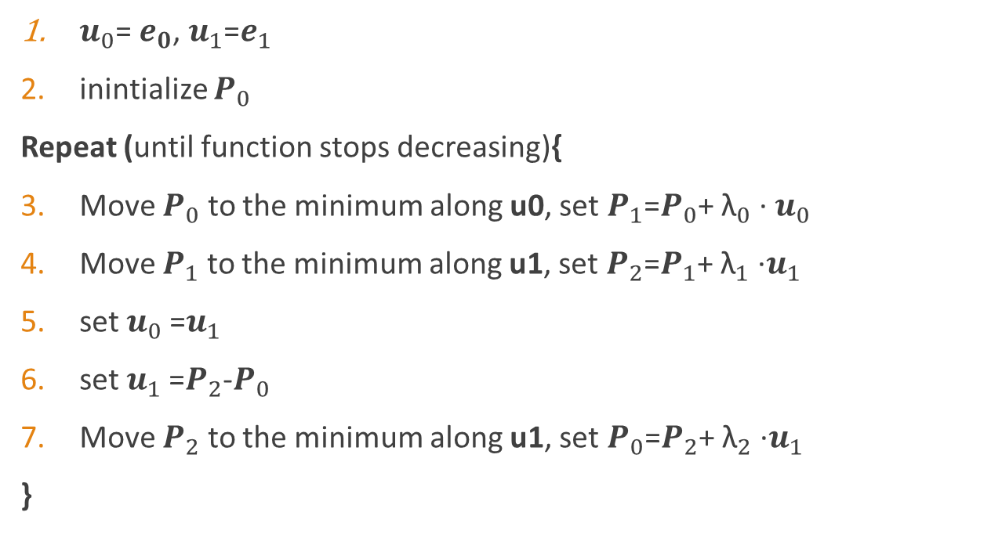
Example with N=2
$u_{0}$= $e_{0}$, $u_{1}$=$e_{1}$
inintialize $P_{0}$
Repeat (until function stops decreasing){
Move $P_{0}$ to the minimum along u0, set $P_{1}$=$P_{0}$+ ${\text{λ}}_{0}$∙ $u_{0}$
Move $P_{1}$ to the minimum along u1, set $P_{2}$=$P_{1}$+ ${\text{λ}}_{1}$∙$u_{1}$
set $u_{0}$=$u_{1}$
set $u_{1}$=$P_{2}$-$P_{0}$
Move $P_{2}$ to the minimum along u1, set $P_{0}$=$P_{2}$+ ${\text{λ}}_{2}$∙$u_{1}$
}

Slide 13
Problem of Powell’s Method
The procedure of throwing away at each stage, $u_{0}$ in favor of $P_{N}$-$P_{0}$tends to produce sets of directions that “fold up on each other” and become linearly dependent. Once this happens, the procedure finds the minimum of the function f only over a subspace of the full N-dimensional case; in other words, it gives the wrong answer.
For previous example, if $u_{1}$=$P_{2}$-$P_{0}$ from step 6 has the same direction as $u_{0}$ from step 5, linearly dependence happens for latter loops.

Slide 14
Discarding the Direction of Largest Decrease
The basic idea of modified Powell’s method is still to take $P_{N}$-$P_{0}$ as a new direction;
For a valley whose long direction is twisting slowly, this direction is likely to give us a good run along the new long direction. The change is to discard the old direction along which the function f made its largest decrease. This seems paradoxical, since that direction was the best of the previous iteration. However, it is also likely to be a major component of the new direction that we are adding, so dropping it gives us the best chance of avoiding a buildup of linear dependence.

Slide 15
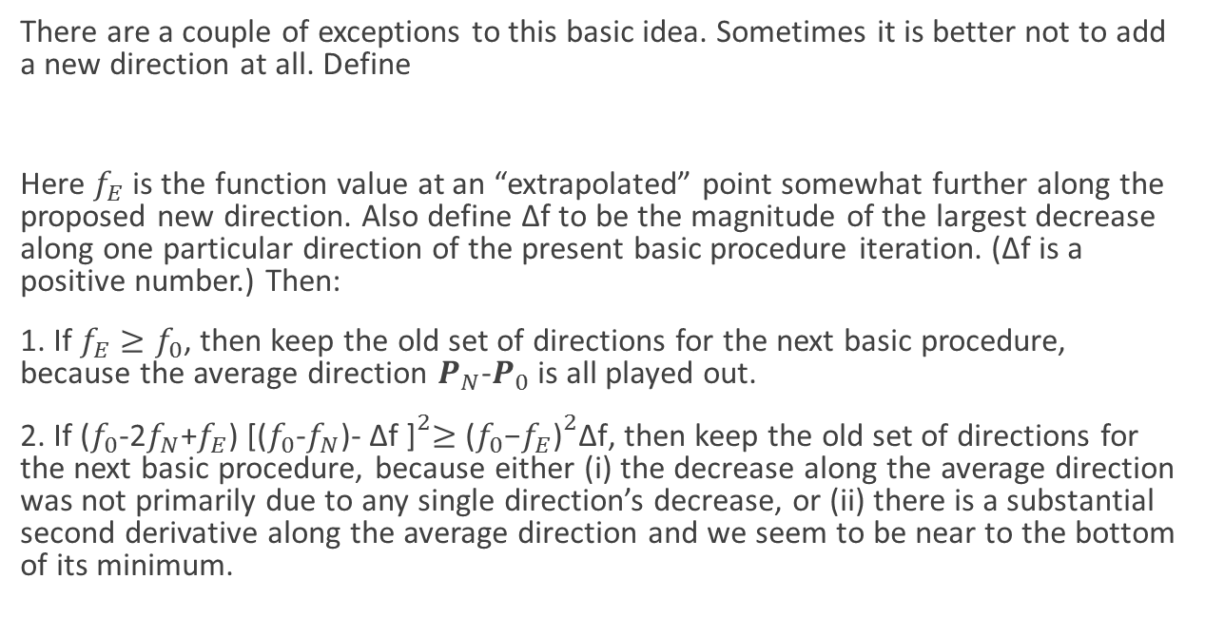
There are a couple of exceptions to this basic idea. Sometimes it is better not to add a new direction at all. Define
Here $f_{E}$ is the function value at an “extrapolated” point somewhat further along the proposed new direction. Also define ∆f to be the magnitude of the largest decrease along one particular direction of the present basic procedure iteration. (∆f is a positive number.) Then:
1. If $f_{E}≥f_{0}$, then keep the old set of directions for the next basic procedure, because the average direction $P_{N}$-$P_{0}$is all played out.
2. If ($f_{0}$-2$f_{N}$+$f_{E}$) ${\text{[(}f_{0}\text{−}f_{N}\text{)− ∆}\text{f}\text{ ]}}^{2}≥{\text{(}f_{0}\text{−}f_{E}\text{)}}^{2}\text{∆}\text{f}$, then keep the old set of directions for the next basic procedure, because either (i) the decrease along the average direction was not primarily due to any single direction’s decrease, or (ii) there is a substantial second derivative along the average direction and we seem to be near to the bottom of its minimum.

