Slide 1
2.7.6 Conjugate Gradient Method for a Sparse System
Shi & Bo

Slide 2
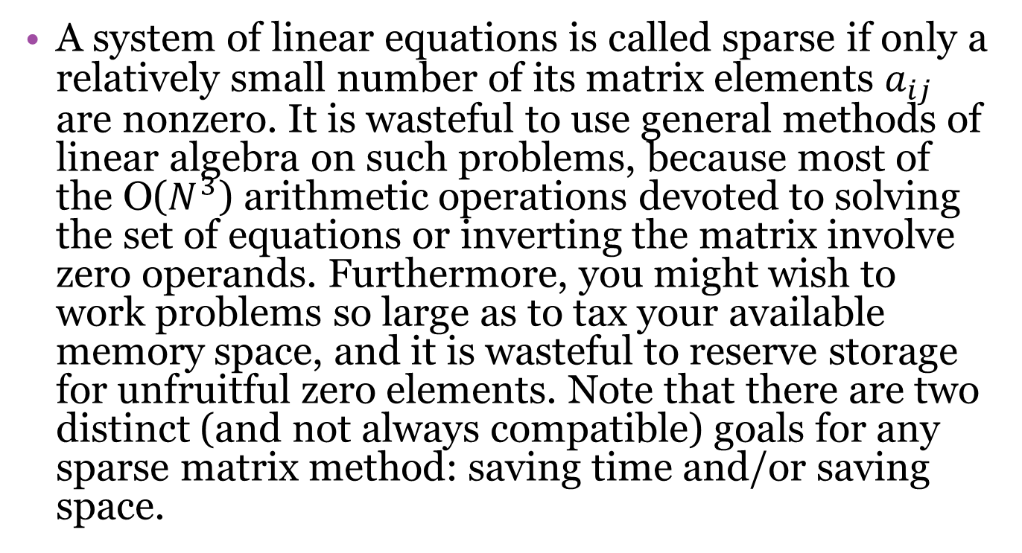
What is sparse system
A system of linear equations is called sparse if only a relatively small number of its matrix elements $a_{ij}$ are nonzero. It is wasteful to use general methods of linear algebra on such problems, because most of the O($N^{3}$) arithmetic operations devoted to solving the set of equations or inverting the matrix involve zero operands. Furthermore, you might wish to work problems so large as to tax your available memory space, and it is wasteful to reserve storage for unfruitful zero elements. Note that there are two distinct (and not always compatible) goals for any sparse matrix method: saving time and/or saving space.

Slide 3
Conjugate Gradient Method
Ax=b
The ordinary conjugate gradient algorithm:
steepest descent method

Slide 4
steepest descent method
Where A is n*n symmetric positive definite matrix, b is known n-d vector.
Solving Ax=b is equivalent to minimizing
$f\left(x\right)=\frac{1}{2}xAx−bx+c$
▽f=Ax-b

Slide 5
steepest descent method
Steepest Descent
Start at a initial guess point $x_{0};$ adjust until close enough to the exact solution:
$x_{i+1}=x_{i}+s_{i}r_{i}$
Where i is number of iterations $s_{i}$ is step size, $r_{i}$ is Adjustment Direction.
How to choose direction and step size?

Slide 6
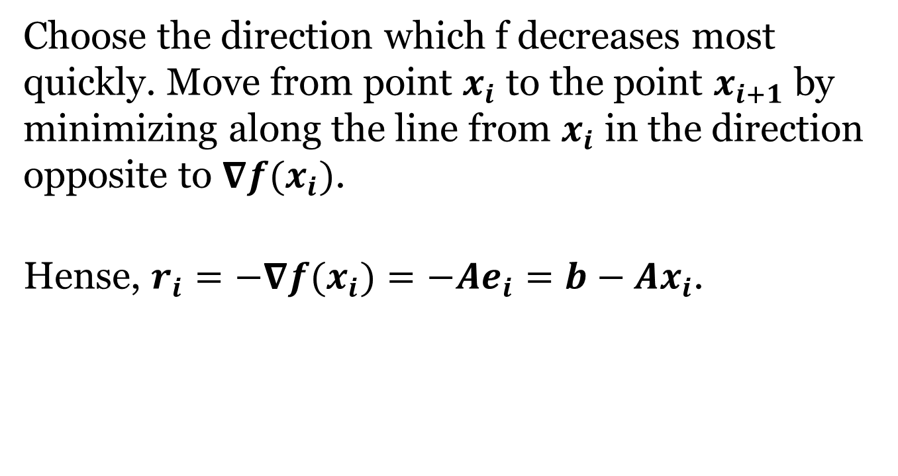
Choose direction
Choose the direction which f decreases most quickly. Move from point $x_{i}$ to the point $x_{i+1}$ by minimizing along the line from $x_{i}$ in the direction opposite to ${∇f(x}_{i})$.
Hense, ${r_{i}=−∇f(x}_{i})=−Ae_{i}=b−Ax_{i}$.

Slide 7
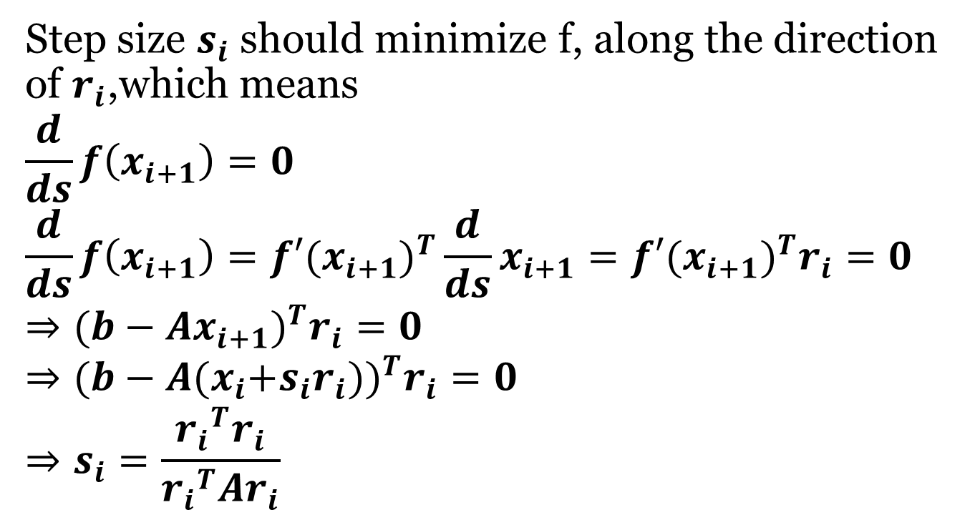
Choose step size
Step size $s_{i}$ should minimize f, along the direction of $r_{i}$,which means
$$\frac{d}{ds}f\left(x_{i+1}\right)=0$$
$$\frac{d}{ds}f\left(x_{i+1}\right)=f′(x_{i+1})^{T}\frac{d}{ds}x_{i+1}=f′(x_{i+1})^{T}r_{i}=0$$
$$⇒(b−Ax_{i+1})^{T}r_{i}=0$$
$$⇒(b−A{(x}_{i}+s_{i}r_{i}))^{T}r_{i}=0$$
$$⇒s_{i}=\frac{{r_{i}}^{T}r_{i}}{{r_{i}}^{T}{Ar}_{i}}$$

Slide 8
When to stop
We should give a stopping criterion because there may have many errors and noises.
only for exact arithmetic, not in practice
in practice unstable alg for general A
stopping criterion is $i>i_{max}$ or $||r_{i}||<ε||r_{0}||$ with an given small $ε$.

Slide 9
Symmetric but non-positive definite A
With the choice $\overline{r_{0}}=A∙r_{0}$ instead of $\overline{r_{0}}=r_{0}$. In this case $\overline{r_{k}}=A∙r_{k}$ and $\overline{p_{k}}=A∙p_{k}$for all k. This algorithm is equivalent to the ordinary conjugate gradient algorithm, but with all dot products $a∙b$ replaced by $a∙A∙b$. It is called the minimum residual algorithm, because it corresponds to successive minimizations of the function

Slide 10
For any nonsingular matrix A, $A^{T}∙A$ is symmetric and positive-definite.
But we can’t use $\left(A^{T}∙A\right)∙x=A^{T}∙b$.
Because the condition number of the matrix $A^{T}∙A$ is the square of the condition number of A.

Slide 11
Thanks
Reference
Numerical Recipes
Steepest Decent and Conjugate Gradients, w3.pppl.gov/m3d/reference/SteepestDecentandCG.ppt

Slide 12
Reference
Numerical Recipes
Steepest Decent and Conjugate Gradients

