Slide 1
Singular Value Decomposition(SVD)
Bo & Shi

Slide 2
Definition of SVD
Formally, the singular value decomposition of an m*n real or complex matrix M is a factorization of the form$M=UΣV^{T}$
where U is an m*m real or complex unitary matrix, Σ is an m*n rectangular diagonal matrix with nonnegative real numbers on the diagonal, and V* (the conjugate transpose of V) is an n×n real or complex unitary matrix. The diagonal entries Σi,i of Σ are known as the singular values of M. The m columns of U and the n columns of V are called the left-singular vectors and right-singular vectors of M

Slide 3
Geometrical interpretation of SVD
for every linear map T:Kn → Km one can find orthonormal bases of Kn and Km such that T maps the i-th basis vector of Kn to a non-negative multiple of the i-th basis vector of Km, and sends the left-over basis vectors to zero. With respect to these bases, the map T is therefore represented by a diagonal matrix with non-negative real diagonal entries.

Slide 4
Geometrical interpretation of SVD
The SVD decomposes M into three simple transformations: a rotation V*, a scaling Σ along the rotated coordinate axes and a second rotation U.

Slide 5
Range, null-space, rank
Range
The range of A is the set of all vectors v for which the equation Ax = v has a solution.
Null-space
The null-space of A is the set of all the solutions to the equation Av = 0.
Rank
The rank of A is equal to its number of linearly independent columns, and also to its number of linearly independent rows.

Slide 6
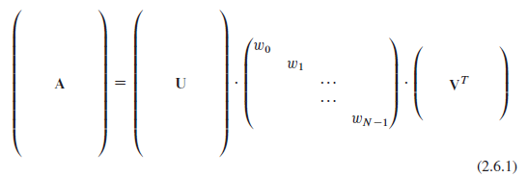
SVD-overdetermined

Slide 7
SVD-undetermined

Slide 8
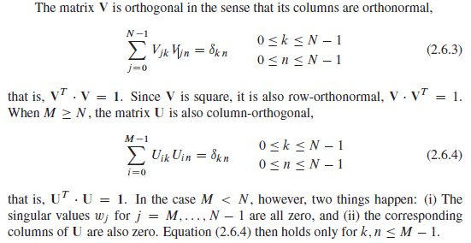
Orthonormal matrix

Slide 9
SVD of a Square Matrix
If A is square matrix, then U,Σ and V are also square Matrix.

Slide 10
Condition number
the ratio of the largest(in magnitude) of the wj ’s to the smallest of the wj ’s.
(1) infinite: martrix is singular
(2)ill-conditoned : condition number is too
large, that is, if its reciprocal approaches the machine’s floating-point precision

Slide 11
Three cases
1. b=0.
2. vector b on the right-hand side is not zero, and b lies in the range of A or not.
3. b is not in the range of the singular matrix A.

Slide 12
First case
b=0
It is solved immediately by SVD.
The solution is any linear combination of the columns returned by the nullspace method above.

Slide 13
Second case
Vector b on the right-hand side is not zero, and b lies in the range of A or not.
Specially, when $w_{j}=0, let 1/w_{j}$=0.
This will be the solution vector of smallest length; the columns of V that are in the nullspace complete the specification of the solution set.

Slide 14
Proof

Slide 15
Third case
b is not in the range of the singular matrix A.
The number r is called the residual of the solution.

Slide 16
Proof

Slide 17
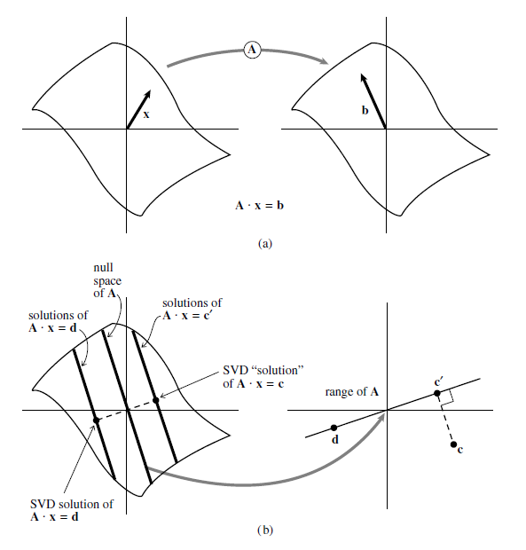
An example

Slide 18
SVD for Fewer Equations than Unknowns
If we have fewer linear equations M than unknowns N, then we are not expecting a unique solution. Usually there will be an N*M dimensional family of solutions (which is the nullity, absent any other degeneracies), but the number could be larger. If we want to find this whole solution space, then SVD can readily do the job: Use solve to get one (the shortest) solution, then use nullspace to get a set of basis vectors for the nullspace. Our solutions are the former plus any linear combination of the latter.

Slide 19
Constructing an Orthonormal Basis
Construct an orthonormal basis for subspace by SVD:
Form an M*N matrix A whose N columns are our vectors. Construct an SVD object from the matrix. The columns of the matrix U are our desired orthonormal basis vectors.

Slide 20
Approximation of Matrices
The equation A=UWV can be rewritten to express any matrix $A_{ij}$as a sum of outer products of columns of U and rows of $V^{T}$, with the “weighting factors” being the singular values $w_{j}$

Slide 21
Advantage
If we ever encounter a situation where most of the singular values $w_{j}$ of a matrix A are very small, then A will be well-approximated by only a few terms in the sum. This means that we have to store only a few columns of U and V (the same k ones) and we will be able to recover, with good accuracy, the whole matrix.

Slide 22
Advantage
It is very efficient to multiply such an approximated matrix by a vector x: We just dot x with each of the stored columns of V, multiply the resulting scalar by the corresponding $w_{k}$, and accumulate that multiple of the corresponding column of U. If our matrix is approximated by a small number K of singular values, then this computation of A·x takes only about K(M+N) multiplications, instead of MN for the full matrix.

Slide 23
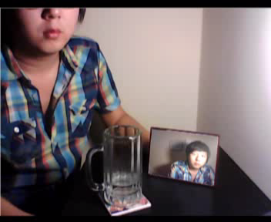
A application of image transformation

Slide 24
Thank you
Reference
Numerical Recipes
Wikipedia about Singular Value Decomposition
Fundamentals of Computer Graphics

