Slide 1
LU Decomposition

Slide 2
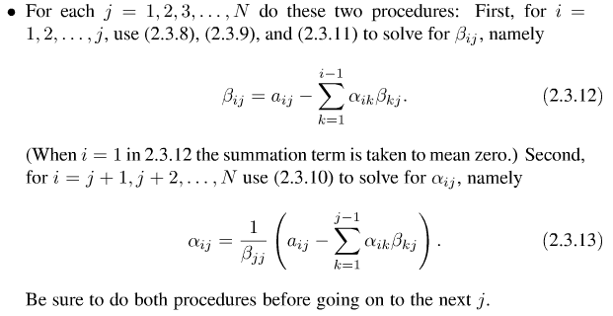
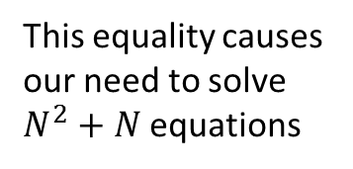
Decomposition
This equality causes our need to solve $N^{2}+N$equations
$$α_{i0}β_{0j}+…=a_{ij}$$

Slide 3
First For Loop of the Constructor
For instance try working through this code with the matrix $\left(\begin{matrix}4 & 3 \\ 6 & 3\end{matrix}\right)$
This is all a search for the scaling information of each row
for(i=0;i<n;i++){
big=0.0;
for(j=0;j<n;j++){
if((temp=abs(lu[i][j]))>big){
big=temp;
}
}
vv[i]=1.0/big;
}
This information will become necessary to conduct normalization of each row before deciding on pivoting.

Slide 4
This is the first part of the search for the largest pivot element
big=0.0;
for (i=k;i<n;i++) {
temp=vv[i]*abs(lu[i][k]);
if (temp > big) {
big=temp;
imax=i;
}
}
Here is where the code decides which row to pivot off of
Remember pivoting (or at minimum partial pivoting) is required for the stability of Crout’s Method.
No changes actually made to our matrix so far.

Slide 5
Deciding whether to change rows or not
if(k!=imax){
for(j=0;j<n;j++){
temp=lu[imax][j];
lu[imax][j]=lu[k][j];
lu[k][j]=temp;
}
d=-d;
vv[imax]=vv[k];
}

Slide 6
Altering our Matrix
indx[k]=imax;
if(lu[k][k]==0.0){
lu[k][k]=TINY;
}
for(i=k+1;i<n;i++){
temp=lu[i][k];
lu[i][k]/=lu[k][k];
for(j=k+1;j<n;j++){
lu[i][j]-=(temp*lu[k][j]);
}
}
Only partial pivoting (interchange of rows) can be implemented efficiently. However this is enough to make the method stable. This means, incidentally, that we don’t actually decompose the matrix A into LU form, but rather we decompose a row wise permutation of A.

Slide 7
LU Decomposition Solution Process
$$A=L ∙U$$
(2.3.1)
$$A∙x=\left(L∙U\right)∙x=L∙\left(U∙x\right)=b$$
$$L ∙y=b$$
$$U ∙x=y$$

Slide 8
if(b.size()!=n||x.size()!=n){
cout<<"Error"<<endl;
}
for(i=0;i<n;i++){
x[i]=b[i];
}
for(i=0;i<n;i++){
ip=indx[i];
sum=x[ip];
x[ip]=x[i];
if(ii!=0){
for(j=ii-1;j<i;j++){
sum-=lu[i][j]*x[j];
}
}
else if(sum!=0.0){
ii=i+1;
}
x[i]=sum;
}
for(i=n-1;i>=0;i--){
sum=x[i];
for(j=i+1;j<n;j++){
sum-=lu[i][j]*x[j];
}
x[i]=sum/lu[i][j];
}
The loop marked by red arrows is the forward substitution (2.3.6)
The loop marked by blue arrows represents the back substitution (2.3.7)

