Slide 1
3.6 Interpolation on a Grid in Multidimensions
Yunfei duan Hui Pan

Slide 2
Bilinear interpolation
The concept of linear interpolation between two points can be extended to bilinear interpolation within the grid cell.
http://en.wikipedia.org/wiki/Bilinear_interpolation
(congruence)

Slide 3
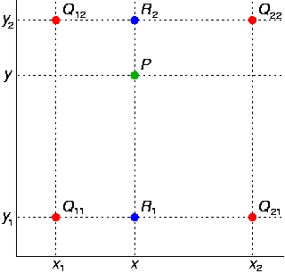
Example bilinear interpolation in grid square
Q₁₁ = (x₁, y₁), Q₁₂ = (x₁, y₂), Q₂₁ = (x₂, y₁), and Q₂₂ = (x₂, y₂).

Slide 4
3.6.1 higher order interpolation
What is higher order interpolation?
A second order polynomial interpolation form
f(x) = a₀ + a₁ x + a₂ x²
the interpolation function in Lagrange form
An N order polynomial interpolation form

Slide 5
High order interpolation is a bad idea?
The classic example show the concept is from a German mathematician Carl Runge
As we thought the more points we can get the more accuracy but the truth is it doesn’t work high order interpolation is generally a bad idea

Slide 6
Example 3.6.1
We choose a simple and smooth function
f(x) = 1/(1+25x^2) -----[-1,1](domain)
six equidistant points table 1
fa
5th order polynomial
X | Y
-1 | 0.038462
-0.6 | 0.1
-0.2 | 0.5
0.2 | 0.5
0.6 | 0.1
1 | 0.038462

Slide 7
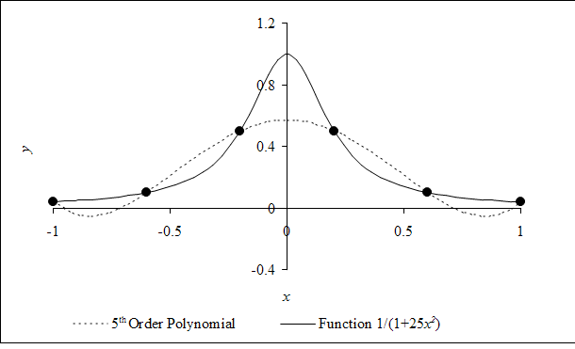
Example 3.6.1
X=0.85 y=0.052459 the solid line
5th order y=- 0.055762. the dotted line

Slide 8
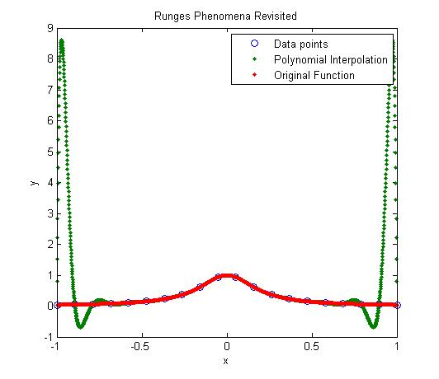
Example 3.6.1
19th order polynomial interpolation

Slide 9
3.6.2 Higher order for smoothness: Bicubic Spline
for each desired interpolated value you proceed as follows:
(1) Perform M spline interpolations to get a vector of values y(X1i,X2) which i=0 to M-1.
(2) Construct a one-dimensional spline through those values.
(3) Finally, splineinterpolate to the desired value y(X1,X2).

Slide 10
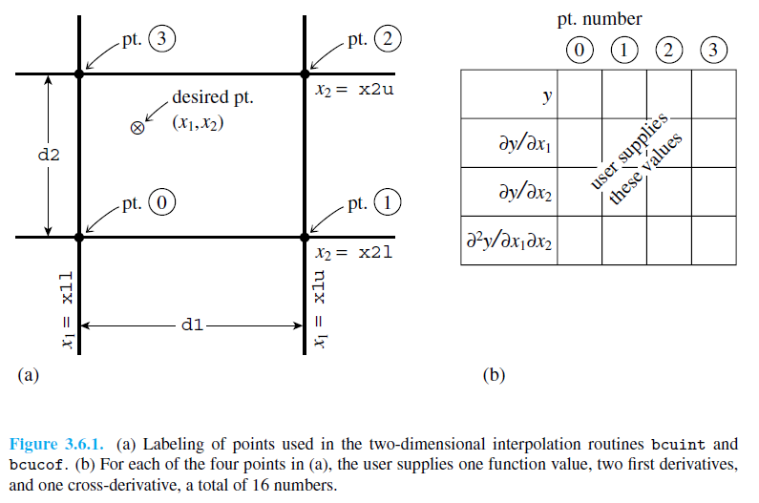
3.6.2 Higher order for smoothness: Bicubic Spline

Slide 11
Cubic interpolation
What is cubic interpolation?
The known values of f(x) its derivative are known at x=0 and 1the interpolation range [0,1] using a third degree polynomial
The value of polynomial and its derivative at x=0 ,1suppose value p0p1p2p3 at x=-1,0,1, 2

Slide 12
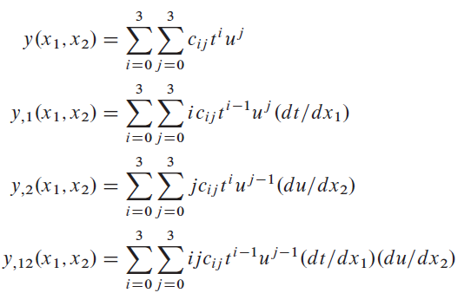
3.6.3 Higher order for smoothness: Bicubic interpolation
Bicubic interpolation can be accomplished using eitherLagrange polynomials, cubic splines, or cubic convolution algorithm. Bicubic interpolation is cubic interpolation in two dimensions.

Slide 13
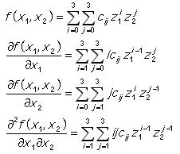
3.6.3 Higher order for smoothness: Bicubic interpolation
Array data points y=f(X1,X2)
Coefficient Cij from the nearest four points
Z1 Z2 values of X1 X2 for a unit square
Partial derivatives from y X1 X2 which is mention before in bilinear interpolation

Slide 14
difference
In many cases, the bilinear interpolations are too inaccurate and the Derivative discontinuity also the problem prevent to use. In such cases, the problem could be solved by using the bicubic spline which guarantees the continuity of the first derivatives dS/dX and dS/dY, as well as the continuity of a cross-derivative d ²S/dXdY.
It is similar to one dimensional spline. but there are some differences. The cubic spline guarantees the continuity of the first and second function derivatives. Bicubic spline guarantees continuity of only gradient and cross-derivative. Second derivatives could be discontinuous.

