Slide 1
Optimization : The min and max of a function
Michael Sedivy
Daniel Eiland

Slide 2
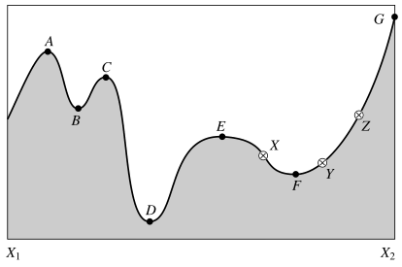
Introduction
Given a function F(x), how do we determine the location of a local extreme (min or max value)?
Two standard methods exist :
F(x) with global minimum D and local minima B and F
Searching methods – Which find local extremes using several sets of values (Points) for each function variable then select the most extreme.
Iterative methods – Which select a single starting value (Point) and take “steps” away from it until the same Point is returned

Slide 3
Algorithm Selection
Calculation of an extreme is not a perfect thing and is highly dependant upon the input function and available constraints.
For basic one-dimensional functions [F(x)] choices include :
Brent’s method – For calculation with or without the derivative
Golden Section Search – For functions with multiple values for a given point

Slide 4
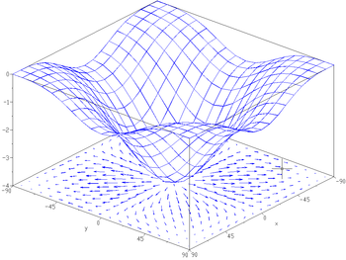
Multi-Dimensional Selection
For multi-dimensional, there are two sets of methods which can be grouped by the use (or lack there-of) of the gradient.
The gradient is the set of first partial derivatives for a function f and is represented as :
For a given point in f, the gradient represents the direction of greatest increase.
Gradient of f(x,y) = -(cos²x +cos²y)² shown below the plane as a vector field
Notes:
Gradient Image courtesy of Wikipedia - http://en.wikipedia.org/wiki/File:Gradient99.png

Slide 5
Multi-Dimensional Methods
Gradient Independent Methods :
Downhill Simplex Method – “Slow but sure”. A general purpose algorithm that requires O(N²) of storage
Direction Set Method (Powell’s Method) – Much faster than the Downhill method but requires a smooth function
Gradient Dependent Methods :
Conjugate Gradient Method – The gradient of the function must be known but only requires O(~3N) storage
Quasi-Newton (or variable metric) methods – Requires O(N²) storage but calculates the gradient automatically

Slide 6
Line Minimization
The first step for many one-dimensional and multi-dimensional methods is to determine the general location of the minimum.
This based on ability to bracket a minimum between a triplet of points [a,b,c] such that f(a) > f(b) and f(c) > f(b).

Slide 7
Bracketing
Calculation of this bracket is straightforward assuming points a and b are supplied.
Simply scale the value of b such that is moves further away from a until a point c is found such that f(c) > f(b).

Slide 8
Line Minimization (Con’t)
Once c is calculated, the final search for a minimum can be begin.
The simplest method (Golden Section Search) is to evaluate a point d, halfway between b & c.
If f(d) > f(b), then set c to d otherwise set b to d and a to b. This then process then repeats alternating between the a-b line segment and b-c line segment until the points converge (f(a) == f(b) == f(c)).

Slide 9
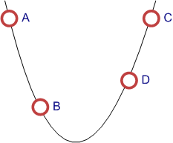
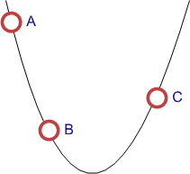
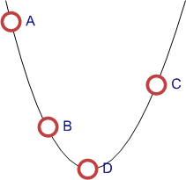
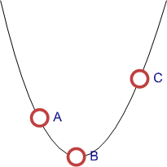
Line Minimization (Golden Section)
f(d) > f(b)
d > b
f(d) < f(b)
b > d

Slide 10
Brent’s Method
While the Golden Section Search is suitable for any function, it can be slow converge.
When a given function is smooth, it is possible to use a parabola fitted through the points [a,b,c] to find the minimum in far fewer steps.
Known as Brent’s method, it sets point d to the minimum of the parabola derived from :

Slide 11
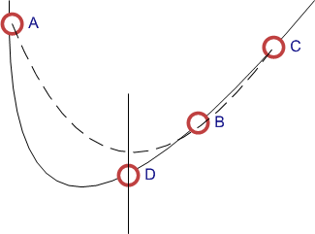
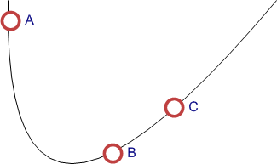
Brent’s Con’t
It then resets the initial points [a,b,c] based on the value of f(d) similar to Golden Section Search.
f(d) < f(b)
b > d
Of course, there is still the matter of the initial points a and b before any method can be applied…

Slide 12
Downhill Simplex Method
Multi-dimensional algorithm that does not use one-dimensional algorithm
Not efficient in terms of function evaluations needed.
Simplex – geometric shape consisting of N+1 vertices, where N= # of dimensions
2 Dimensions – triangle
3 Dimensions - tetrahedron

Slide 13
Downhill Simplex Method, cont’d.
Start with N+1 points
With initial point P₀, calculate other N points using P_{i} = P₀ + deltae_{i}
E_{i} – N unit vectors, delta – constant (estimate of problem’s length scale)
Move point where f is largest through opposite face of simplex
Can either be a reflection, expansion, or contraction
Contraction can be done on one dimension or all dimensions
Termination is determined when distance moved after a cycle of steps is smaller than a tolerance
Good idea to restart using P₀ as on of the minimum points found.
http://optlab-server.sce.carleton.ca/POAnimations2007/NonLinear7.html

Slide 14
Direction Set/Powell’s Method
Basic Method - Alternates Directions while finding minimums
Inefficient for functions where 2nd derivative is larger in magnitude than other 2nd derivatives.
Need to find alternative for choosing direction

Slide 15
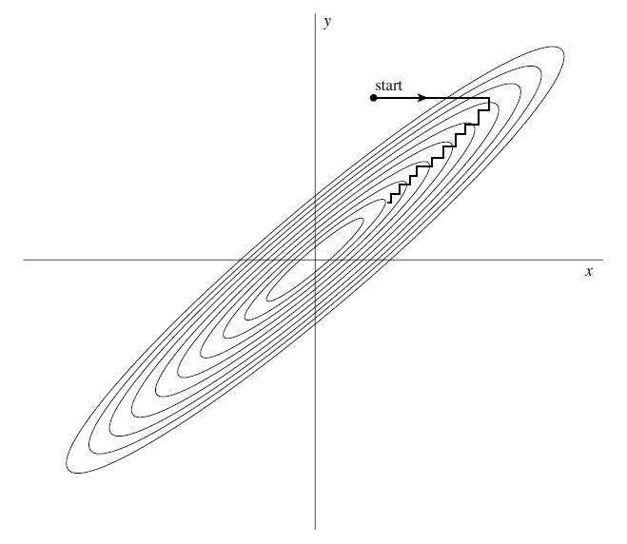
Conjugate Directions
Non-interfering directions (gradient perpendicular to some direction u at the line minimum)
N-line minimizations
Any function can be approximated by the Taylor Series:
Where:

Slide 16
Quadratically Convergent Method
Powell’s procedure – can exactly minimize quadratic form
Can have directions become linearly dependent (finds minimum over subset of f)
Three ways to fix problem:
Re-initialize direction set to basis vectors after N or N+1 iterations of basic procedure
Reset set of directions to columns of any orthogonal matrix
Drop quadratic convergence in favor of finding a few good directions along narrow valleys

Slide 17
Dropping Quadratic Convergence
Still take P_{n}-P₀ as a new direction
Drop old direction of the function’s largest decrease
Best chance to avoid buildup of linear dependence.
Exceptions:
If f_{E} >= 0, avg. direction P_{N}-P₀ is done
If 2(f₀ – 2f_{N} + f_{E})[(f₀ – f_{N}) - Δf]² >= (f₀ – f_{E})² Δf
Decrease along avg. direction not due to single direction’s decrease
Substantial 2nd derivative along avg. direction and near bottom of its minimum

Slide 18
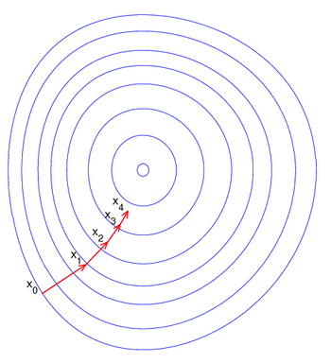
Conjugate Gradient Method
Like other iterative methods, the Conjugate Gradient method starts at a given point and “steps” away until it reaches a local minima [maxima can be found by substituting f(x) with –f(x)].
Iterative step-wise calculation of a minima

Slide 19
Calculating the Conjugate Gradient
As the name implies, the “step” is based on the direction of the Conjugate Gradient which is defined as :
Where h₀ = g₀ and g_{i} is the steepest gradient a given point :
And y_{i} is a scalar based on the gradient :

Slide 20
Basic Algorithm
Given the function f, its gradient and an initial starting point P₀.
Determine the initial gradient and conjugate values :
Iteratively repeat :
Calculate P_{i} using a line minimization method with the initial points as a=P_{i-1} and b=h_{i}
If P_{i} equals P_{i-1}; stop
Calculate the new gradient :
Calculate the new conjugate :
While this can terminate in O(N) [N = # terms in f] iterations, it is not guaranteed but can still result in fewer computations than the number needed for the Direction Set Method

