Slide 1
Linear Programming Simplex Method
Greg Beckham

Slide 2
Introduction
Linear Optimization
Minimize the function
Subject to non-negativity conditions
M additional constraints

Slide 3
Definitions
A set of values x₁,…,x_{n} satisfies all constraints is a feasible vector
The function we are trying to minimize is called the objective function
The feasible vector that minimizes the objective function is called the optimal feasible vector

Slide 4
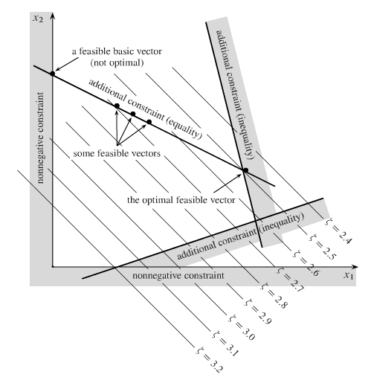
Constraints
An optimal feasible vector may not exist
No feasible vectors
No minimum, one or more variables can be taken to infinity while still satisfying constraints

Slide 5
Applications
Non-negativity
Standard constraint on some x_{i}
Represents tangible amount of a physical commodity (dollars, corn, etc)
Interest is usually in linear limitations (maximum affordable cost, minimum grade to graduate)

Slide 6
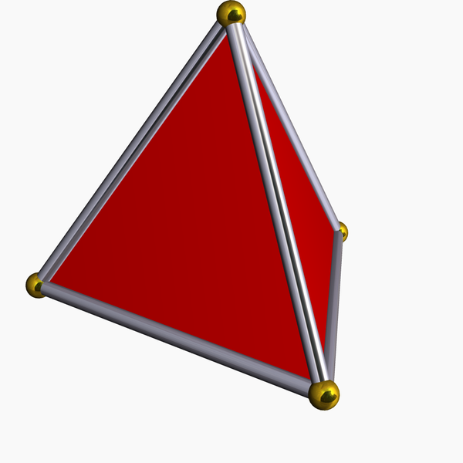
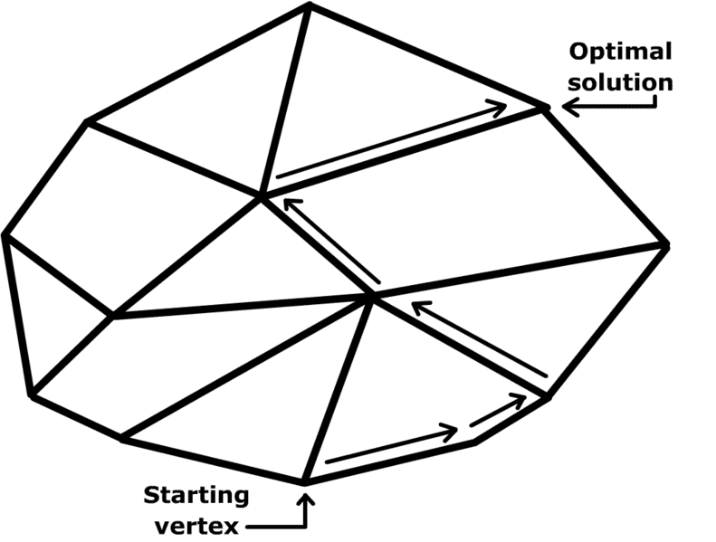
Simplex
Generalization of the tetrahedron
Algorithm moves along edges of polytope from starting vertex to the optimal solution

Slide 7
Fundamental Theorem of Linear Optimization
Boundary of any geometrical region has one less dimension than its interior
Continue to run down boundaries until we meet a vertex of the original simplex
Solution of n simultaneous equalities
Points that are feasible vectors and satisfy n of the original constraints as equalities are termed feasible vectors
If an optimal feasible vector exists, then there is a feasible basic vector that is optimal.

Slide 8
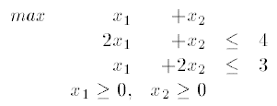
Example Problem
Solve
Convert to standard form by adding slack variables

Slide 9
Example Cont’d
Modify Objective function from z = x₁ + x₂ to z – x₁ – x₂ = 0
Putting it all together

Slide 10
Example
Use Gauss-Jordan to perform row pivots to find the solution
Non -basic variables are those that are present in multiple rows, basic are only in one row
Start with basic feasible solution by setting non-basic variables to zero and solving for basic variables
x1 = x2 = 0, x3 = 4, x4 = 3, z = 0

Slide 11
Example
Rule 1 – If all variables have a non-negative coefficient in Row 0, the current basic feasible solution is optimal. Otherwise, pick a variable x_{j} with a negative coefficient in Row 0
Converts a non-basic variable to a basic variable and a basic variable to a non-basic variable
The non-basic variable chosen is called the entering variable the basic variable that becomes non-basic is called the leaving variable
The variable chosen doesn’t matter as long as it conforms to rule 1.

Slide 12
Example
How to choose the pivot element?
Rule 2 – For each Row I, I >= 1, where there is a strictly positive “entering variable co-efficient”, compute the ratio of the Right Hand Side to the “entering variable coefficient”. Choose the pivot row as being the one with the Minimum ratio.

Slide 13
Example
Select x₁ as the entering variable then compute the ratios for Rows 1 and 2
Row 1 = 4/2 ← Chose Row 1
Row 2 = 3/1

Slide 14
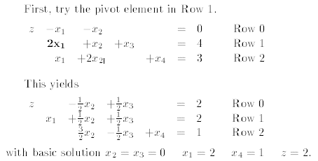
Example
Perform pivots

Slide 15
Example
Continue to Pivot since there is still a negative coefficient
Row 1, 2/(1/2) = 4
Row 2, 1/(3/2) = 2/3 ← Choose Row 2

Slide 16
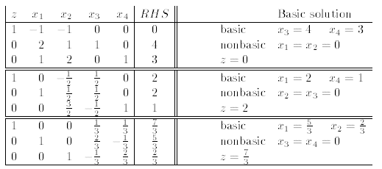
Example
No more negative coefficients in Row 0 so the solution is optimal

Slide 17
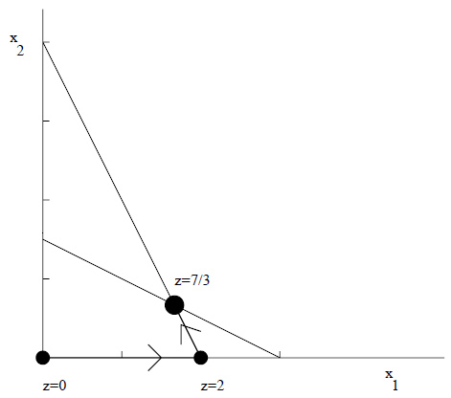
Example
Shows how the algorithm moves along the boundaries to find the solution

Slide 18
Questions

Slide 19
Example Problem
Minimize (10.10.5)
X’s non-negative and the following constraints
Re-write inequalities as equalities by adding slack variables

Slide 20
References
Wikipedia, Simplex Algorithm. http://en.wikipedia.org/wiki/Simplex_algorithm. Accessed March 1st 2010
Press, et al. Numerical Recipes The Art of Scientific Computing. Third Edition. Cambridge University Press. 2007
Chapter 7, The Simplex Method. Quantitative Methods Class Notes. http://mat.gsia.cmu.edu/classes/QUANT/NOTES/chap7.pdf

