Slide 1
Edge Detection Enhancement Using Gibbs Sampler
Author: Michael Sedivy

Slide 2
Introduction
Edge Detection in Image Processing
MCMC and the Use of Gibbs Sampler
Input
Results
Conclusion/Future Work
References

Slide 3
Edge Detection
Detecting Edges in images is a complex task, but it useful in other image processing problems
Feature detection/extraction
Segmentation
Picture enlargement
Many algorithms exist for edge detection
Used Canny Algorithm for its robustness (when set correctly, hard to find a better performing algorithm)
However, issues in image enhancement still exist when using Canny Edge Detector

Slide 4
Gibbs Sampler in Edge Detection
Gibbs Sampler is a Markov Chain Monte Carlo (MCMC) algorithm
Uses a random walk throughout the dataset and a probability distribution to determine whether to accept or reject each step
Only the current step is kept when searching for the next step, and the entire dataset can be reached
In order to attempt to increase Canny Edge Detection performance, Gibbs will be performed on the magnitude value for each pixel
A positive magnitude value is generated where the difference between pixel colors (gradient) is large enough.
Canny E.D. will rule out small magnitude values, but Gibbs will strengthen those edges depending on a probability distribution and a simple proposal distribution
More edges means better results for other image processing tools that use edge images.
Purpose: to improve image enlargement techniques

Slide 5
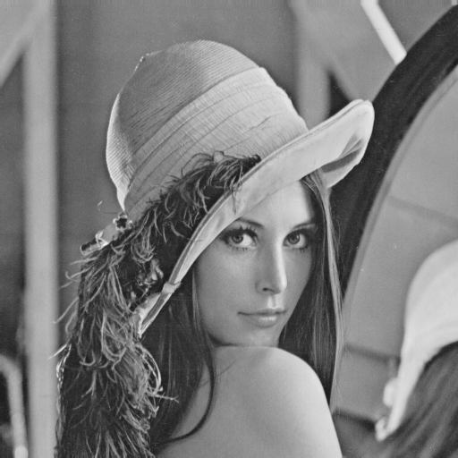
Inputs
Two Images: Lena and a Test Circle
Both Grayscale images, but color images could be used
In addition, each image was enlarged 4x the original size and tested
Lena Image, 512 x 512 pixels
Test Image, 200 x 200 pixels

Slide 6
Results
Circle Image – not much improvement
Lena Image – improvement in detailed areas (eyes, feathers in hat)
Run Time is long for large and complex images (each pixel is scanned for each iteration of Gibbs)

Slide 7
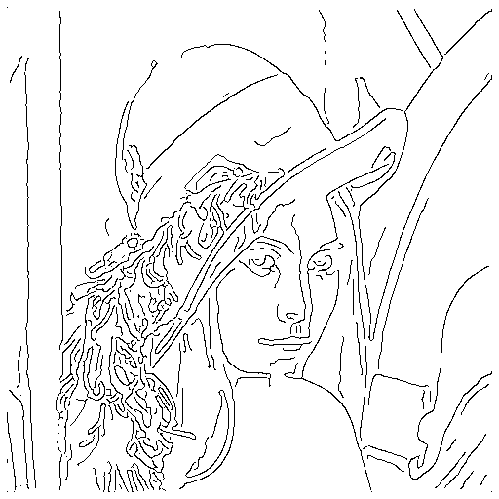
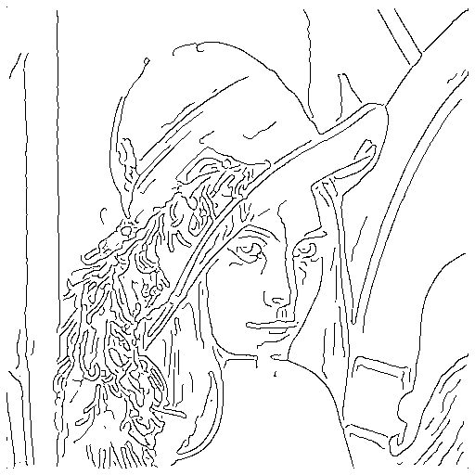
Original Image (512x512)
Canny Edge Detection
Edge Detection with Gibbs

Slide 8
Original Image (200x200)
Canny Edge Detection
Edge Detection with Gibbs

Slide 9
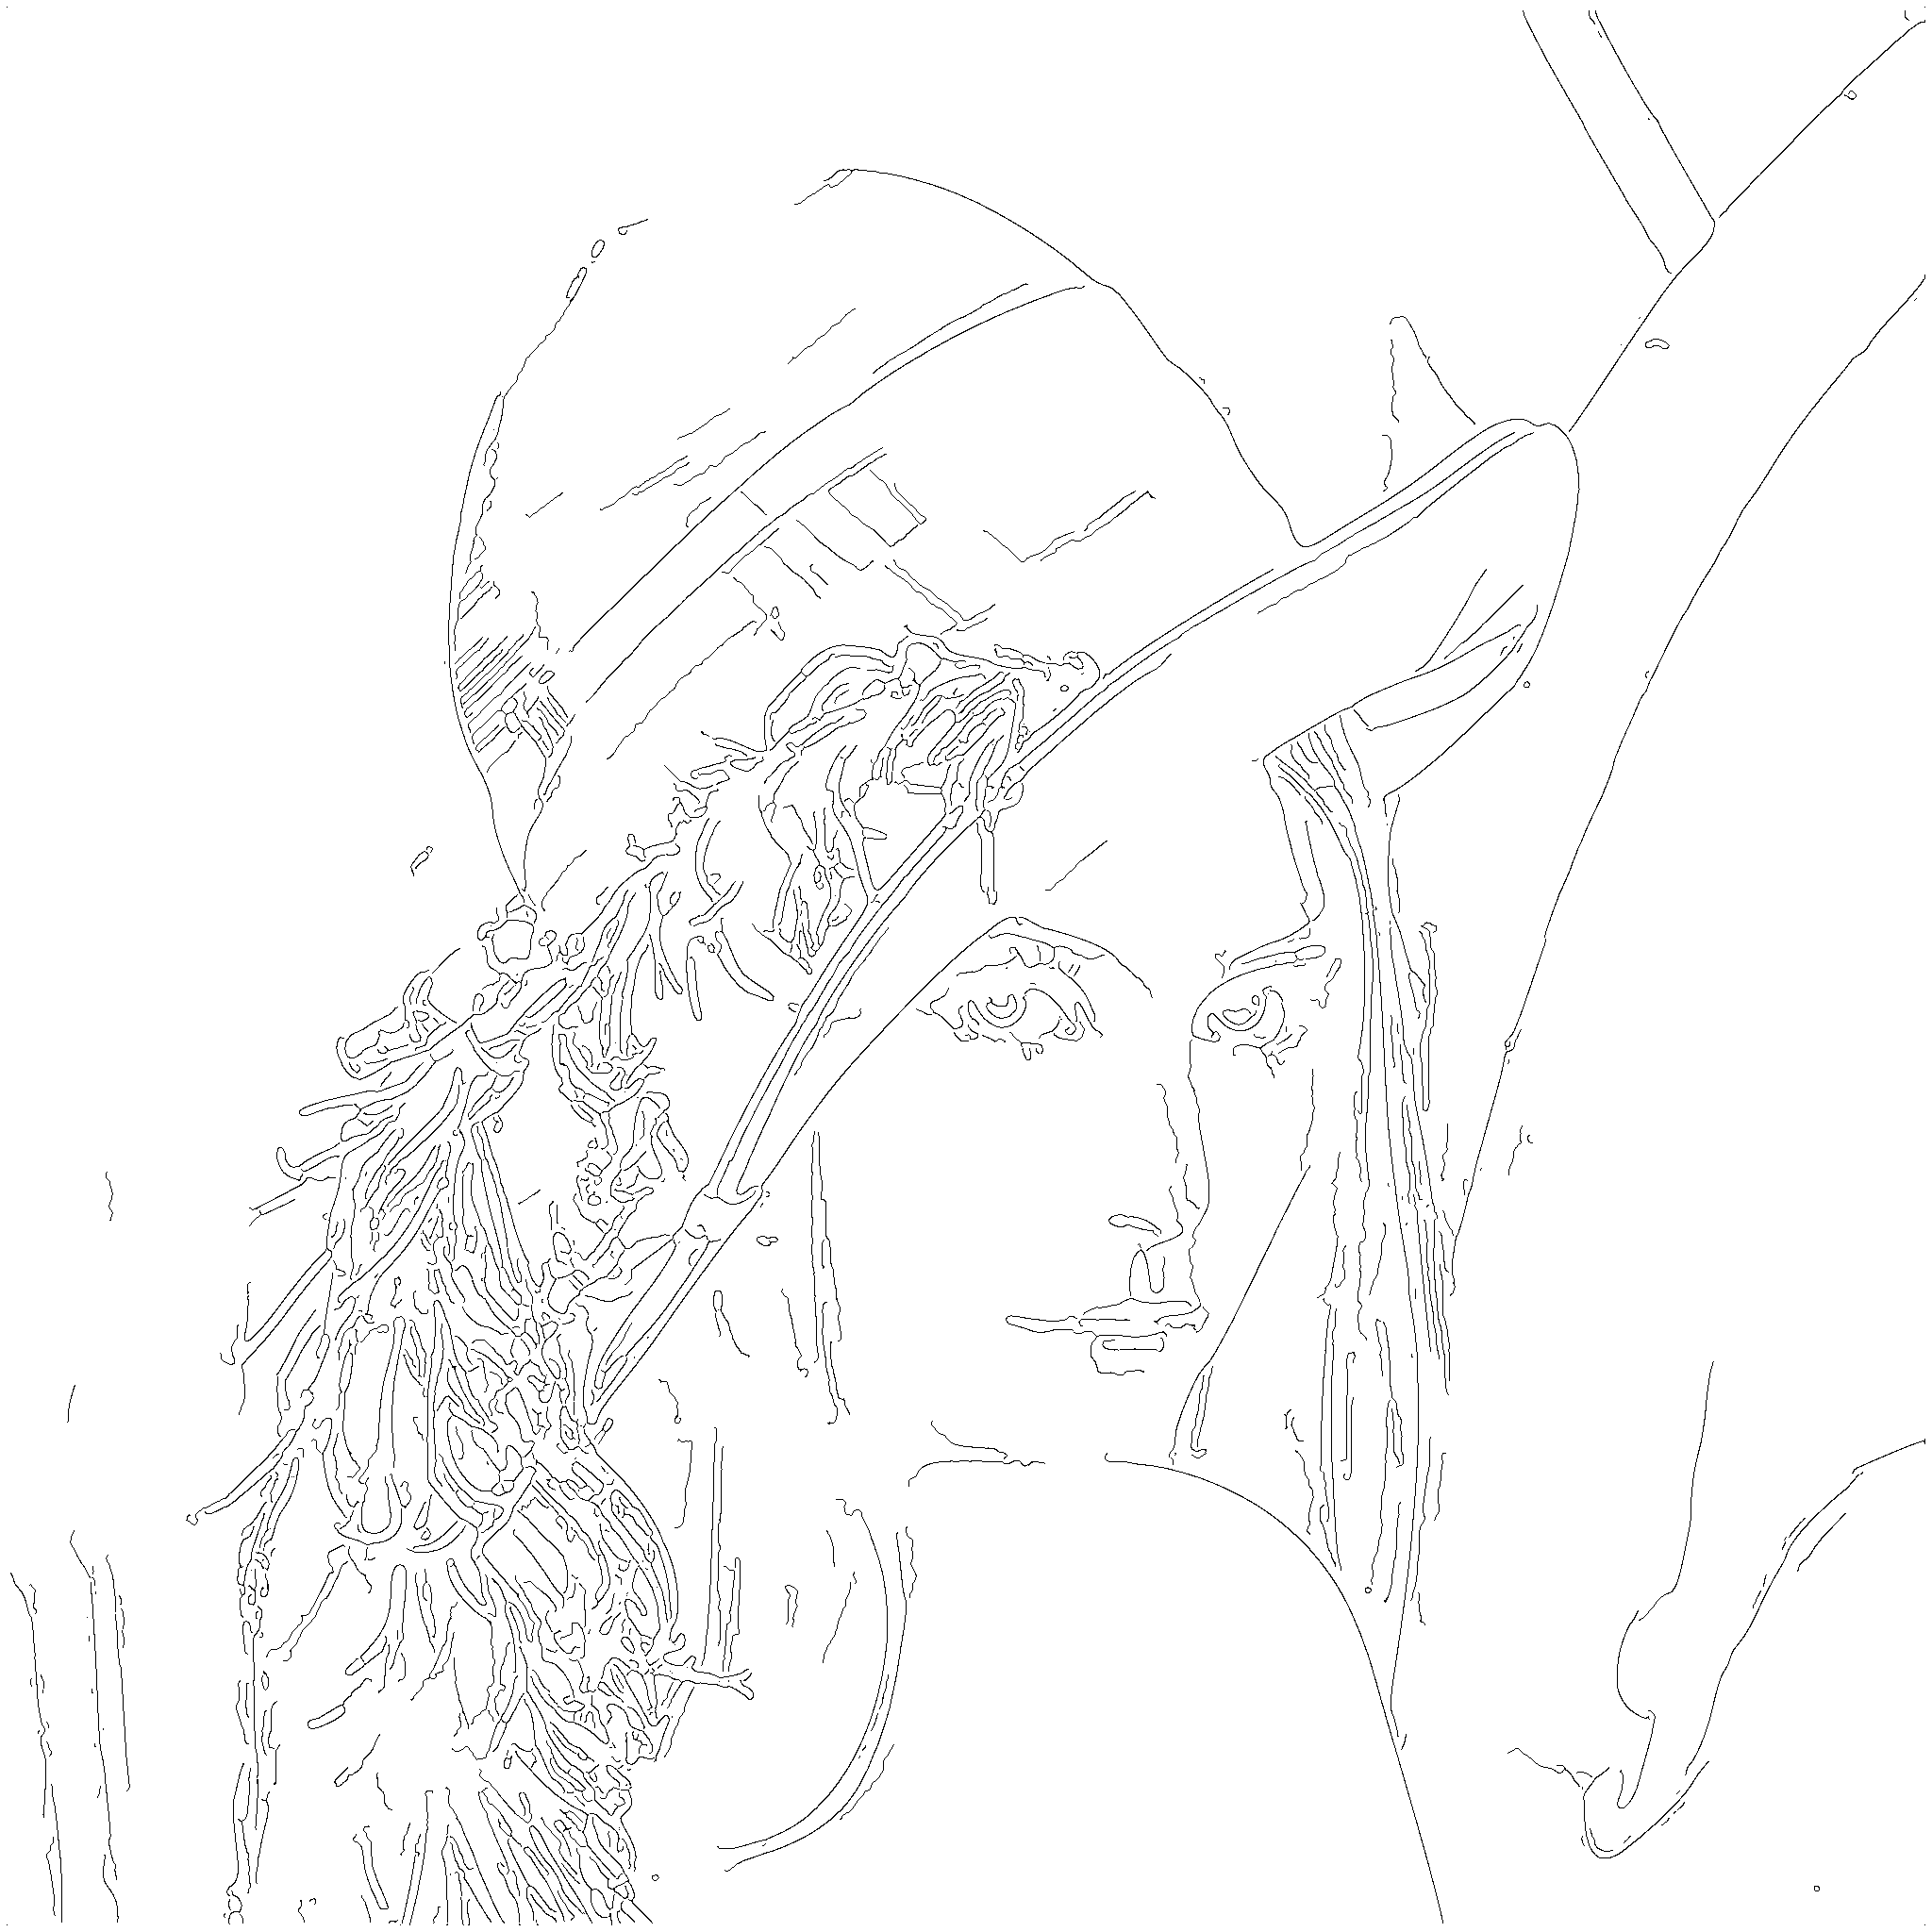
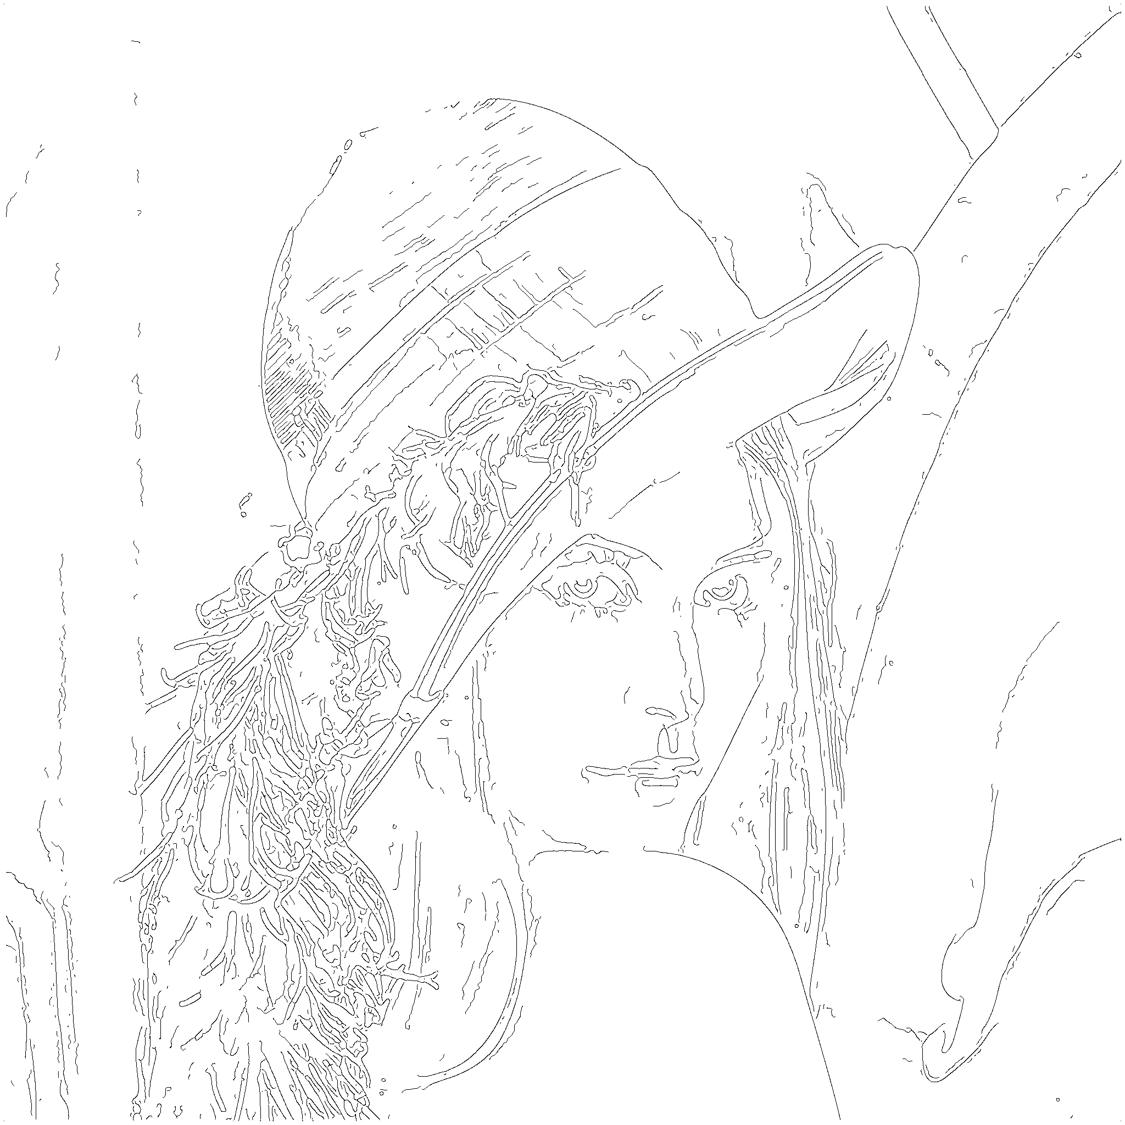
Original Image (2048x2048)
Canny Edge Detection
Edge Detection with Gibbs

Slide 10
Original Image (800x800)
Canny Edge Detection
Edge Detection with Gibbs

Slide 11
Image Enlargement, Canny Edge Detector Image Used
Image Enlargement, Gibbs Enhanced Edge Detector Image Used
Notice the sharpness in the detailed areas, such as the feathers and the eyes.

Slide 12
Image Enlargement, Canny Edge Detector Image Used
Image Enlargement, Gibbs Enhanced Edge Detector Image Used
No noticeable improvements over a basic image.

Slide 13
Conclusion/Future Work
Overall, Gibbs is useful for increasing results in image enlargement problems
More research needs to be done for other uses
Proposal and Probability Distributions were Gaussian-based.
Also included random generation of values for determining increase of a magnitude value.
Directed distributions could increase the efficiency in edge detection
Image can be broken up into segments
Allows for different algorithms to be applied in different areas to maximize the edges kept
MCMC is also used in segmentation problems, so could use similar code to determine algorithms for each segment

Slide 14
References
http://en.wikipedia.org/wiki/Edge_detection
http://en.wikipedia.org/wiki/Markov_chain_monte_carlo
http://www.tomgibara.com/computer-vision/canny-edge-detector
http://civs.ucla.edu/old/MCMC/MCMC_tutorial.htm
Numerical Recipes 3rd Edition

