Slide 1
Operation sequences in MLEM -- Debasis Mitra

Slide 2
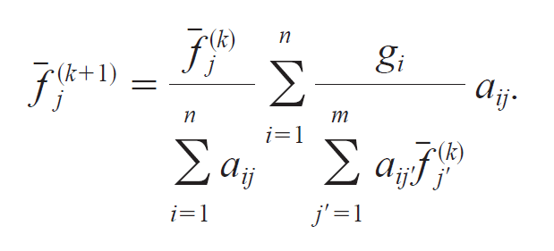
4
3
1-2
2
0
1-1
0: Pre-computation outside Forward or Back Projection: Unary Matrix row/col sum
1-1: Binary matrix mult of different dimensions (Forward Projection: sinogram->vol)
2: Binary element-wise matrix division
3: Binary matrix mult of different dimensions (Backprojection: vol->sinogram)
1-2. Binary element-wise matrix division
4. Binary element-wise matrix multiplication

Slide 3
3
2-1
2-4
4
1-2
0
2-3
1-1
0: Pre-computation outside Forward or Back Projection: Unary Matrix row/col sum
1-1: Binary matrix mult of different dimensions (Forward Projection: sinogram->vol)
2-1: Binary element-wise matrix division
3: Binary matrix mult of different dimensions (Backprojection: vol->sinogram)
1-2: Unary matrix gradient operation (Total variation)
2-3. Binary element-wise matrix addition
2-4: Binary element-wise matrix division
4. Binary element-wise matrix multiplication

Slide 4
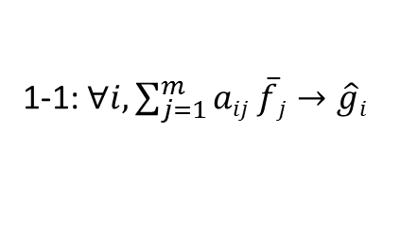
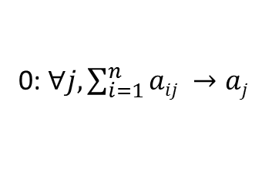
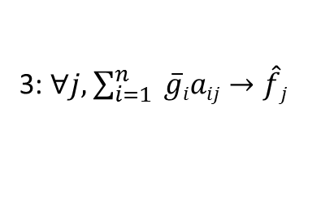
a_{ij}
g_{i}
a_{ij}
0: $∀j, \sum_{i=1}^{n}{aij →aj}$
1-1: $∀i, \sum_{j=1}^{m}{aij \overline{f}j→\hat{g}i}$
2-1: $∀i, \frac{gi}{\hat{g}i} →\overline{g}i$
3: $∀j,$ $\sum_{i=1}^{n}{ \overline{g}iaij→\hat{f}j}$
$$\overline{f}j$$
1-2: $∀j,TV(\overline{f}j1\overline{,f}j2$ $,…,\overline{f}jp) →tj$
2-3:$∀j,aj+tj→\overline{a}j$
1-2: $∀j, \frac{\overline{f}j}{\overline{a}j} →\overline{\overline{f}}$_{j}
4:$∀j,\hat{f}j\overline{\overline{f}}\text{j}→\overline{f}j$
Data flow architecture: Keep data as local as possible

Slide 5
Matrix operations to Parallelize:
Note: A_{ij} will be in LBL-compressed format
Binary, different dimensions, matrix multiplication
g_{i} = Σ_{k} A_{ik} f_{k} : j runs on 2Dxθ pixels, k runs on 3D voxels
f_{k} = Σ_{i} g_{i} A_{ik}
Binary, same dimensions, element-wise matrix addition
Binary, same dimensions, element-wise matrix multiplication
Binary, same dimensions, element-wise matrix division
Future/Hui: Binary, different dimensions (?), matrix convolution

Slide 6
System Matrix Generation Parallelization: Ray-tracing
System matrix (A_{ij}):
Note: we use LBL compressed form for only non-zero elements
For each i,
Record non-zero j values in a line
The corresponding values next line
Input: (1) LBL Parameter text file
(2) UCSF parameter text files
Types: (1) Pinhole SPECT
(2) Parallel-hole SPECT
(3) CT
Code sources: (1) LBL-parallelhole CPU, (2) LBL-pinhole CPU,
(3) UCSF-Fares pinhole CPU,
(4) UCSF-Fares pinhole GPU, uses CSR compression of NVIDIA GPU default
(5) Muon Tomography-Richie Ray tracing CPU
Note: most codes use modified Forward Projection calls to generate System Matrix

