Slide 1
Iterative Algorithm
g = Af
g : Vector of projection data
f : vector of image data
A : matrix
The principle of the iterative algorithms is to find a solution by successive estimates.

Slide 2
Iterative Algorithm
Algorithms of General Concept of Iterative Methods:
make the first arbitrary estimate of the slice.
int maximumOfLoop = MAX_NUM
Int current_loop = 0;
while (current_loop <= maximumOfLoop){
generate estimate projections;
compare the projections of estimate with measured projections;
calculate correction factors;
if(the correction factors == 0)
break;
else
apply corrections to the estimate and make
the new estimate of the slice
}

Slide 3
Iterative Algorithm
Example of ART Iterative Algorithm Formula:
f^{k+1} : new estimates
f^{k} : current estimates:
N: the num of pixels along ray i,
: the sum of counts in the N pixels along ray i for the k iteration.

Slide 4
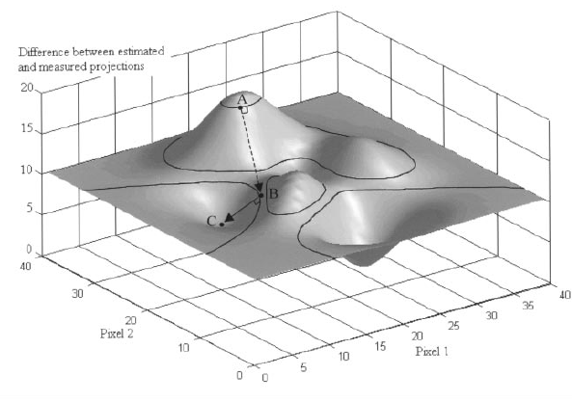
Gradient Algorithm
Features of Gradient:
Handle huge number of images
See the different which between measured projections and image projections as mountainous terrain.
Using 3D plot to display the different.
The Goal of Gradient Algorithm:
Find the location of the point which has minimal difference.

Slide 5
Gradient Algorithm
Steps of Gradient:
Start from an arbitrary location.
Find the direction with steepest descent.
Step in that direction with optimizing step length.
Stop before ascend.
If new direction and new step length can be found, step in new direction with new step length, else, the algorithm ends.

Slide 6
Gradient Algorithm

Slide 7
Gradient Algorithm
f^{k+1} : new estimates
f^{k} : current estimates
^{k} : step length
p^{k} : new direction

Slide 8
CG Algorithm
Disadvantages of Gradient Algorithm:
Not effcient
Local minimal.
Conjugate gradient algorithm:
Find the new direction based on current location combine with previous location.

Slide 9
MLEM Algorithm
g = Af
Features of MLEM:
Use Poisson probabilistic phenomena of the radioactive disintegrations.
g is a particular measurement.
3. f is the particular solution corresponding to that particular measurement g.
The Goal of MLEM Algorithm
Find a general solution as the best estimate for f: the mean number of radioactive disintegrations f in the image that can produce the sinogram g with the highest likelihood.

Slide 10
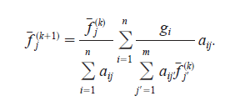
MLEM Algorithm
Steps of MLEM:
Find an arbitrary start point.
2. Calculate the likelihood of any reconstructed image given the measured data is formed.
3. The image that has the greatest likelihood to give the measured data is found

Slide 11
MLEM Algorithm
Problem of MLEM Algorithm:
With the increasing of iterations, the noisy will also be increase.
Why?
Because noisy reconstructed images may yield projections that are very close to the measured noisy projections.

Slide 12
New Criterion
Old Criterion:
1, estimated projections have to be as close as possible to measured projections.
New Criterion:
1, estimated projections have to be as close as possible to measured projections.
2, the reconstructed images have to be not too noisy.

Slide 13
Maximum A Posteriori (MAP) Algorithms
: Use to enforce smoothing

