Slide 1
Picture Archiving and Communication System (PACS) -Krystal Kerney and Hui Pan

Slide 2
What is PACS?
PACS is a medical imaging technology that provides storage of and convenient access to images from multiple medical imaging modalities.
Electronic images and reports are transmitted via PACS, thereby eliminating the need to manually file, retrieve, or transport film jackets.
PACS consists of four major components:
The imaging modalities
A secured network for transmission of information
Workstations for interpreting and reviewing images
Archives for the storage and retrieval of images and reports

Slide 3
History of PACS
The principles of PACS were first discussed at meetings of radiologists in 1982.
There is some discrepancy over who coined the term PACS.
Dr. Andre Deurinckx
Dr. Judith M. Prewitt
Dr. Harold Glass secured UK government funding in the early 1990s and managed the project over many years. This transformed Hammersmith Hospital in London as the first filmless hospital in the UK
The first large-scale PACS installation was in 1982 at the University of Kansas, but became more of a teaching experience of what not to do rather than guidelines for what to do in PACS installation.

Slide 4
Types of Images
Ultrasound
Magnetic Resonance
Positron Emission Tomography
Computed Tomography
Endoscopy
Mammograms
Digital Radiography
Computed Radiography
And others

Slide 5
Uses
PACS has 4 main uses:
Hard copy replacement
Managing medical images such as film archives.
Advantages are cost, space, and quick access compared to film archives.
Remote access
Off-site viewing allows people in different locations to access the same information simultaneously.
Electronic image integration platform
Allows for interfacing with other medical systems such as Hospital Information System, Electronic Medical Record, Practice Management Software, and Radiology Information System.
Radiology workflow management
PACS is used by radiology personnel to manage workflow of patient exams

Slide 6
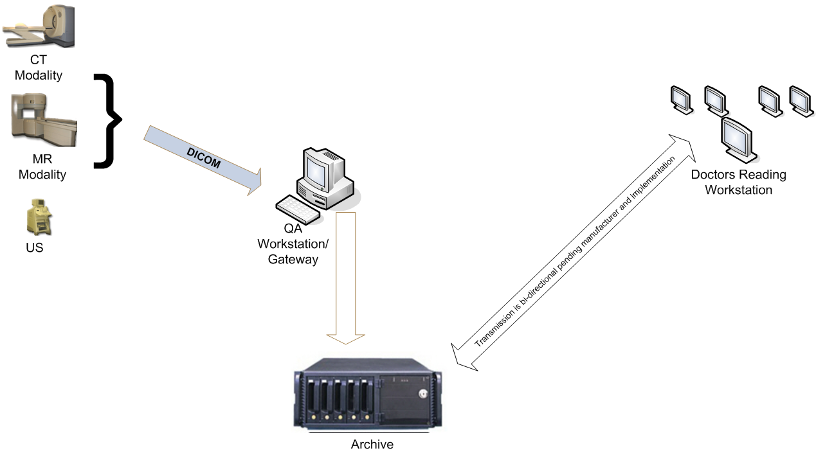
Architecture

Slide 7
Finding and Retrieving Images
The process for communication with PACS server
The client establishes the network connection to the PACS server.
The client prepares a query object which is an empty dicom dataset object
The client fills in the query object with the keys that should be matched.
The client creates empty attributes (attributes with zero length string values) for all the attributes it wishes to receive from the server.
The query object is sent to the server.
The server sends back to the client a list of response dicom objects.
The client extracts the attributes that are of interest from the response dicom objects.
Images are retrieved from a PACS server through a C-MOVE request, as defined by the DICOM network protocol.
If the radiologist or radiology technical query the off-site or long term archive for the prior exam, The archive will receive the C-FIND request.

Slide 8
Image Archival and Backup
Goal of image backup:
Easy to administer different facility
Two ways to store images:
Locally
Remotely on off-line media
Hard drives can be configured and attached to the PACS server in some ways:
Direct-Attached Storage (DAS)
Network-attached storage (NAS)
Storage Area Network (SAN)

Slide 9
Integration
All PACS should interface with existing hospital information systems:
Hospital information system (HIS)
Radiology Information System (RIS)
The input and output for PACS
Input: patient identification and orders for examination.
Output: Diagnosis Report and Images created accordingly.
The advantages of interface
Less risk of entering an incorrect patient ID for a study.
Data saved in the PACS can be tagged with unique patient identifiers obtained from HIS.
Improved use of online storage and nearline storage in the image archive.

Slide 10
Regulatory Concerns
In the US PACS are classified as Medical Devices, so if for sale are regulated by the USFDA.
Some specific applications, such as the use for primary mammography interpretation, are additionally regulated within the scope of the Mammography Quality Standards Act.
There is a worldwide professional and trade organization provides an annual meeting and a peer-reviewed journal to promote research and education about PACS and related digital topics.

