Slide 1
Dynamic Image Reconstruction in Nuclear Medicine
Ryan O’Flaherty
Kyle Fontaine
Krystal Kerney

Slide 2

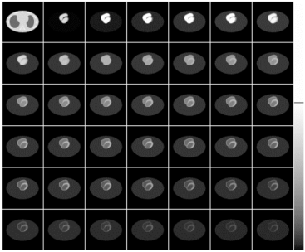
Acquisition techniques
Static
  Data acquisition starts after the radiotracer is distributed and settled in the targeted tissues.
  Static SPECT provides one static 3D image of the distribution of the radiotracer.
Dynamic
  Data acquisition starts immediately after the injection of radiotracer.
  Dynamic SPECT provides a series of 3D images. Each image represents the distribution of the radiotracer at a certain time.
  Dynamic images convey information about tracer movement through different body tissues.

Slide 3
Data Acquisition
Input
  3D volume (body injected by the radiotracer).
Process
  Recording the activity of tracer in the 3D volume.
Output
  A set of 2D projections taken from different angles (Sinogram).

Slide 4
Image Reconstruction
Input
  A set of 2D projections taken from different angles (Sinogram).
Process
  Reconstructing the 3D volume back from the recorded projections.
Output
  3D volume (radiotracer activity in the body tissues).
Time Activity Curves (TACs) can be extracted from the reconstructed time-dependent images for tissues in interest.
Example of Myocardium Time Activity Curves

Slide 5
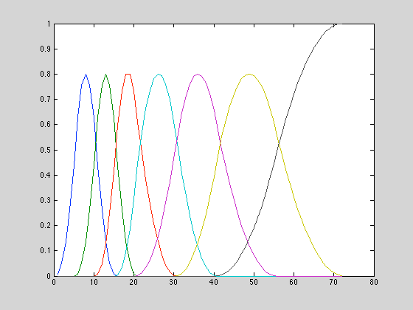
Bsplines
Instead of reconstructing a time independent-volume, we try to estimate the input functions of tissues in interest.
Time basis functions (B-splines) represent the temporal behavior of radioactive tracer in the imaged tissues.

Slide 6
Task
Our task
  Generate desired time activity curves based off the time basis functions (Bsplines) that we create.
Generate Bsplines → Create TAC’s → Cluster TAC’s
Example TAC to mimic:

Slide 7


Mathematical formulation
Similarly to static image reconstruction, a form of the equation below is used:
However, the case of dynamic imaging requires that the imagined volume V_k be split up into several imagined volumes, each representing the volume at a given time, m.
C is an algorithmically determined coefficient and f represents the time dependent operator, the B-spline

Slide 8

Mathematical formulation
Thus, the new equation for the sinogram which will be used to reconstruct V_k is below:
Where:
P is the sinogram vector
S is the system matrix
n is the number of pixels
m is the number of projections (and thus represents time)
K is the number of voxels

Slide 9

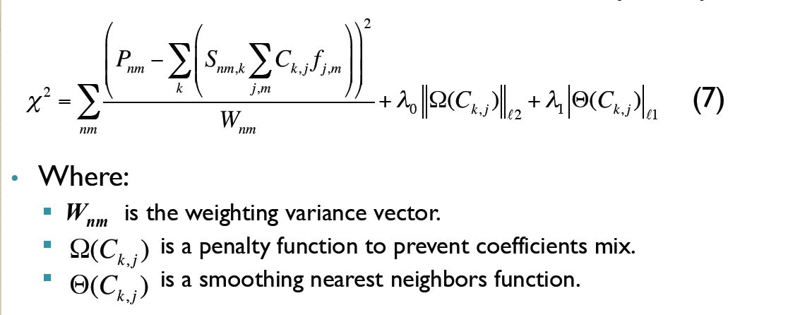
Coefficient Calculation
* From Mamoud’s Presentation
This objective function x^2 is to be minimized based on the parameters C and f. This allows for the verification of the coefficients

Slide 10
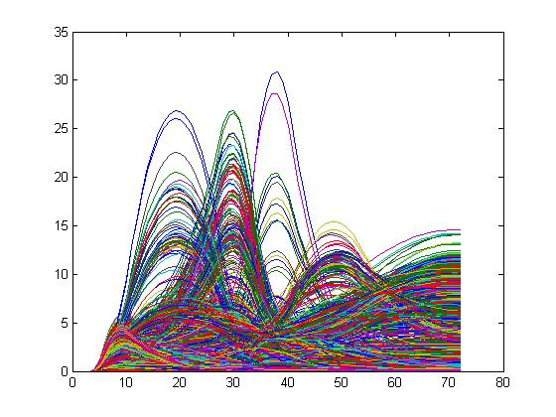
results
An example of our time activity curves before clustering
These were extracted from our reconstructed volumes (unable to view)
  If we could, it would be 72 volumes concatenated with each other
Relative Activity (Arbitrary Units)
Time (s)

Slide 11
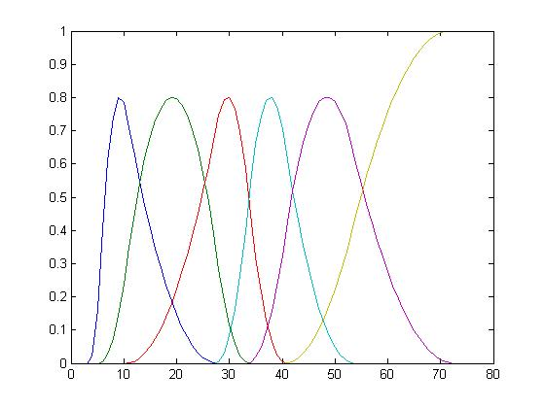
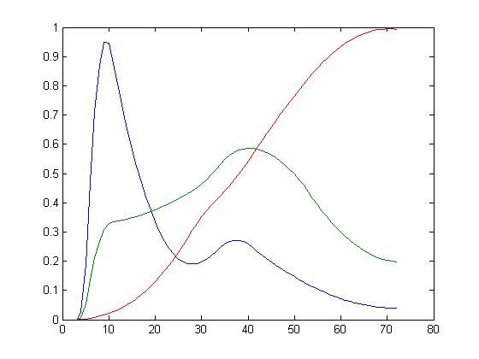
Results
Shown below - the Bsplines and their corresponding TAC’s
Relative Activity (Arbitrary Units)
Time (s)

Slide 12
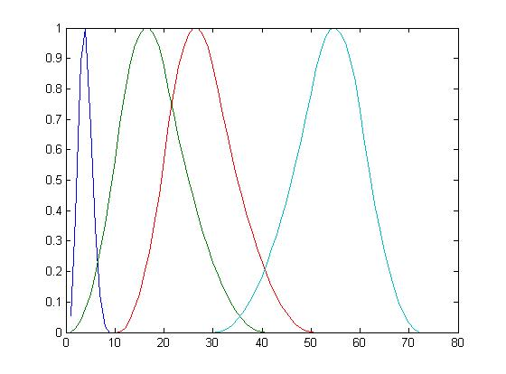
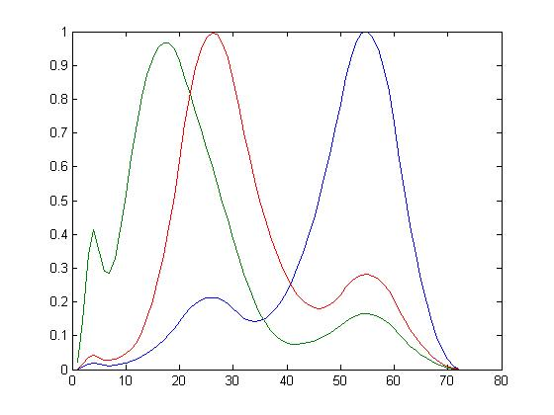
results
Relative Activity (Arbitrary Units)
Time (s)

Slide 13
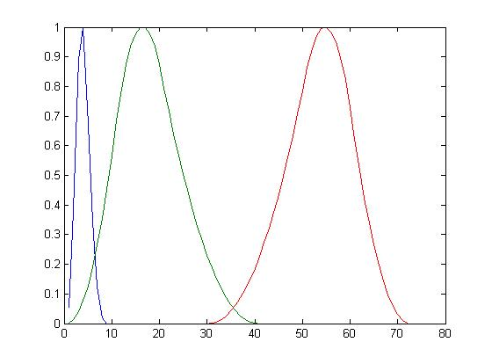
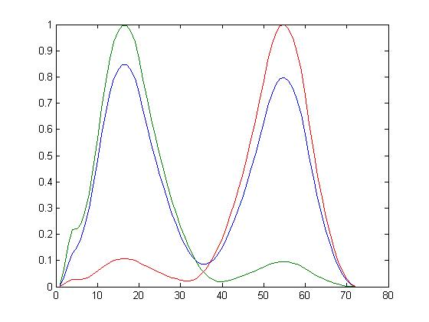
results
Relative Activity (Arbitrary Units)
Time (s)

Slide 14
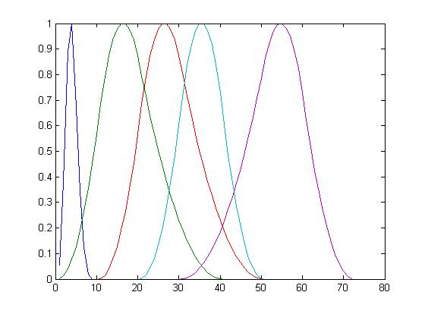
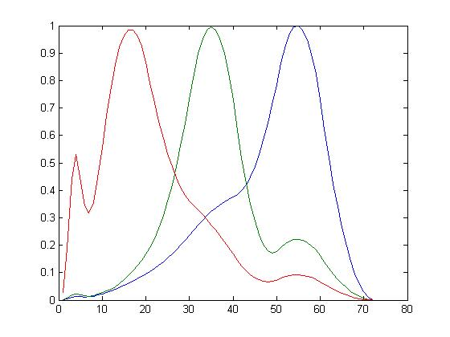
results
Relative Activity (Arbitrary Units)
Time (s)

Slide 15
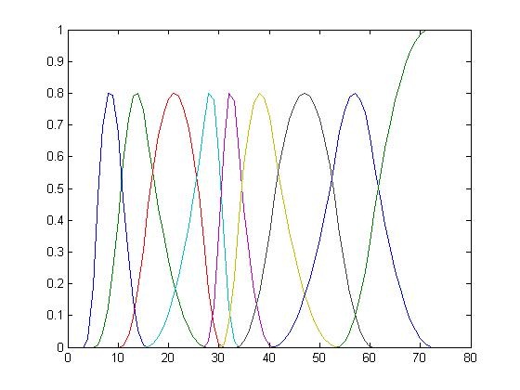
New Results
Relative Activity (Arbitrary Units)
Time (s)

Slide 16
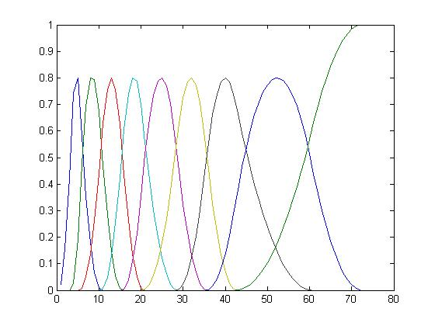
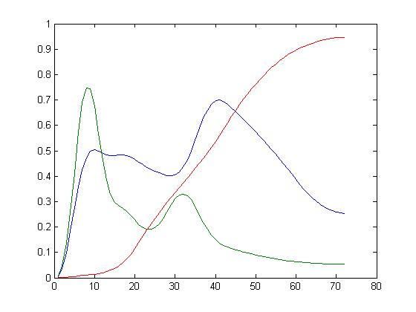
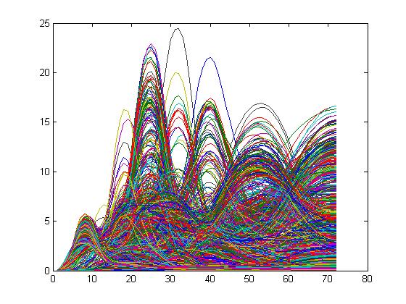
New results
Relative Activity (Arbitrary Units)
Time (s)

Slide 17
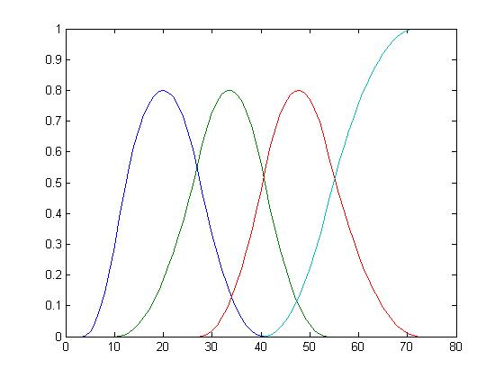
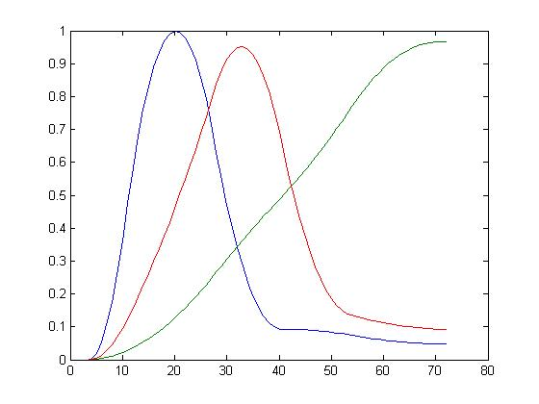
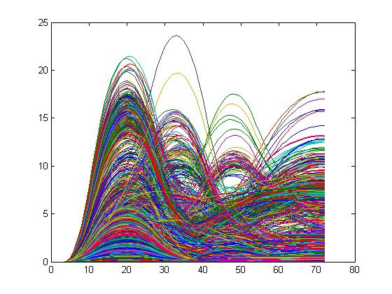
New results
Relative Activity (Arbitrary Units)
Time (s)

Slide 18
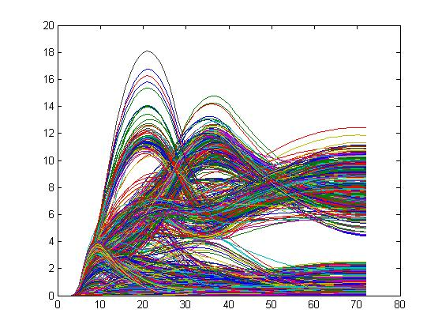
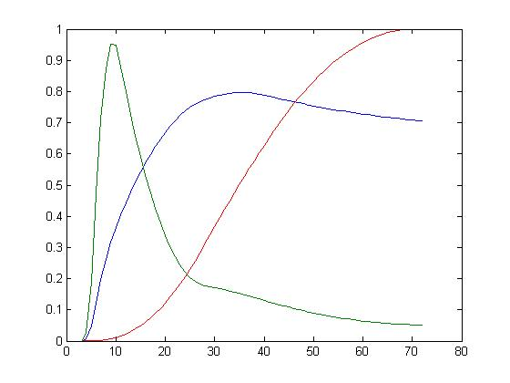
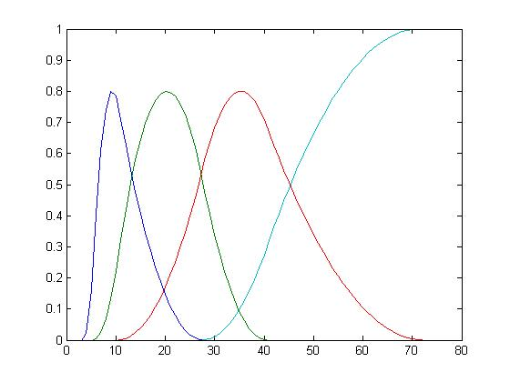
New results
Relative Activity (Arbitrary Units)
Time (s)

Slide 19
Best result
Our result
Goal
Relative Activity (Arbitrary Units)
Time (s)

Slide 20
Refining Results
Take output clustered TAC → Feed back into C code as our spline input
  Attempt to initialize the algorithm using different initial conditions
  Hope to find new, more accurate, local minimum
  Won’t necessarily ‘refine’ (can even have opposite effect)

Slide 21
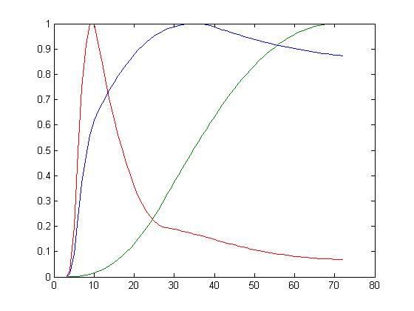
Refined Results
Previous Best Result
Refined
Relative Activity (Arbitrary Units)
Relative Activity (Arbitrary Units)
Time (s)
Time (s)
Goal

Slide 22
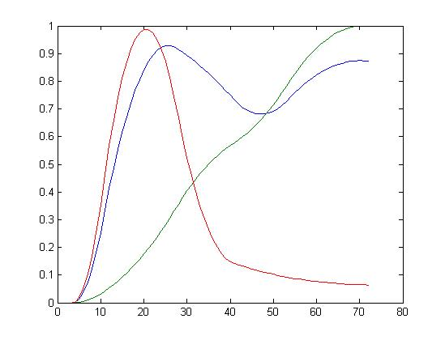
Refined results
Previous Result
Refined Result
Relative Activity (Arbitrary Units)
Relative Activity (Arbitrary Units)
Time (s)
Time (s)
Goal

Slide 23
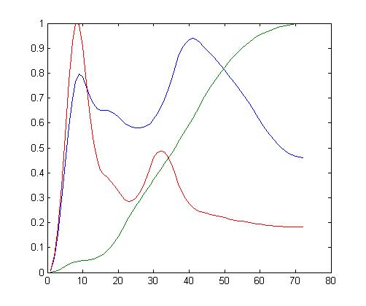
Refined Results
Previous Result
Refined Result
Relative Activity (Arbitrary Units)
Relative Activity (Arbitrary Units)
Time (s)
Time (s)
Goal

Slide 24
Summary
Our task was to understand the concepts behind dynamic imaging, and then reproduce given results.
The team was able to recreate the given data using event ques from a supplied sinogram. These events are translated into knots, which represent the beginning, end, and inflection points in a B-spline curve.
Each of these curves were used as operators to affect algorithmically determined constant coefficients. These constant/curve pairs are summed to represent Time Activity Curves, which denote the temporal dependence of specific radiotracers within known tissues of a patient.
Attempted to initialize the algorithm with different initial conditions (clustered TAC outputs) in hopes for more accurate minimization.

Slide 25
Summary
Our success was based on varying the B-splines we input, and noting the influence of the changes on the clustered TAC’s.
Notes
  Open ended B-spline necessary to avoid symmetrical TAC’s
    Such tendencies don’t make sense when considering the temporal activity of radiotracer in tissue
  Clustering B-splines in either direction (more B-splines in the beginning, or more B-splines later) caused irregular TAC’s
  Reducing the number of B-splines gave us TAC’s that more closely mimicked our desired output
  However, increasing the number of B-splines didn’t necessarily cause irregular TAC outputs.
Result of refining
  Small but noticeable refinements for all 3 attempts
  More experimentation required (very time consuming)

Slide 26
review of journal article (Part 1)
Article title: The role of nuclear imaging in the failing heart: myocardial blood flow, sympathetic innervation, and future applications
Journal: Heart Failure Reviews
Year: 2010

Slide 27
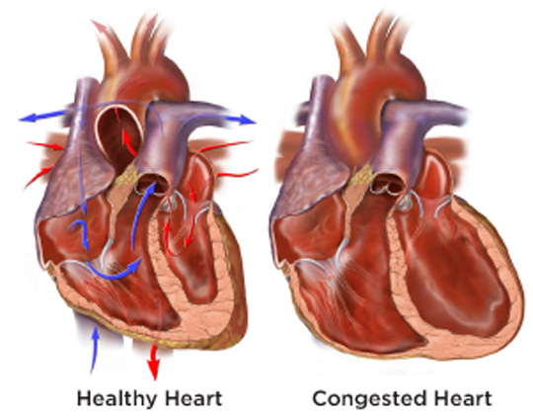
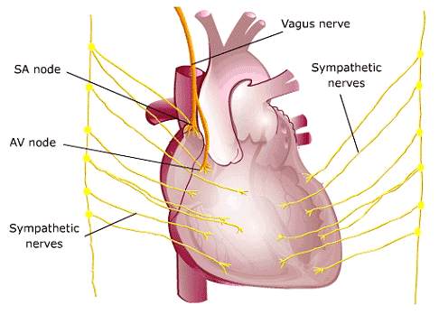
Nuclear imaging in the failing heart
Heart failure affects approximately 5 million patients in the United States!

Slide 28
SPECT/pet imaging in the failing heart
Nuclear imaging is the only modality with sufficient sensitivity to assess blood flow and innervation of the failing heart.
  Innervation is excitation of the heart by nerve cells.
SPECT is most commonly used for evaulation of myocardial perfusion (blood flow to the heart).
PET allows for quantification of myocardial blood flow.
Both can be used for evaluation of diagnosis, treatment options, and prognosis in heart failure patients.

Slide 29
Sympathetic innervation of the heart
Sympathetic innervation (excitation) represents another important parameter in patients with heart failure.
Sympathetic nerve imaging with 123-iodine. metaiodobenzylguanidine (123-I MIBG) is often used for assessment of cardiac innervation.
Abnormal innervation is associated with increased mortality and morbidity rates in patients with heart failure.
123-I MIBG can be used to categorize patients by risk for ventricular arrhythmias or sudden cardiac death.

Slide 30
Potential of nuclear imaging in heart failure
Detailed information on several biological processes in heart failure
  Myocardial blood flow
  Sympathetic innervation of the myocardium
Myocardial perfusion imaging represents the mainstay of cardiovascular radionuclide applications
Sympathetic innervation imaging is increasingly used in patients with heart failure

Slide 31
Myocardial blood flow in the failing heart
SPECT
  Well-established and safe imaging modality for the evaluation of location, extent and severity of myocardial perfusion defects.
  3 commercially available SPECT tracers: 201Thallium, 99mTc-tetrofosmin, and 99mTc-sestamibi.
    201Thallium
    99mTc-tetrofosmin
    99mTc-sestamibi
PET
  Several PET tracers currently available for assessment of myocardial perfusion
  2 approved for clinical use by the FDA
    N-13 Ammonia (13NH3)
    Rubidium-82 (82Rb)
    Both can be used for absolute quantification of myocardial blood flow

Slide 32
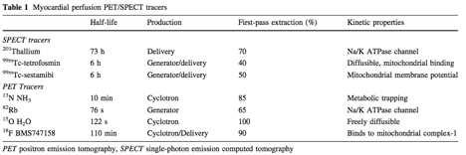
Table of SPECT/PET tracers

Slide 33
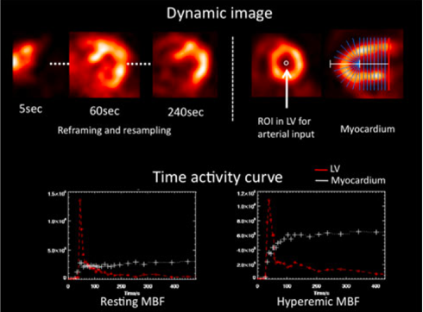
Dynamic imaging and tracer kinetics
Dynamic imaging with multiple time frames requires a high count density and advanced data processing
For tracer kinetic analysis, arterial input function and myocardial kinetics are measured from regions of interest in dynamic images
Absolute flow quantification is achieved by employing compartmental modeling analysis to the obtained time-activity curves.
Various tracer kinetic models have been established according to the nature of each PET tracer

Slide 34
review of journal article (Part 2)
Last time:
  Introduction
  Potential of nuclear imaging in heart failure
  Myocardial blood flow in the failing heart.
  Dynamic images and time-activity-curves
Today:
  Sympathetic innervation in the failing heart
    Using SPECT
    Using PET

Slide 35
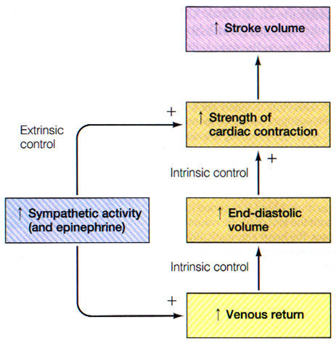
Sympathetic innervation in the failing heart
The sympathetic nervous system can do two things:
  ⬆ strength of contraction
  ⬆ amount of blood returned
Sympathetic input:
  speeds SA depolarization (HR
  decreases AV delay (HR)
  increases contractility in contractile cells (SV)
In sum: sympathetic input increases heart rate and degree of contraction per beat

Slide 36
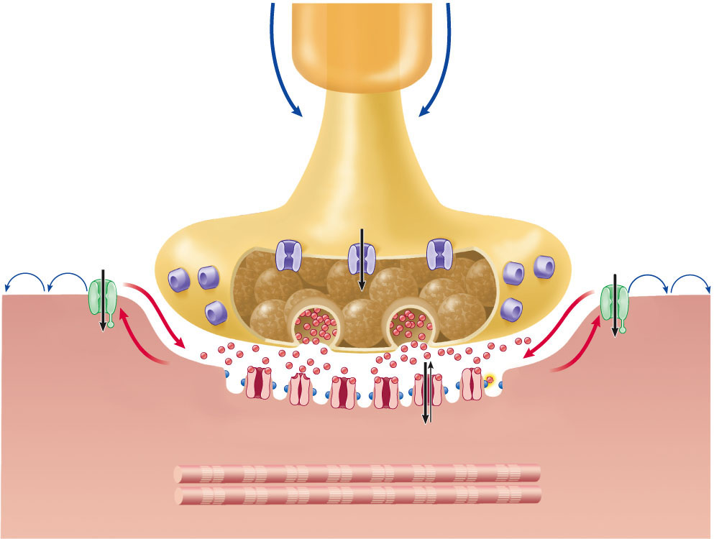
Regulation of the sympathetic nervous system

Slide 37
Imaging with SPECT/Planar
Radionuclide imaging of the norepinepherine analog metaiodobenzylguanidine (MIGB) baleled with 123-iodine (123-I).
Planar and SPECT imaging are performed in the early and late phase of the 123-I MIBG protocol.
  Planar images from Left-Anterior oblique view and provide information on global sympathetic innervation pattern.
  SPECT images are used to assess regional abnormalities in cardiac sympathetic innervation.

Slide 38
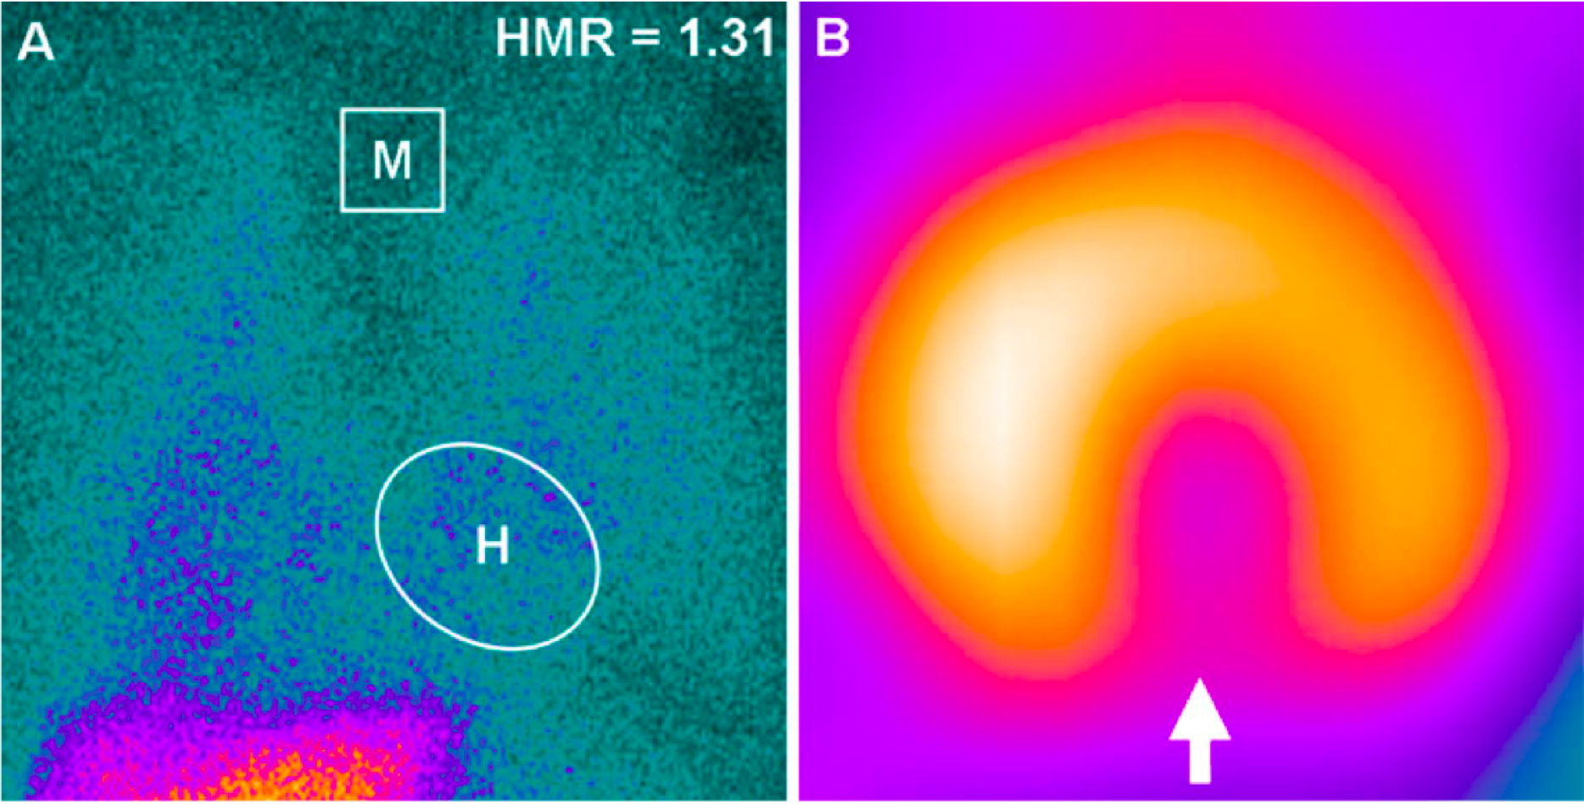
Imaging with SPECT/Planar
Notes:
The heart-to- mediastinum (H/M) ratio on panel A was calculated by dividing the mean counts per pixel within the heart (H) by the mean counts per pixel within the upper mediastinum (M). In this example, the late H/M ratio was 1.31
In a study called the ADMIRE-HF trial, they found that the risk for major cardiac events was significantly lower in patients with H/M ratio greater than or equal to 1.60 when compared to patients with H/M ratio less than or equal to 1.60
Panel B shows an example of regional abnormalities in sympathetic innervation as indicated by regional defect in 123-I MIBG uptake, white arrow.

Slide 39
Imaging with PET
In contrast to SPECT/Planar imaging, PET maps the sympathetic nervous system with superior temporal and spatial resolution.
  Spatial resolution of 4-7mm.
  Temporal resolution allows for development of dynamic images which can be used to assess tracer kinetics.
  Can be used to quantify the absolute amount of tracer and its time-dependent kinetics.

Slide 40
Two categories of PET tracers
Radiolabeled catecholamines
  Molecularly identical to endogenous neurotransmitters
  Undergo similar uptake, release and metabolic pathways
Radiolabeled catecholamine analogs
  False neurotransmitters
  Follow the same uptake and release mechanisms without being metabolized like endogenous transmitters
  Example: Hydroxyephedrine labeled with carbon-11

Slide 41
Hydroxyephedrine labeled with carbon-11
One of the most frequently applied PET tracers for cardiac sympathetic nerve imaging as it shows high affinity for a common uptake mechanism.
Can be used for accurate assessment of regional neuronal defects as it has been shown to distribute equally within the myocardium in physiologic conditions.

Slide 42
More uses for pet imaging
Cardiac innervation has also been explored in heart failure patients who underwent cardiac transplantation.
PET has also been used to evaluate the relation between cardiac sympathetic innervation and ventricular arrhythmias.

Slide 43
Future role of nuclear imaging
In the future scientists hope to:
  Use nuclear medicine for prevention of overt heart failure.
  To develop molecular-targeted imaging techniques that will provide further insight into the pathophysiology of the failing heart

Slide 44
MICAD
The Molecular Imaging and Contrast Agent Database (MICAD) is an online source of scientific information regarding molecular imaging and contrast agents (under development, in clinical trials or commercially available for medical applications) that have in vivo data (animal or human) published in peer-reviewed scientific journals.

Slide 45
micad
MICAD is a key component of the “Molecular Libraries and Imaging” program of the National Institutes of Health (NIH) Common Fund, designed to accelerate medical research for disease detection, diagnosis and therapy. By linking programs in molecular imaging, molecular probes, and molecular libraries, the NIH Common Fund provides much needed support for the development of new, more specific therapies for a wide range of diseases such as cancers, Alzheimer’s and Parkinson's diseases.

Slide 46
micad
MICAD is edited by a team of scientific editors and curators who are based at the National Library of Medicine, NIH, in Bethesda, Maryland.
The database includes, but is not limited to, agents developed for PET, SPECT, MRI, ultrasound,CT, optical imaging, planar radiography, and planar gamma imaging. The information on each agent is summarized in a book chapter format containing several sections such as Background, Synthesis, in vitro studies, Animal Studies, Human Studies, and References.

Slide 47
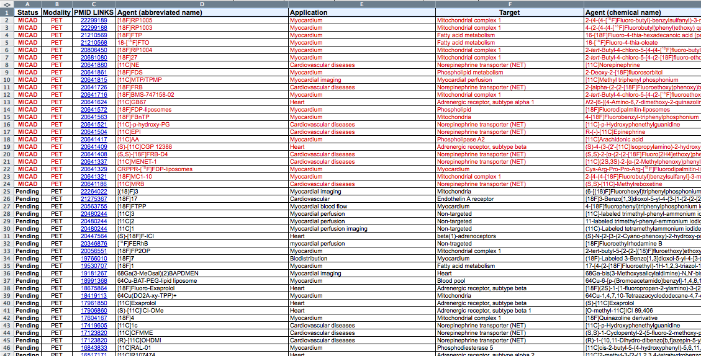
Micad
From http://www.ncbi.nlm.nih.gov/books/NBK5330/ you can download a CSV file of all of the imaging agents.
I did this and trimmed the database down to only PET and SPECT agents that were related to the heart.

