Slide 1
PHYSICS OF MAGNETIC RESONANCE
RAJAN PANDYA & MOHIT GANGULY

Slide 2
Magnetic Resonance Imaging
Provide high resolution anatomic structure (as with X-ray CT)
Provide high contrast between different soft tissues (X-ray CT cannot)
No exposure to radiation and hence safe
More complicated instrumentation
Takes longer to acquire a scan than CT, more susceptible to patient motion

Slide 3
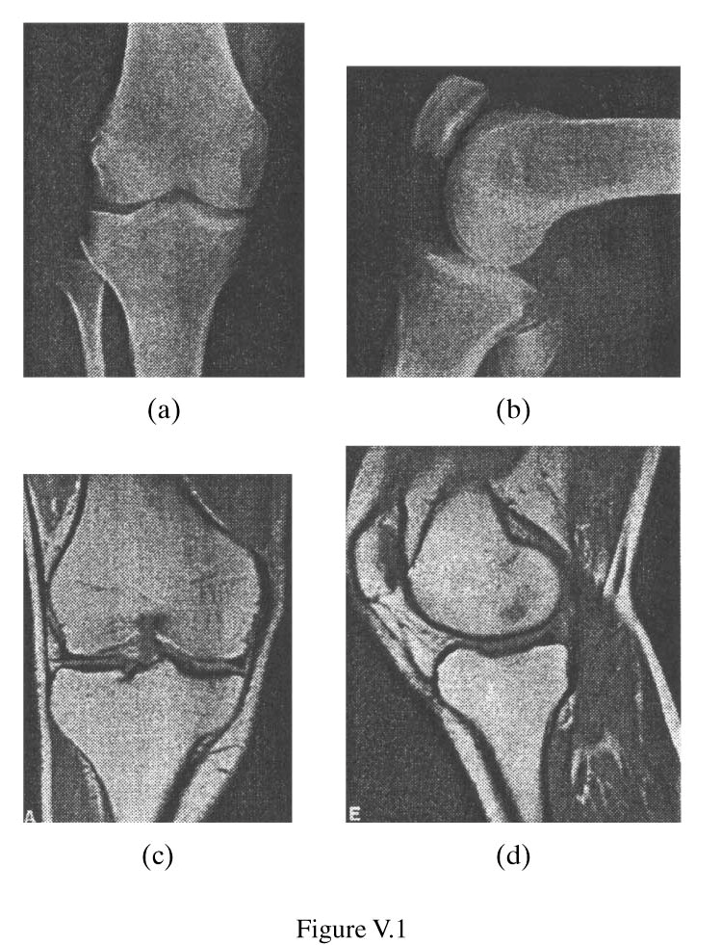
Comparison
X RAY PROJECTION
MRI

Slide 4
Principle of MRI
The hydrogen (1^H) atom inside body possess “spin”. In the absence of external magnetic field, the spin directions of all atoms are random and cancel each other.
When placed in an external magnetic field, the spins align with the external field. By applying an rotating magnetic field in the direction orthogonal to the static field, the spins can be pulled away from the z-axis with an angle \alpha
The bulk magnetization vector rotates around z at the Larmor frequency (presses). The precession relaxes gradually, with the xy-component reduces in time, z-component increases
The xy component of the magnetization vector produces a voltage signal, which is the NMR signal we measure.

Slide 5
Spin
Spin is a fundamental property of nature like electrical charge or mass. Spin comes in multiples of 1/2 and can be + or -. Protons, electrons, and neutrons possess spin.
Individual unpaired electrons, protons, and neutrons each possesses a spin of ½ or - ½. Two or more particles with spins having opposite signs can pair up to eliminate the observable manifestations of spin.
In nuclear magnetic resonance, it is unpaired nuclear spins that are of importance.

Slide 6
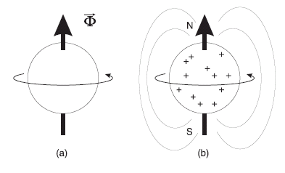
Nuclear Spin
A nucleus consists of protons and neutrons. When the total number of protons and neutrons (=mass number A) is odd or the total number of protons is odd, a nucleus has an angular momentum (\phi) and hence spin
– Ex. Hydrogen (1^H) (1 proton), 13^C
The spin of a nucleus generates a magnetic filed, which has a magnetic moment (\mu) The spin causes the nucleus behave like a tiny magnet with a north and south pole

Slide 7
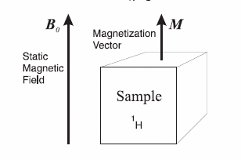
Bulk Magnetization at Equilibrium

Slide 8
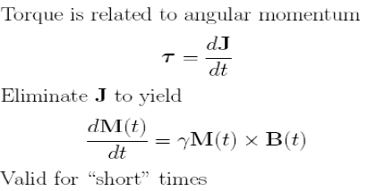
Evolution of magnetization when a Time varying magnetic field is applied
M(t) experiences a torque when an external magnetic field B(t) is applied
Using the right hand rule, M will rotate around z if M is not aligned with z

Slide 9
Longitudinal and Transverse components

Slide 10
NMR Signal
The rapidly rotating transverse magnetization (M_xy) creates a radio frequency excitation within the sample.
If we put a coil of wire outside the sample, the RF excitation will induce a voltage signal.
In MRI, we measure this voltage signal. Voltage produced is (Faraday’s Law of Induction)

Slide 11
RF excitation
Circularly polarized (rotating) magnetic field B1(t) in the x-y plane with the same Larmor frequency forces the magnetization vector to tilt down to the x-y plan
B1(t) has two orthogonal components, in x and y directions respectively, and is produced by using quadrature RF coil – Simplest envelop B1,e is a rectangular pulse

Slide 12
Motion of M(t) is spiral

Slide 13
Circularly Polarized Magnetic Field

Slide 14
Tip Angle
If M is parallel to z-axis before the RF excitation pulse, the tip angle after the excitation is
If B1^e(t) is rectangular

Slide 15
Tip angle
Pulse that leads to alpha=pi/2 is called “pi over 2 pulse”, which elicits the largest transverse component Mxy, and hence largest NMR signal.
Pulse that leads to alpha=pi is called “pi pulse” or inverse pulse, which is used to induce spin echo (later).
The excitation pulse (envelop of B1(t)) is also called “an alpha pulse”.

Slide 16
Relaxation
Magnetization cannot be presses forever .
There are two relaxation processes working together cause the received signal vanish
Transverse relaxation
Longitudinal relaxation
This properties defers as per tissue so MR images get rise to tissue contrast

Slide 17
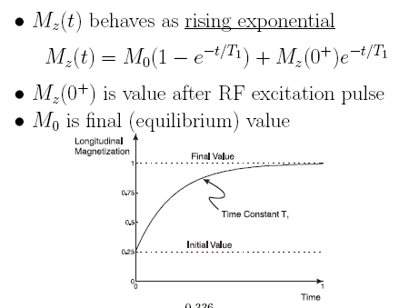
Longitudinal Relaxation
The magnetization vectors tend to return to equilibrium state (parallel to B0)

Slide 18
Transverse Relaxation
The strength of the magnetic field in the immediate environment of a 1H nucleus is not homogeneous due to presence of other nucleus (and their interactions)
Hence the Larmor frequencies of nearby nuclides are slightly different (some spins faster, some slower)
– Spin-spin interactions
This causes dephasing of the xy components of the magnetization vector

Slide 19
Transverse Relaxation

Slide 20
Transverse Relaxation
T2 is called transverse relaxation time, which is the time for Mxy to decrease by 1/e.
Also called spin-spin relaxation time
T2 is much smaller than T1
– For tissue in body, T2: 25-250ms, T1: 250-2500 ms

Slide 21
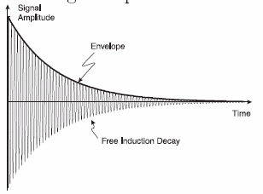
Free Induction Decay
The voltage signal (NMR signal) produced by decaying Mxy also decays.
This is called free induction decay (FID), and is the signal we measure in MRI

Slide 22
T2 Star Decay
Received signal actually decays faster than T2 (having a shorter relaxation time T2^*)
Caused by fixed spatial variation of the static field B0 due to imperfection of the magnet
– Accelerates the dephasing of magnetization vectors
– T2 is caused by spatial variation of the static field due to interactions of nearby spins
The initial decay rate is governed by T2^* , but the later decay by T2.

Slide 23
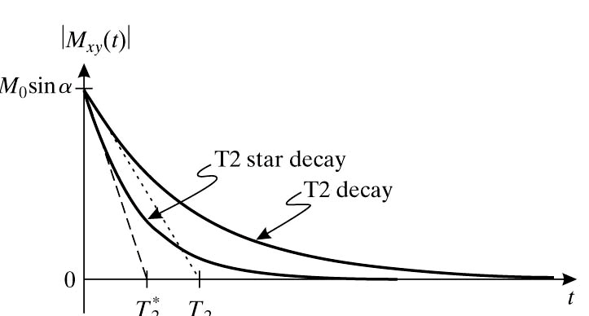
T2 Star Decay

Slide 24
Bloch Equations

Slide 25
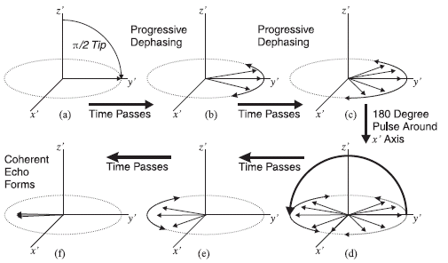
Formation of Spin Echo
By applying a 180 degree pulse, the dephased spins can recover their coherence, and form an echo signal

Slide 26
RF Pulse Sequence and Corresponding NMR Signal

Slide 27
MR Contrast
Different tissues vary in T1, T2 and PD (proton density)
The pulse sequence parameters can be designed so that the captured signal magnitude is mainly influenced by one of these parameters
Pulse sequence parameters
– Tip angle \alpha
– Echo time TE
– Pulse repetition time TR

Slide 28
Typical Brain Tissue Parameters

Slide 29
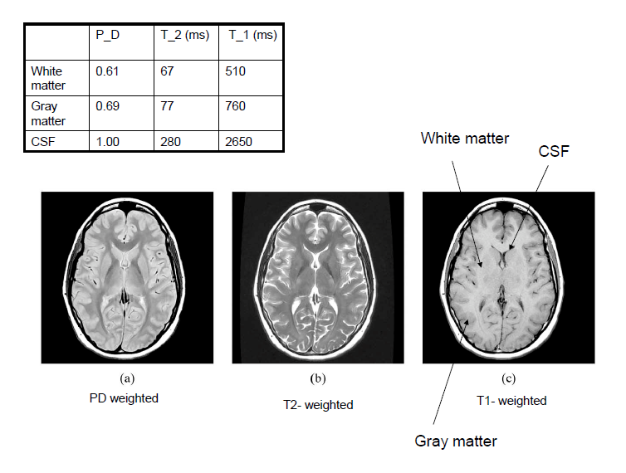

Slide 30
Spin density weighting
Signal at equilibrium proportional to PD
Long TR:
– Minimizes effects of different degrees of saturation (T1 contrast)
– Maximizes signal (all return to equilibrium)
Short TE:
– Minimizes T2 contrast
– Maximizes signal

Slide 31
Spin density weighting

Slide 32
T2 weighting
Long TR:
– Minimizes influence of different T1
Long TE:
– Maximizes T2 contrast
– Relatively poor SNR

Slide 33
T2 weighting

Slide 34
T1-weighting
Short TR:
– Maximizes T1 contrast due to different degrees of saturation
– If TR too long, tissues with different T1 all return equilibrium already
Short TE:
– Minimizes T2 influence, Maximizes signal

Slide 35
T1-weighting

