Slide 1
Magnetic Resonance Imaging
Chapter 13
Shi Chen & Pan Hui

Slide 2
Outline
We first explore the instrumentation necessary to create MR images.
Then we present the image formation process.
Imaging equations
Computer algorithms
Finally, we discuss the factors affecting image quality.

Slide 3
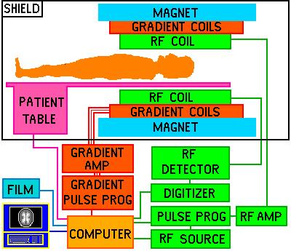
Instrumentation
MRI System components
1 the main magnet
2 a set of coils
3 resonators
4 electronics
5 a console
http://www.fas.org/irp/imint/docs/rst/Intro/Part2_26c.html

Slide 4
The magnet, gradient coils, and RF coils must be isolated from the electronic noise of the outside world in order to prevent interfering signals.
Faraday Cage
All electronic signals go through this filters to ensure that no noise is present.

Slide 5
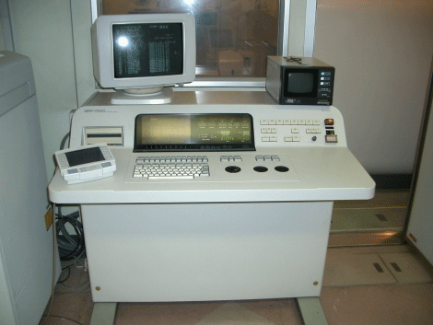
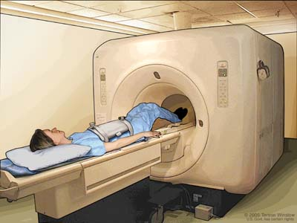
Magnet
Cylindrical superconducting magnet
The most common type used in MRI systems
Main magnet with the patient table
The console for operating the scanner
http://www.ahtiny.com/equipments/Imaging/MRI_Scanner.htm

Slide 6
superconducting magnets
There are two major challenges in the design and maintenance of superconducting magnets.
The homogeneity of the magnetic field within the bore must be maintained at better than +5ppm.
The minimization of the so-called fringe field—the magnetic field that is outside the bore of the magnet.

Slide 7
Gradient Coils
Definition
The gradient coils fit just inside the bore of the magnet.
Function
To provide a temporary change in the magnitude B₀ of the main magnetic field as a function of position in the magnet bore.

Slide 8
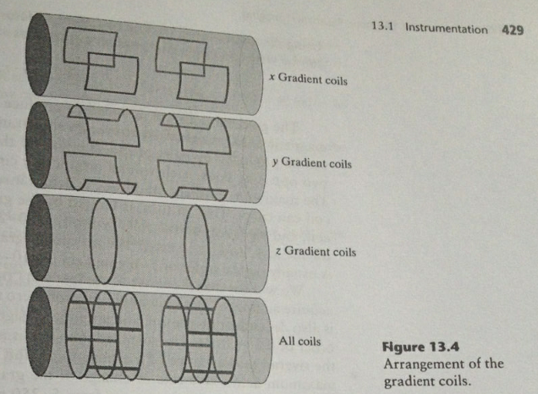
Gradient Coils
There are usually 3 orthogonal gradient coils.
Gradient coils provide the means to choose slices of the body for selective imaging. In this way, it can image slices.

Slide 9
If all three coils are turned on at the same time with strengths $G_{x},G_{y},G_{z},$ the main field is given by
$G_{x},G_{y},G_{z}$ is often written in vector form as
B can be written using a dot product notation as
$$B=(B_{0}+G_{x}x+G_{y}y+G_{z}z)\hat{z}$$
$$G=(G_{x},G_{y},G_{z})$$
$$B=(B_{0}+G∙r)\hat{z}$$

Slide 10
Radio-Frequency Coils
RF Coils serve to both induce spin precession and to have currents induced in them by the spin system.
There are two types of RF coils:
Volume coils
Surface coils

Slide 11
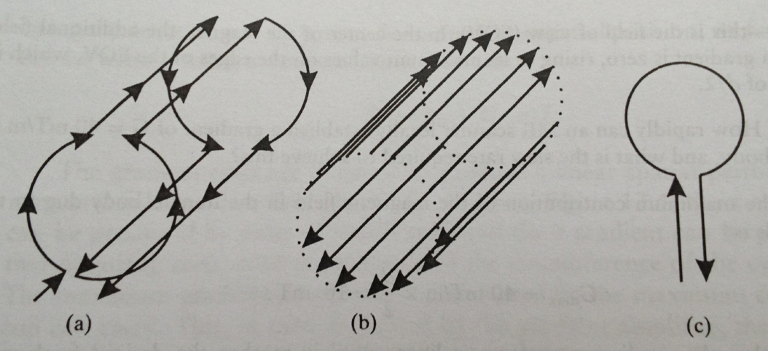
Radio-Frequency Coils
(a)saddle coil (b)birdcage coil (c)surface coil
There are many other volume coils, such as knee coils, neck coils, etc.

Slide 12
MRI Data Acquisition
Encoding Spatial Position
The +z-direction is from the head to the feet;
+y is oriented posterior(back) to anterior(front);
+x is oriented right to left.
In this scenario,
We could get a axial image by holding z constant;
We could get a coronal image by holding y constant;
We could get a sagittal image by holding x constant;

Slide 13
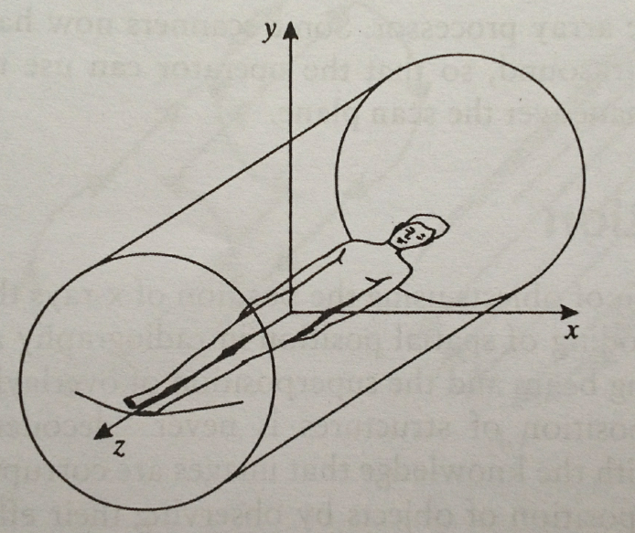
Laboratory coordinates in an MR scanner

Slide 14
Frequency encoding
Larmor frequency
Where the dependence of Larmor frequency v(r) on spatial position r=(x,y,z) is made explicit.
$$v\left(r\right)=γ(B_{0}+G∙r)$$

Slide 15
Slice selection
Principle of Slice selection
When G has only one nonzero component z
G=(0,0,$G_{z}$)
$$v\left(z\right)=γ(B_{0}+G_{z}z)$$

Slide 16
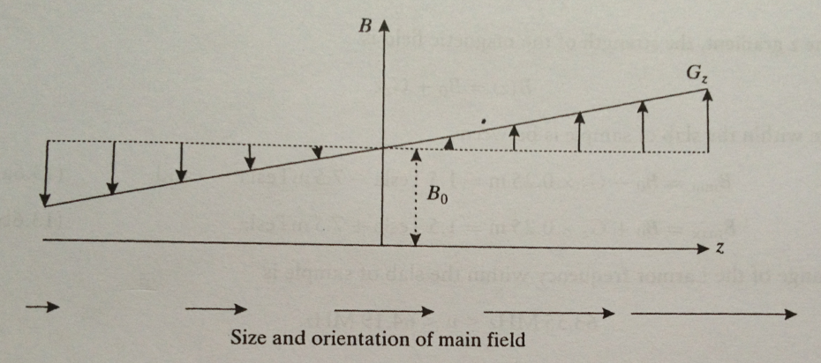
Effect on the main magnetic field from a z-gradient

Slide 17
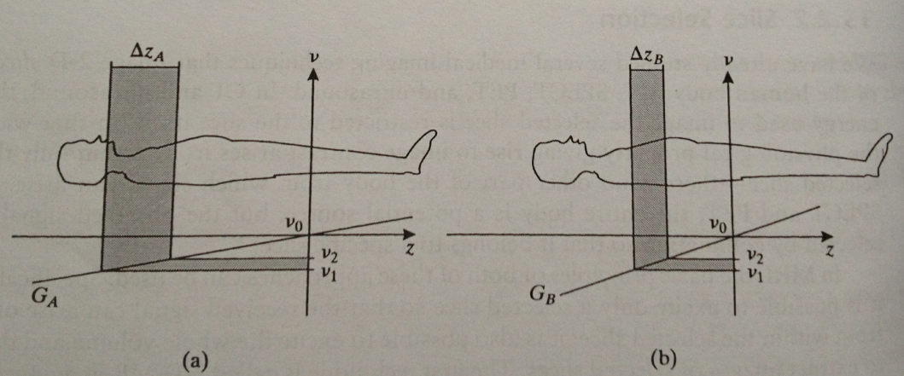

Slide 18
There are 3 parameters to select slices:
z-gradient strength G_{z},
RF center frequency,
And RF frequency range,
$$\overline{v}=\frac{v_{1}{+v}_{2}}{2}$$
$$△v=|v_{2}{−v}_{1}|$$

Slide 19
We find that the v1 and v2 yield the slice boundaries,
Where $v_{1}$=v($z_{1}$) and $v_{2}$=v($z_{2}$)
$$z_{1}=\frac{v_{1}−γB_{0}}{γG_{z}}$$
$$z_{2}=\frac{v_{2}−γB_{0}}{γG_{z}}$$

Slide 20
Slice position $\overline{z}$ is therefore given by
Slice thickness $△z$ is given by
$$\overline{z}=\frac{z_{1}+z_{2}}{2}=\frac{\overline{v}−v_{0}}{γG_{z}}$$
$$△z=\left|z_{2}{−z}_{1}\right|=\frac{△v}{γG_{z}}$$

Slide 22
We know that slice selection uses a constant gradient together with an RF excitation over a range of frequencies[v₁,v₂]. We can desire a signal whose frequency content is:
According to Fourier transform theory, the signal itself should be:

Slide 23
The gradient is constant during RF excitation.
The RF excitation is short.
If RF signal B₁(t) = s(t) has on the spin system, the final tip angle after an RF excitation pulse of duration t_{p} and is repeated here:
Where is the envelope of the RF excitation evaluated in the rotating coordinate system.

Slide 24
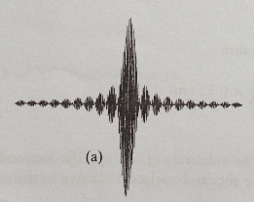
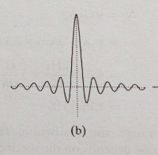
For isochromats whose Larmor frequency is v, the excitation signal in the rotating coordinate system is:
a slice selection waveform
envelop of this slice selection

Slide 25
Refocusing Gradients
During RF excitation, the spin system within the excited slab is undergoing forced precession. The slice profile reveals differences in the final tip angels and hence implies different transverse magnetizations experienced at different z positions.
The effect of slice dephasing:
During forced precession, the spins at the “lower” edge of the slice are processing slower than those at the “higher” edge.

Slide 26
Refocusing Gradients
Why?
Because system use different Larmor frequencies. As a result of this, the spins become out of phase with each other across the slice.

Slide 27
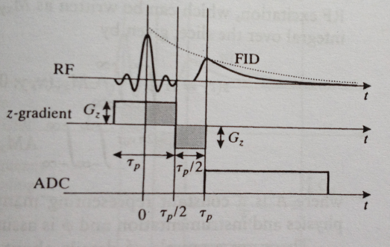
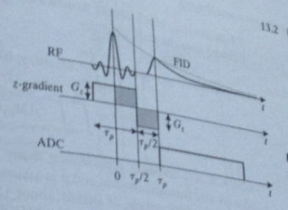
A Simple Pulse Sequence
After the RF waveform is completed., another gradient is applied to refocus the spins within the slice. After this, we expect to find an FID arising from the excited spins in the slice that was selected.

Slide 28
At the completion of the refocusing gradient pulse, the phase angle of all magnetization vectors in the same, and the signal from these magnetization vectors will add constructively.
If no dephasing were present across the selected slice, then we would expect the FID to begin at the center of the RF pulse.
Because of dephasing, the appearance of the FID is delayed until near the conclusion of the refocusing lobe.

Slide 29
Assuming the slice is fairly thin so there is no z variation. There will be a spatial variation of transverse magnetization immediately after RF excitation, which is M _{xy}(x,y;0+). So the received signal can be written as:

Slide 30
gl
Some details must make clear:
The FID decays more rapidly than T₂; therefore, we must view either as an idealized signal model, or one that applies only for very short time intervals, where the difference in decay rates is negligible.
It should be noted that t = 0 represents the center of the slice selection RF waveform.
The equation ignores the short time t_{p} it takes for the FID to actually appear after the refocusing lobe of the slice select gradient.

Slide 31
For clarity, define the effective spin density as:
Which represents the MR quantity that is being imaged here.
The received signal is always demodulated in MRI hardware, yielding the baseband signal:

Slide 32
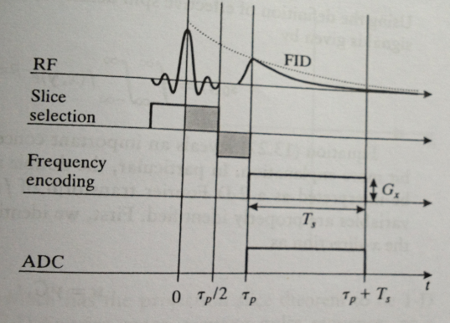
Readout Gradient
The first concept required for spatially encoding MR signals is frequency encoding. In frequency encoding, a gradient is turned on during the FID, causing the Larmor frequencies to be spatially dependent.

Slide 33
Readout Gradient
The direction of the frequency encoding gradient is called the readout direction because the signal that is “read out” is spatially encoded in that direction.
The Larmor frequencies during a frequency encode gradient are given by:

Slide 34
Using Larmor frequency in received signal equation:
Using the definition of effective spin density, above equation can covert to:

Slide 35
The spatial frequency variable in the x-direction as
Which has units of inverse length.
The spatial frequency variable in the y direction is :
Denoting F(u,v) as the 2-D Fourier transform of f(x,y), we can now make the identity:
Which shows that the demodulated FID represents a certain “scan” of the 2-D Fourier space of the effective spin density.

Slide 36
In magnetic resonance imaging, Fourier space is usually referred to as k-space. The k-space variables can be identified with our Fourier frequencies,

Slide 37
Polar Scanning
A more general gradient involving both an x- and a y-component can be used to encode the Larmor frequency:
A baseband signal given by :

Slide 38
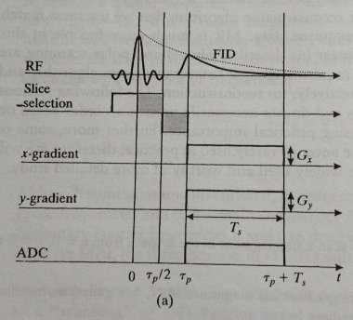
Polar Scanning
A pulse sequence for arbitrary polar scan

Slide 39
Polar Scanning
The Fourier frequencies can be defined as:
The implied Fourier trajectory is a ray emanating from the origin in the direction:

Slide 40
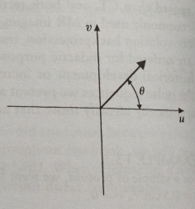
Polar Scanning
A Fourier trajectory for a polar scan.

Slide 41
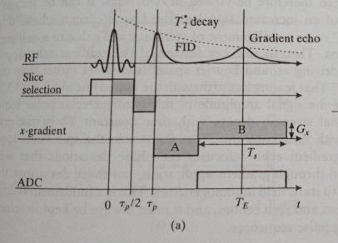
Gradient Echoes
A new mechanism to create an echo,: gradient echo.
This idea can be readily connected to both the Fourier trajectories and the intuitive idea of spins realigning themselves.

