Slide 1
Projection Radiography
Chapter 5 (in more detail)

Slide 2
Introduction
Projection radiography(Conventional radiography)- most common used method of medical imaging that utilizes x-rays
Conventional Radiograph- represents a projection of the 3D volume of the body onto a 2D imaging surface
Conceptually, the projection radiograph represents the transmission of the x-ray beam through the patient weighted by integrated loss of beam energy due to scattering and absorption in the body

Slide 3
Advantages of Projection Radiographic Systems
Short exposure time (0.1 second)
Production of a large area image (e.g. 14x17 in.)
Low cost
Low radiation exposure(30 mR for a chest radiograph, equivalent to 1/10 of the annual background dose)
Excellent contrast and spatial resolution.

Slide 4
Uses of Projection Radiography
Pnemonia
Heart Disease
Lung Disease
Bone Fracture
Cancer
Vascular Disease

Slide 5
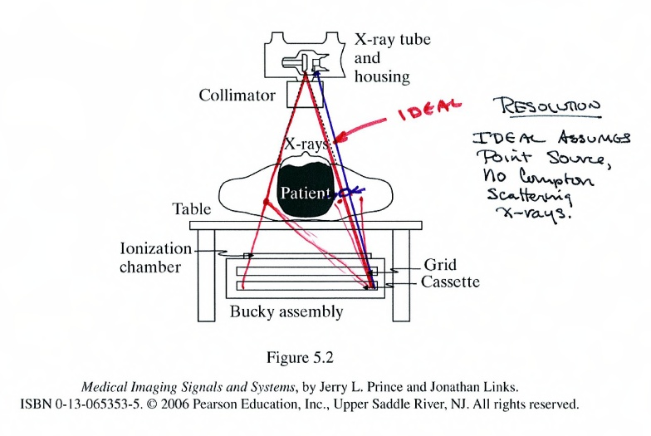
Instrumentation
A conventional projection radiographic system.
The X-ray generates a short pulse of x-rays as a beam that travels through the patient
X-ray photons that are not absorbed within the patient or scattered outside the region of the detector impinge upon the large area protector, ultimately creating an image on a sheet of film.

Slide 6
Instrumentation
Filament(tungsten wire), contained within the cathode assembly, controls tube current of 6-12 volts
Anode voltage switched to high potential(30-150 kVp)
Focusing cup- small depression in the cathode containing the filament is shaped to help focus the electron beam toward a particular spot on the anode.

Slide 7
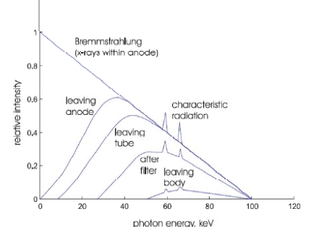
Instrumentation
Relative intensity of x-ray photons
Vast majority of the x-rays produced by an x-ray tube are bremsstrahlung.

Slide 8
Instrumentation
Filtration- the maximum energy of the emitted x-ray photons is determined by the tube voltage
Ex: 100 kVp is the tube voltage then the maximum photon energy is 100 keV
Low energy x-ray will be absorbed by the body without providing diagnostic info.
Inherent filtration(within anode, glass housing)
Added filtration
Restriction- to direct beam toward desired anatomy
Compensation Filters and contrast agents – used for attenuation which is the process by which x-rays are absorbed or redirected (scattered) within the body or other objects in the field of view.
Goal for Compensation: to even out film exposure
Goal for Contrast: to create contrast where there is otherwise none

Slide 9
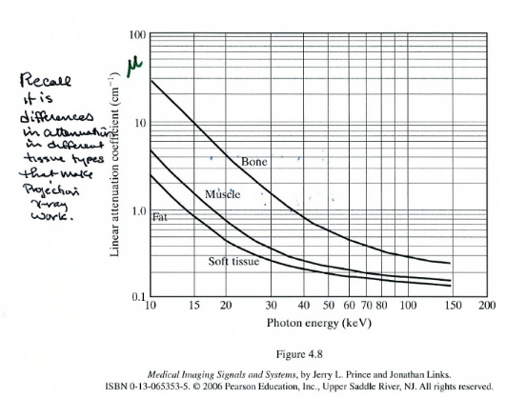
Beam Hardening
Caused by the preferential absorption of lower energy photons, for which attenuation is higher in most materials

Slide 10
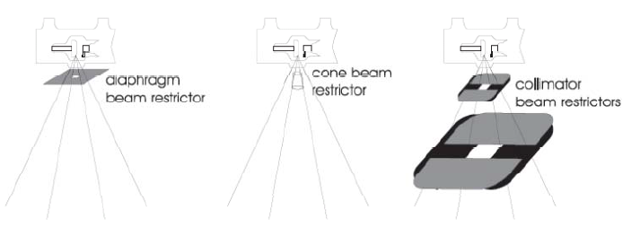
Restriction Beam
X-ray rubes generate x-rays in all directions
Diaphragm: fixed geometry, Chest Radiography, simple and inexpensive
Cones or Cylinders: Fixed in geometry, somewhat better performance
Collimator: More expensive, Flexible and better performing , Projection X-ray systems
Collimators have variable diaphragms composed of movable piece of lead
Most often, there are two collimators, one near the tube and one farther away from the tube. Typically there is a scored mirror in between these two collimators so that a light coming from the side will shine through the second collimator, illuminating the field of view with an alignment grid.

Slide 11
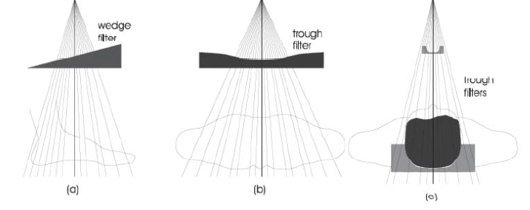
Compensation Filter
Compensation filter: comprised of a specially shaped aluminum or leaded-plastic object can be placed between the x-ray source and patient, or in some cases between the patient and detector.
The compensation filter is thicker where the body part is thinner and vice versa, so that the x-ray detector requires a smaller dynamic range.

Slide 12
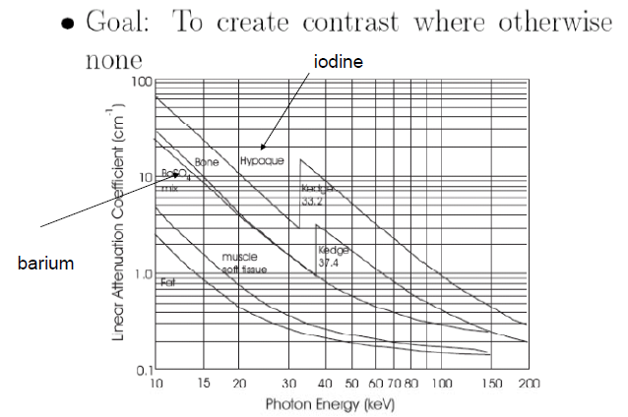
Contrast Agents
When the x-ray energy exceeds the binding energy of k-shell, the linear attenuation coefficient is much higher providing more contrast.

Slide 13
How to Reduce Scatter?
Ideal X-ray path is a line
Compton Scattering causes blurring
Reduce Scatter: airgap, scanning slit, grid

Slide 14
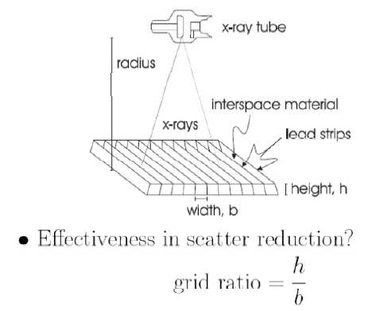
Grids

Slide 15
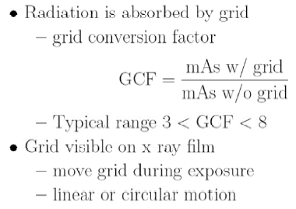
Problems with Grids

Slide 16
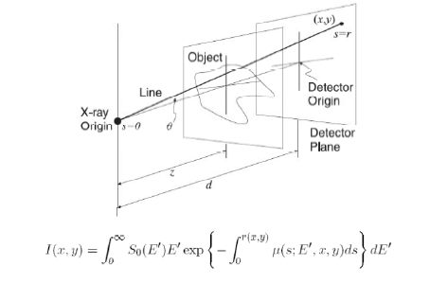
Image Formation
Basic Imaging Equation- the intensity of the x-rays incident on the detector at (x,y)
Geometry of a Conventional Projection Radiographic system

Slide 17
Image Formation
Inverse Square Law states that the net flux of photons decreases as 1/r^2, where r is the distance from the x-ray origin
Example 5.2 in book.
The inverse square law has a very practical use in radiography . Suppose an acceptable chest radiograph was taken using 30 mAs at 80 kVp from 1 m. Suppose that it was now requested that one be taken at 1.5 m at 80 kVp.
(Show solution on board).

Slide 18
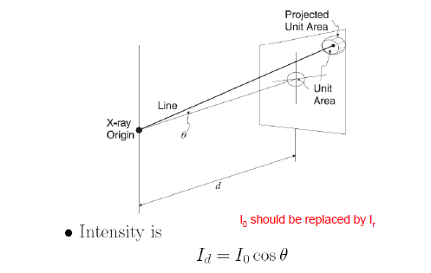
Image Formation
Obliquity-second factor that acts to decrease the beam intensity away from the detector origin
This effect is caused by the detector not being orthogonal to the direction of x-ray propagation
Figure(below) The effect of obliquity on spot size

Slide 19
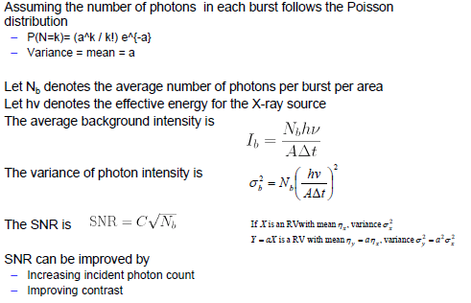
Noise and Scattering

Slide 20
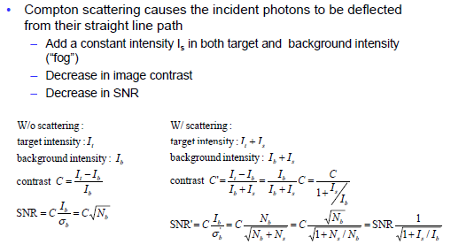
Noise and Scattering

Slide 21
Compton Scattering(cont.)
Degrades image quality
Compton photons are deflected from their ideal straight-line path and some are detected in locations away from the correct, straight-line location----this produces two unwanted results: decrease in image contrast and a decrease in SNR

Slide 22
Summary
Projection radiography produces radiographs which are 2-D projections of a 3D object
EA projection radiography system consists of an x-ray tube, devices for beam filtration and restriction, compensation filters, grids and usually a film-screen protector.
The basic imaging equation describes the energy and material-dependent attenuation of the x-ray beam produced by the system as it passes through the patient
This equation must be modified by several geometric effects, including square law, obliquity, divergence, anode heel effect, path length, and depth-dependent magnification.
The film screen protector produces an optical image on film; the degree of film blackening- the optical density- depends on film exposure in a nonlinear way characterized by the H&D curve
Noise arising from the random nature of x-ray production and transmission reduces an image’s signal-to-noise- ratio and thus the detective quantum efficiency of the sytem.
Acceptance of the Compton Scattered photons reduces image contrast and thus signal-to-noise ratio as well.

