Slide 1

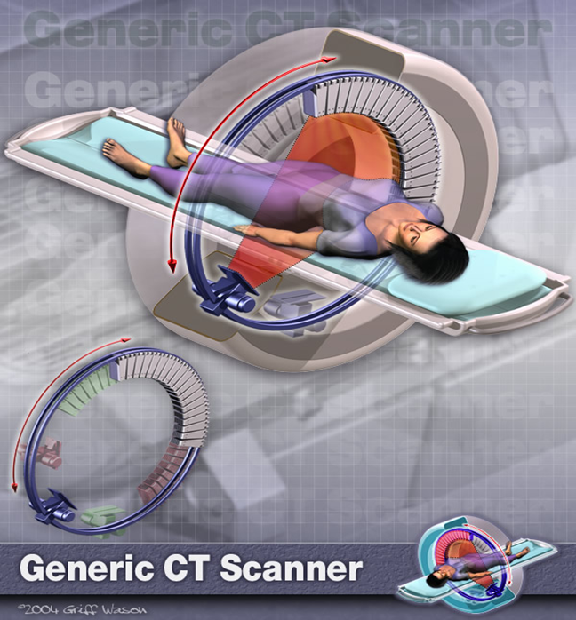
Computed Tomography
CSE 5780 Medical Imaging Systems and Signals
Ehsan Ali and Guy Hoenig

Slide 2
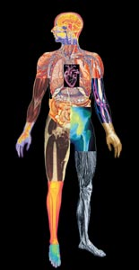
Computed Tomography using ionising radiations
Medical imaging has come a long way since 1895 when Röntgen first described a ‘new kind of ray’.
That X-rays could be used to display anatomical features on a photographic plate was of immediate interest to the medical community at the time.
Today a scan can refer to any one of a number of medical-imaging techniques used for diagnosis and treatment.

Slide 3
Instrumentation
(Digital Systems)
The transmission and detection of X-rays still lies at the heart of radiography, angiography, fluoroscopy and conventional mammography examinations.
However, traditional film-based scanners are gradually being replaced by digital systems
The end result is the data can be viewed, moved and stored without a single piece of film ever being exposed.

Slide 4
CT Imaging
Goal of x-ray CT is to reconstruct an image whose signal intensity at every point in region imaged is proportional to μ (x, y, z), where μ is linear attenuation coefficient for x-rays.
In practice, μ is a function of x-ray energy as well as position and this introduces a number of complications that we will not investigate here.
X-ray CT is now a mature (though still rapidly developing) technology and a vital component of hospital diagnosis.

Slide 5
Comparisons of CT Generations
Comparison of CT Generations
Generation | Source | Source Collimation | Detector | Detector Collimation | Source-Detector Movement | Advantages | Disadvantages
1G | Single x-ray tube | Pencil beam | Single | None | Move linearly and rotate in unison | Scattered energy is undetected | Slow
2G | Single x-ray tube | Fan beam, not enough to cover FOV | Multiple | Collimated to source direction | Move linearly and rotate in unison | Faster than 1G | Lower efficiency and larger noise because of the collimators in directors
3G | Single x-ray tube | Fan beam, enough to cover FOV | Many | Collimated to source direction | Rotate in synchrony | Faster than 2G, continuous rotation using slip ring | Moe expensive than 2G, low efficiency
4G | Single x-ray tube | Fan beam covers FOV | Stationary ring of detectors | Cannot collimate detectors | Detectors are fixed, source rotates | Higher efficiency than 3G | High scattering since detectors are not collimated
5G (EBCT) | Many Tungsten anodes in a single large tube | Fan beam | Stationary ring of detectors | Cannot collimate detectors | No moving parts | Extremely fast, capable of stop-action imaging of beating heart | High cost, difficult to calibrate
6G (Spiral CT) | 3G/4G | 3G/4G | 3G/4G | 3G/4G | 3G/4G plus linear patient table motion | Fast 3D images | A bit more expensive
7G (Multi-slice CT) | Single x-ray tube | Cone beam | Multiple arrays of detectors | Collimated to source direction | 3G/4G/6G motion | Fast 3D images | Expensive

Slide 6
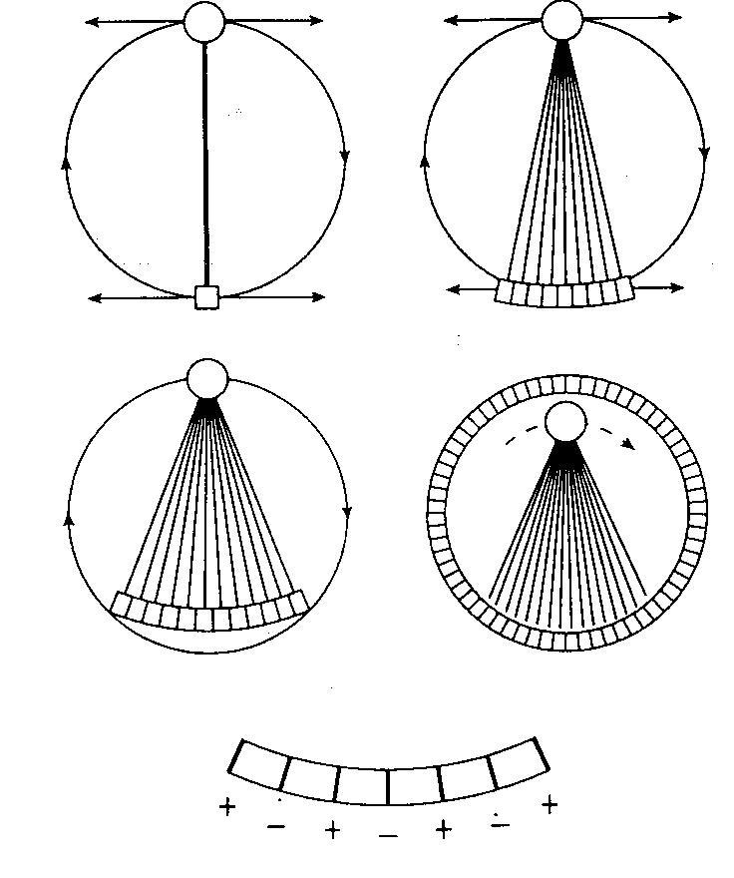
Four generations of CT scanner

Slide 7
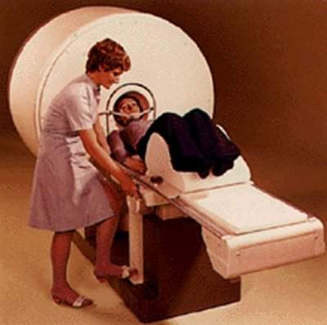
X-rays CT - 1st Generation
Single X-ray Pencil Beam
Single (1-D) Detector set at 180 degrees opposed
Simplest & cheapest scanner type but very slow due to
Translate(160 steps)
Rotate (1 degree)
~ 5minutes (EMI CT1000)
Higher dose than fan-beam scanners
Scanners required head to be surrounded by water bag

Slide 8
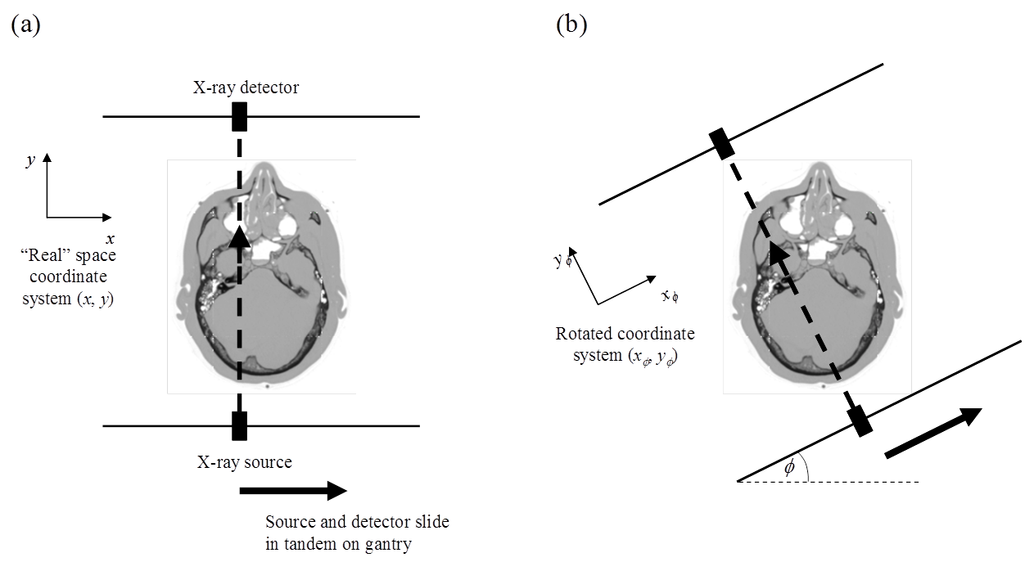
Fig 1: Schematic diagram of a 1st generation CT scanner
(a) X-ray source projects a thin “pencil” beam of x-rays through sample, detected on the other side of the sample. Source and detector move in tandem along a gantry. (b) Whole gantry rotates, allowing projection data to be acquired at different angles.

Slide 9
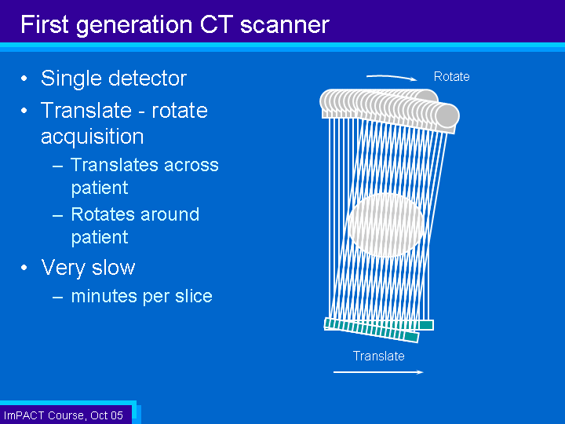
First Generation
CT Scanner

Slide 10
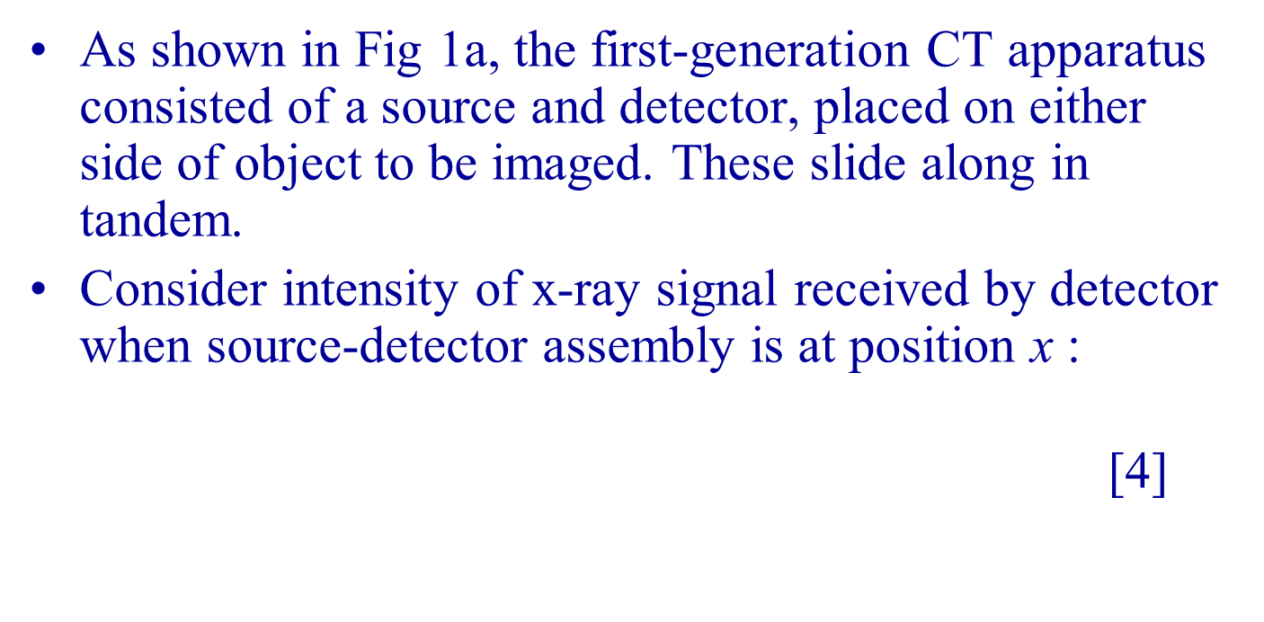
First-generation CT Apparatus
Notes:
Intensity input @ position ‘x’= Intensity output (exp {MU(x,y)dy}

Slide 11
Further generations of CT scanner
The first-generation scanner described earlier is capable of producing high-quality images. However, since the x-ray beam must be translated across the sample for each projection, the method is intrinsically slow.
Many refinements have been made over the years, the main function of which is to dramatically increase the speed of data acquisition.

Slide 12
Further generations of CT scanner (cont’d)
Scanner using different types of radiation (e.g., fan beam) and different detection (e.g., many parallel strips of detectors) are known as different generations of X-ray CT scanner. We will not go into details here but provide only an overview of the key developments.

Slide 13
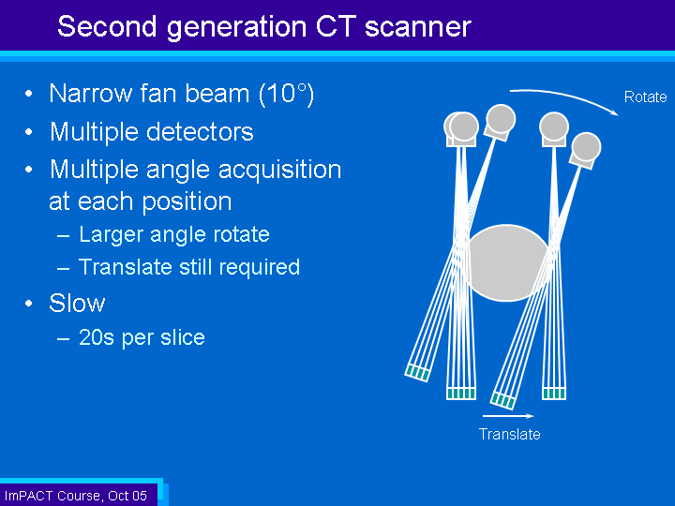
Second Generation
CT scanner

Slide 14
X-rays CT - 2nd Generation (~1980)
Narrow Fan Beam X-Ray
Small area (2-D) detector
Fan beam does not cover full body, so limited translation still required
Fan beam increases rotation step to ~10 degrees
Faster (~20 secs/slice) and lower dose
Stability ensured by each detector seeing non-attenuated x-ray beam during scan

Slide 15
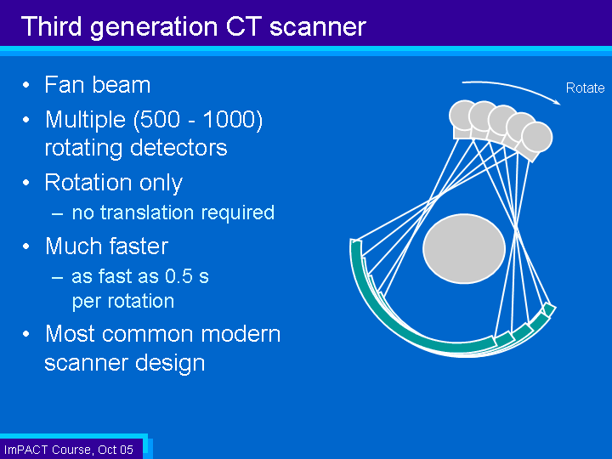
Third Generation
CT Scanner

Slide 16
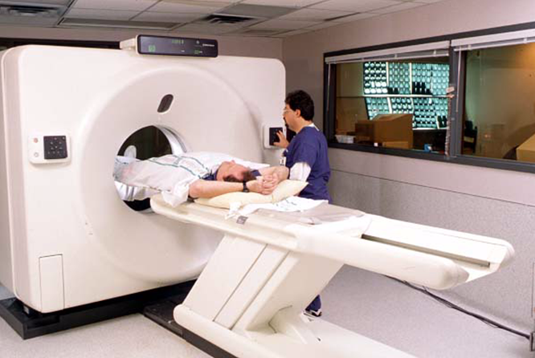
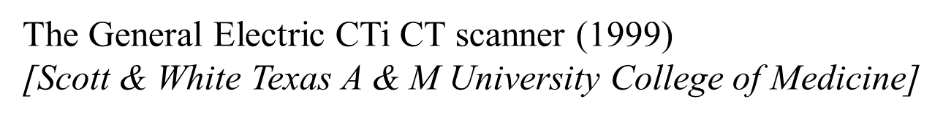
X-rays CT - 3rd Generation (~1985)

Slide 17
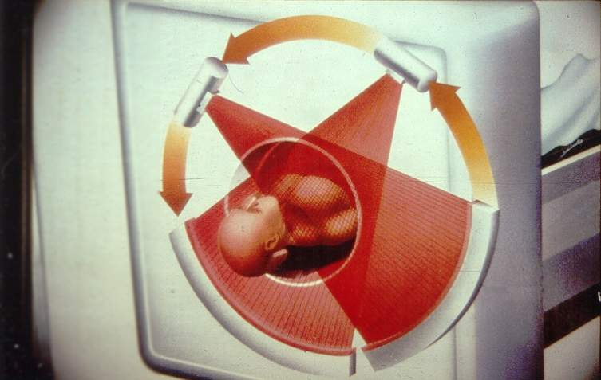
X-rays CT - 3rd Generation (~1985)

Slide 18
X-rays CT - 3rd Generation
Wide-Angle Fan-Beam X-Ray
Large area (2-D) detector
Rotation Only - beam covers entire scan area
Even faster (~5 sec/slice) and even lower dose
Need very stable detectors, as some detectors are always attenuated
  Xenon gas detectors offer best stability (and are inherently focussed, reducing scatter)
  Solid State Detectors are more sensitive - can lead to dose savings of up to 40% - but at the risk of ring artefacts

Slide 19
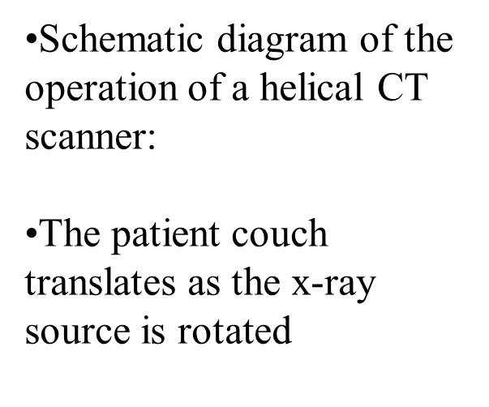
X-rays CT - 3rd Generation Spiral

Slide 20
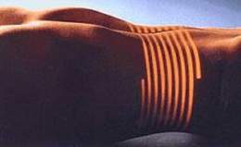
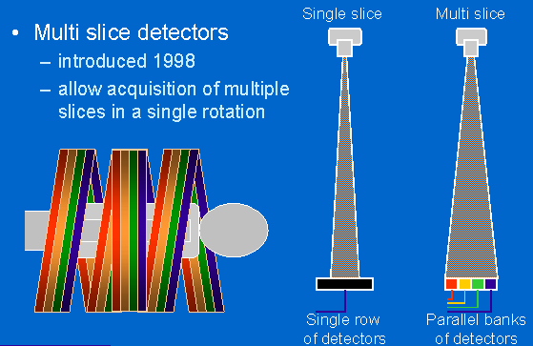
X-rays CT – 3rd Generation Multi Slice
Latest Developments -
Spiral, multislice CT→ Cardiac CT

Slide 21
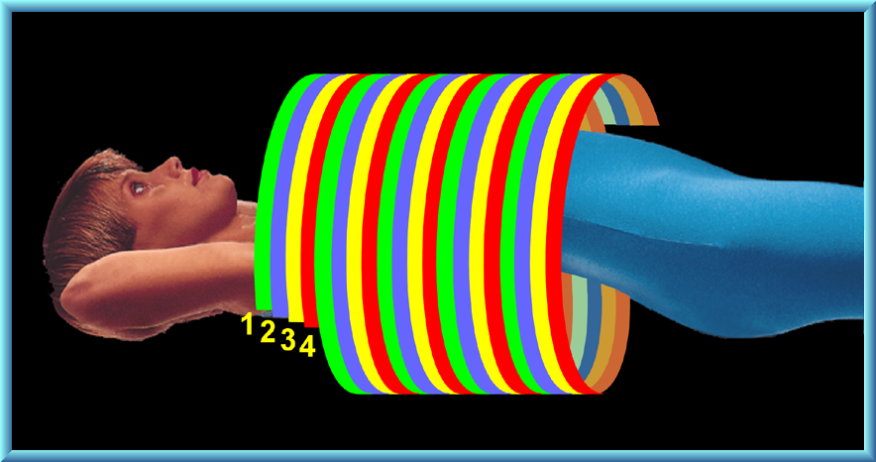
X-rays CT – 3rd Generation Multi Slice

Slide 22
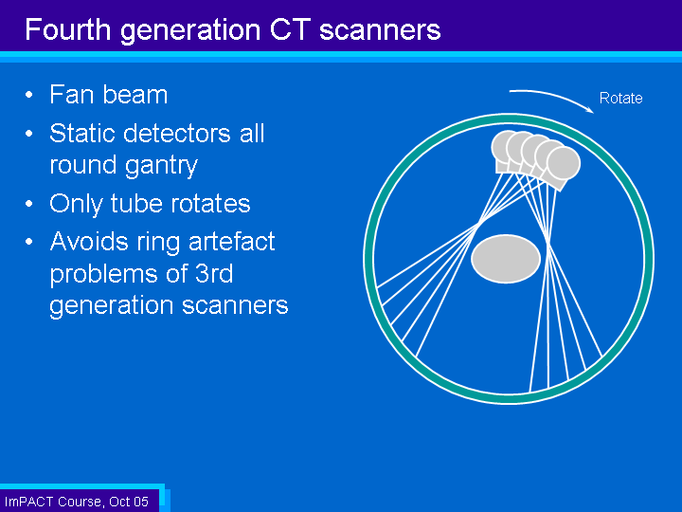
Fourth Generation
CT Scanners

Slide 23
X-rays CT - 4th Generation (~1990)
Wide-Angle Fan-Beam X-Ray: Rotation Only
Complete 360 degree detector ring (Solid State - non-focussed, so scatter is removed post-acquisition mathematically)
Even faster (~1 sec/slice) and even lower dose
Not widely used – difficult to stabilise rotation + expensive detector
Fastest scanner employs electron beam, fired at ring of anode targets around patient to generate x-rays.
Slice acquired in ~10ms - excellent for cardiac work
X-rays CT - Electron Beam 4th Generation

Slide 24
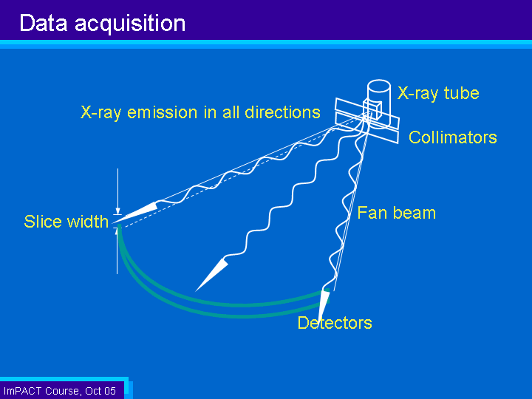
X-Ray Source and Collimation

Slide 25
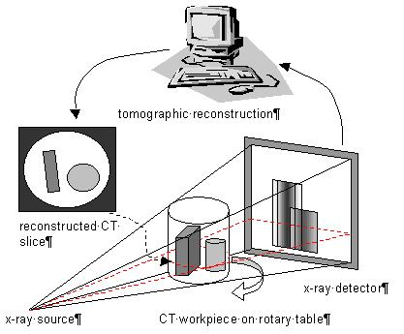
CT Data Acquisition

Slide 26
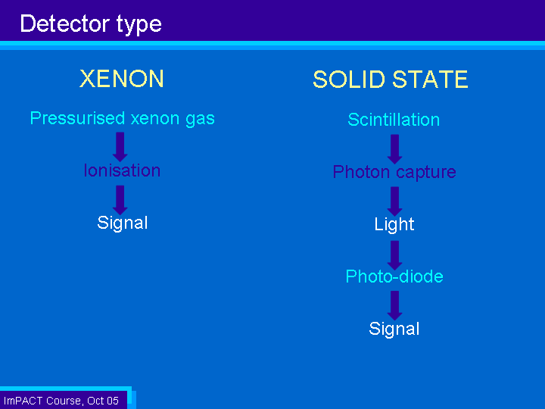
CT Detectors: Detector Type

Slide 27
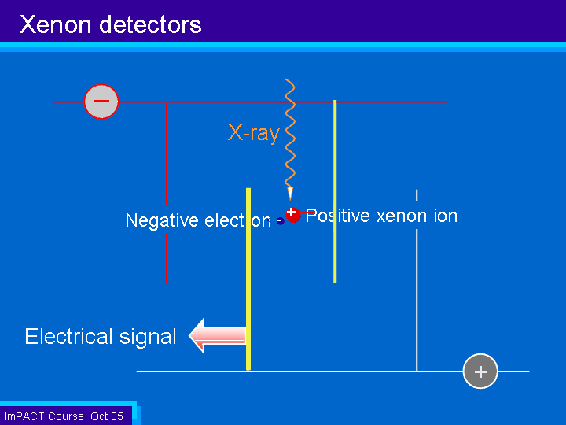
Xenon Detectors

Slide 28
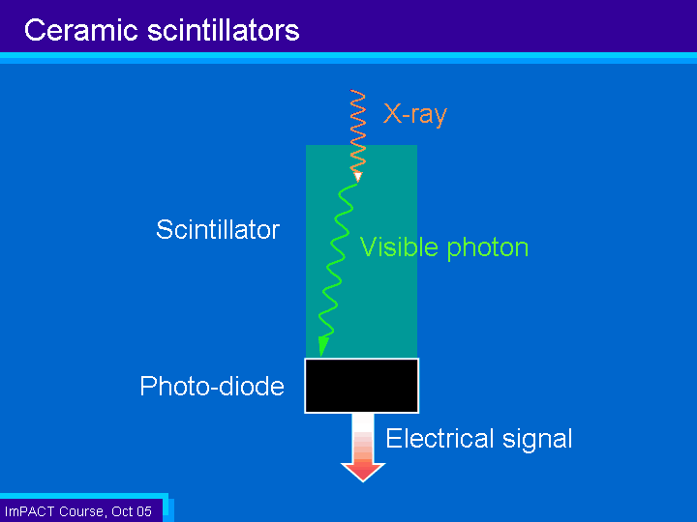
Ceramic Scintillators

Slide 29
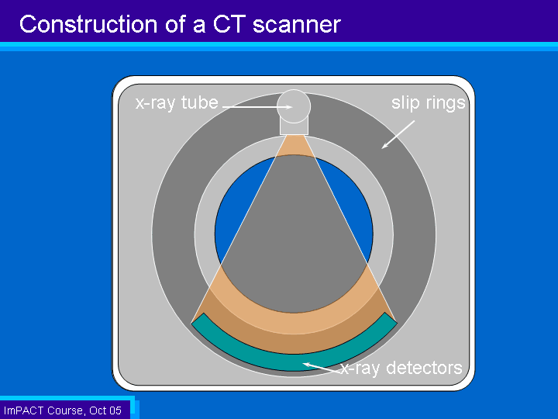
CT Scanner Construction: Gantry, Slip Ring, and Patient Table

Slide 30
Reconstruction of CT Images: Image Formation
REFERENCE DETECTOR
REFERENCE DETECTOR
ADC
PREPROCESSOR
COMPUTER
RAW DATA
PROCESSORS
BACK
PROJECTOR
CONVOLVED DATA
RECONSTRUCTED DATA
DISK
TAPE
DAC
CRT DISPLAY

Slide 31
The
Radon transformation
In a first-generation scanner, the source-detector track can rotate around the sample, as shown in Fig 1. We will denote the “x-axis” along which the assembly slides when the assembly is at angle φ by x_{φ} and the perpendicular axis by y_{φ}.
Clearly, we may relate our (x_{φ}, y_{φ}) coordinates to the coordinates in the un-rotated lab frame by [5]

Slide 32
Figure 2: Relationship between Real Space and Radon Space
Highlighted point on right shows where the value λ_{φ} (x_{φ}) created by passing the x-ray beam through the sample at angle φ and point x_{φ} is placed. Note that, as is conventional, the range of φ is [-π / 2, +π / 2], since the remaining values of φ simply duplicate this range in the ideal case.

Slide 33
Hence, the “projection signal” when the gantry is at angle φ is
[6]
We define the Radon transform as
[7]

Slide 34
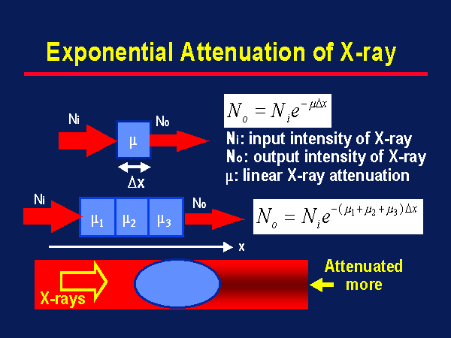
Attenuation
(x-ray intensity)

Slide 35
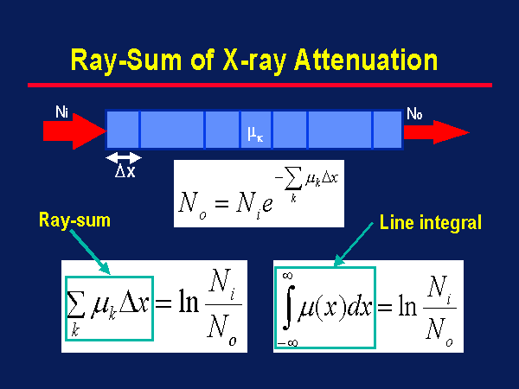
X-ray Attenuation
(cont’d)

Slide 36
Radon Space
We define a new “space”, called Radon space, in much the same way as one defines reciprocal domains in a 2-D Fourier transform. Radon space has two dimensions x_{φ} and φ . At the general point (x_{φ}, φ), we “store” the result of the projection λ_{φ}(x_{φ}).
Taking lots of projections at a complete range of x_{φ} and φ “fills” Radon space with data, in much the same way that we filled Fourier space with our 2-D MRI data.

Slide 37
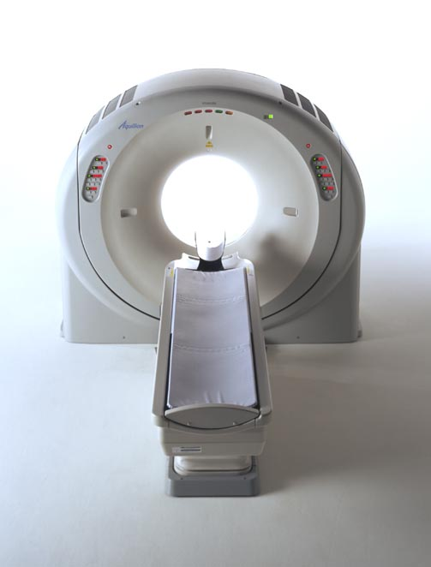
CT ‘X’ Axis
‘X’
Axis

Slide 38
CT ‘Y’ Axis
‘Y’
Axis

Slide 39
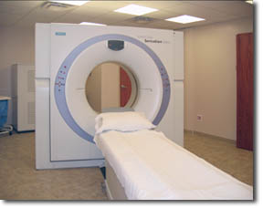
CT ‘Z’ Axis
‘Z’
Axis

Slide 40
CT Isocenter
ISOCENTER

Slide 41
Fig 3. Sinograms for sample consisting of a small number of isolated objects.
In this diagram, the full range of φ is [-π, +π ] is displayed.

Slide 42
Relationship between “real space” and Radon space
Consider how the sinogram for a sample consisting of a single point in real (image) space will manifest in Radon space.
For a given angle φ, all locations x_{φ} lead to λ_{φ}(x_{φ}) = 0, except the one coinciding with the projection that goes through point (x₀, y₀) in real space. From Equation 5, this will be the projection where x_{φ} = x₀ cos φ + y₀ sin φ.

Slide 43
Thus, all points in the Radon space corresponding to the single-point object are zero, except along the track
[8]
where R = (x² + y²)^{1/2} and φ₀ = tan⁻¹ ( y / x).
If we have a composite object, then the filled Radon space is simply the sum of all the individual points making up the object (i.e. multiple sinusoids, with different values of R and φ₀). See Fig 3 for an illustration of this.

Slide 44
Reconstruction of CT images (cont’d)
This is performed by a process known as back-projection, for which the procedure is as follows:
Consider one row of the sinogram, corresponding to angle φ. Note how in Fig 3, the value of the Radon transform λ_{φ}(x_{φ}) is represented by the grey level of the pixel. When we look at a single row (i.e., a 1-D set of data), we can draw this as a graph — see Fig 4(a). Fig 4(b) shows a typical set of such line profiles at different projection angles.

Slide 45
Fig 4a. Relationship of 1-D projection through the sample and row in sinogram

Slide 46
Fig 4b. Projections at different angles correspond to different rows of the sinogram

Slide 47
Fig 4c. Back-projection of sinogram rows to form an image. The high-intensity areas of image correspond to crossing points of all three back-projections of profiles.

Slide 48
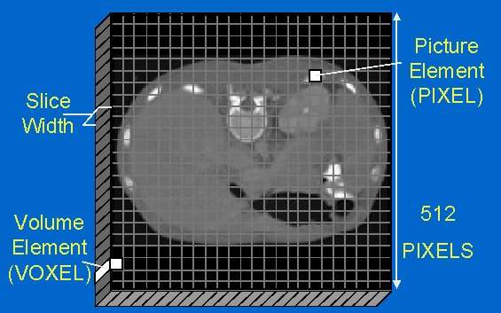
General Principles
of Image Reconstruction
Image Display - Pixels and voxels

Slide 49
PIXEL Size Dependencies:
MATRIX SIZE
FOV

Slide 50
PIXEL vs VOXEL
PIXEL
VOXEL

Slide 51
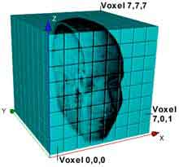
VOXEL Size Dependencies
FOV
MATRIX SIZE
SLICE THICKNESS

Slide 52

Pixel MATRIX

Slide 53
Reconstruction Concept
 |  | Ц
 |  | CT#
RECONSTRUCTION

Slide 54
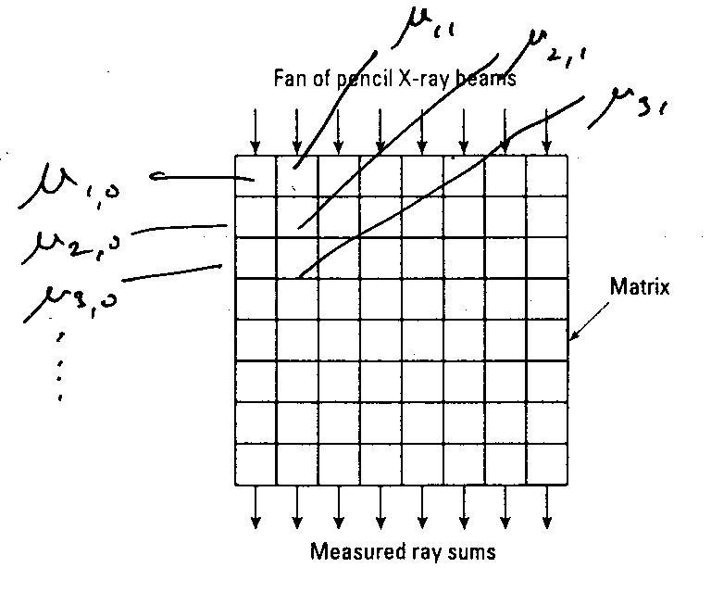
CT and corresponding pixels in image

Slide 55
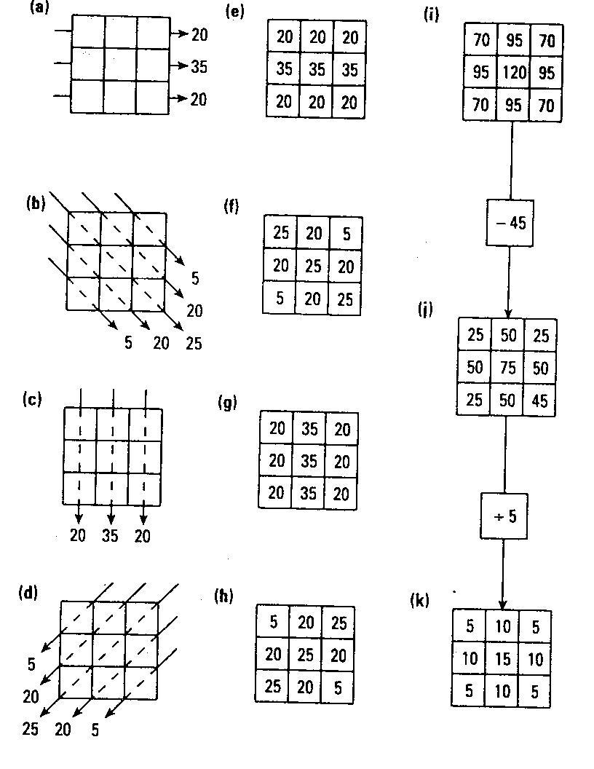
Simple numerical
example

Slide 56
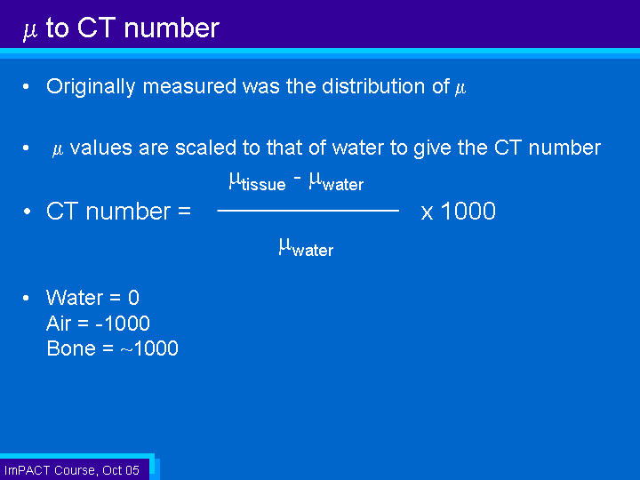
µ To CT number

Slide 57
CT Number Flexibility
We can change the appearance of the image by varying the window width (WW) and window level (WL)
This spreads a small range of CT numbers over a large range of grayscale values
This makes it easy to detect very small changes in CT number

Slide 58
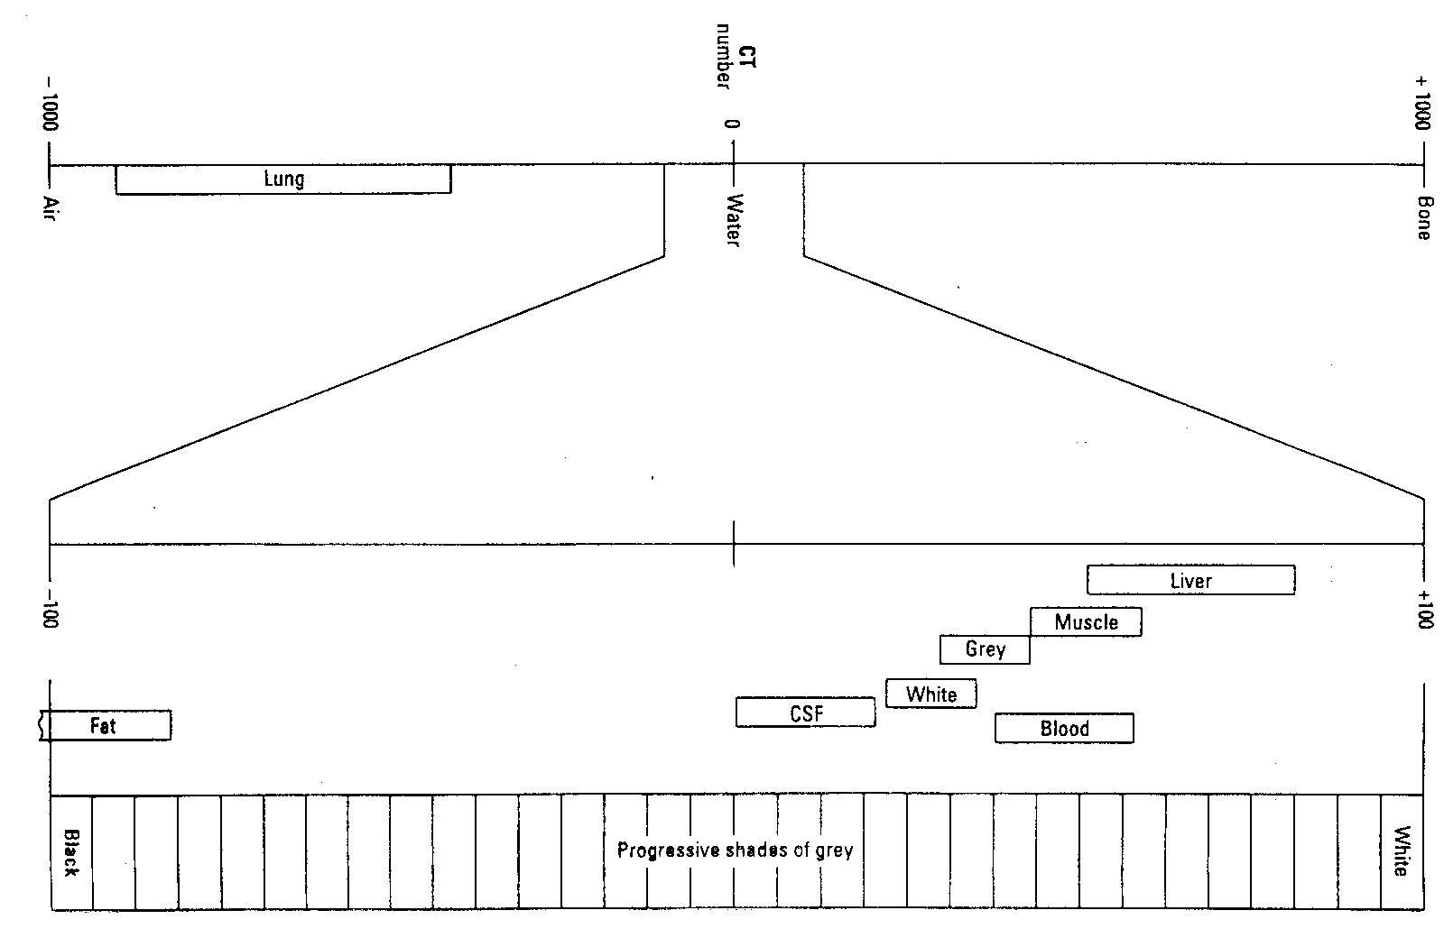
Windowing in CT

Slide 59
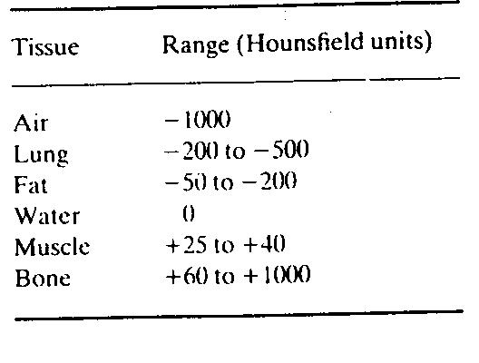
CT Numbers
Linear attenuation coefficient of each tissue pixel is compared with that of water:

Slide 60
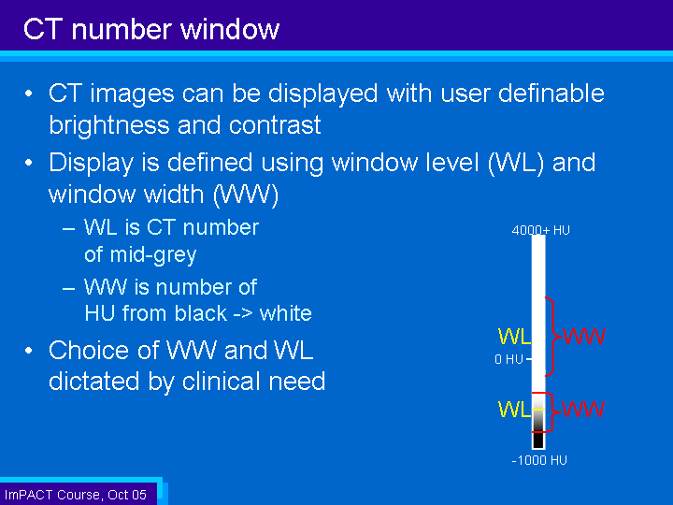
CT Number Window

Slide 61
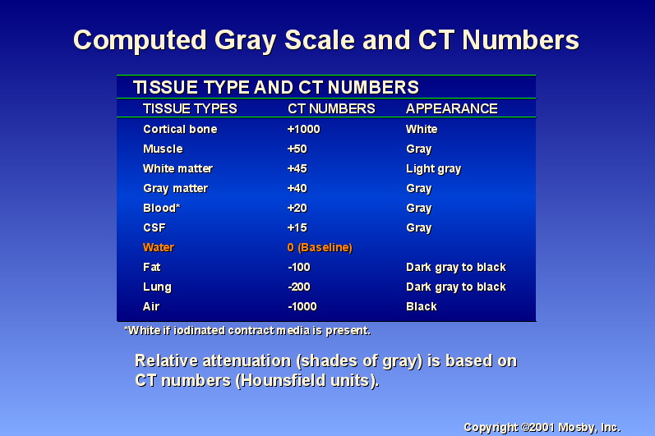

Slide 62
Example values of μ_{t}:
At 80 keV: μ_{bone} = 0.38 cm⁻¹
μ_{water} = 0.19 cm⁻¹
The multiplier 1000 ensures that the CT (or Hounsfield) numbers are whole numbers.

Slide 63
Linear Attenuation Coefficient ( cm⁻¹)
BONE 0.528
BLOOD 0.208
G. MATTER 0.212
W. MATTER 0.213
CSF 0.207
WATER 0.206
FAT 0.185
AIR 0.0004

Slide 64
CT # versus
Brightness Level
+ 1000
-1000

Slide 65
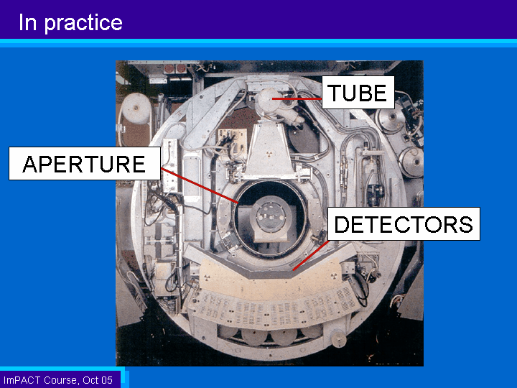
CT in practice

Slide 66
SCAN Field Of View (FOV) Resolution
SFOV

Slide 67
Display FOV versus
Scanning FOV
DFOV CAN BE EQUAL OR LESS OF SFOV
SFOV – AREA OF MEASUREMENT DURING SCAN
DFOV - DISPLAYED IMAGE

Slide 68
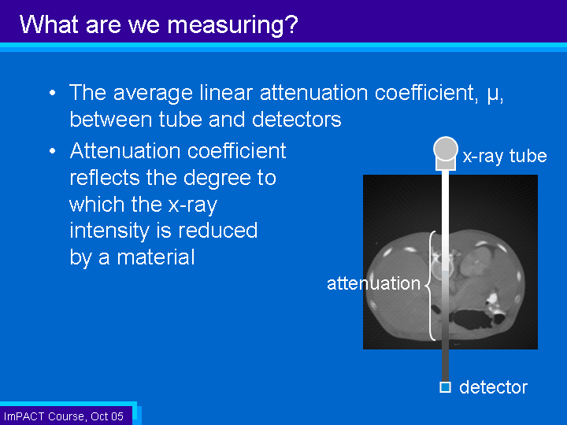
Image Quality in CT

Slide 69
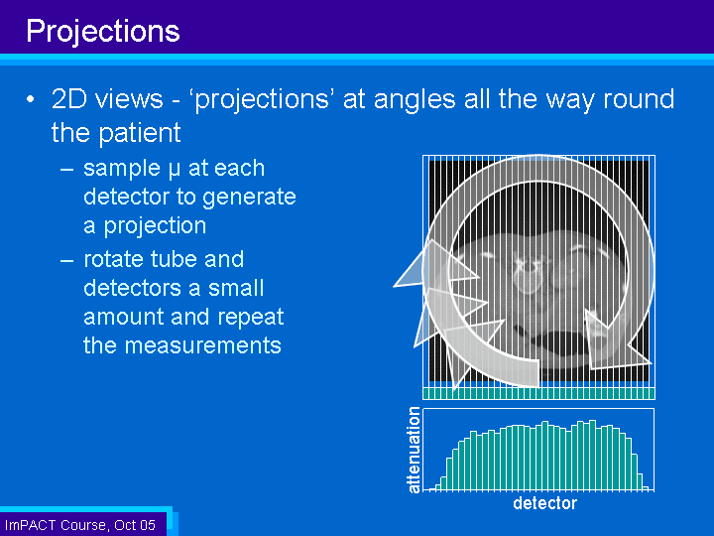
Projections

Slide 70
Back Projection
Reverse the process of measurement of projection data to reconstruct an image
Each projection is ‘smeared’ back across the reconstructed image

Slide 71
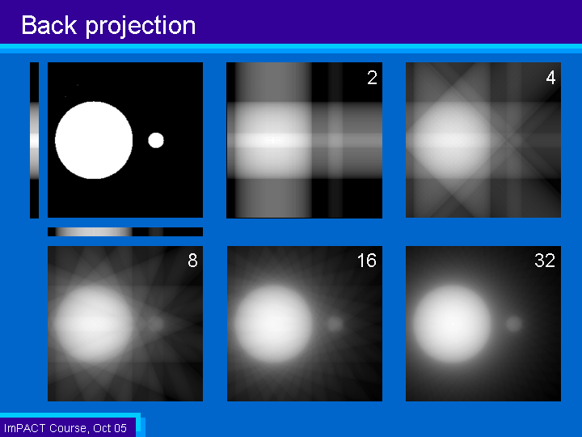
Back Projection

Slide 72
Filtered Back Projection
Back projection produces blurred trans-axial images
Projection data needs to be filtered before reconstruction
Different filters can be applied for different diagnostic purposes
  Smoother filters for viewing soft tissue
  Sharp filters for high resolution imaging
Back projection process same as before

Slide 73
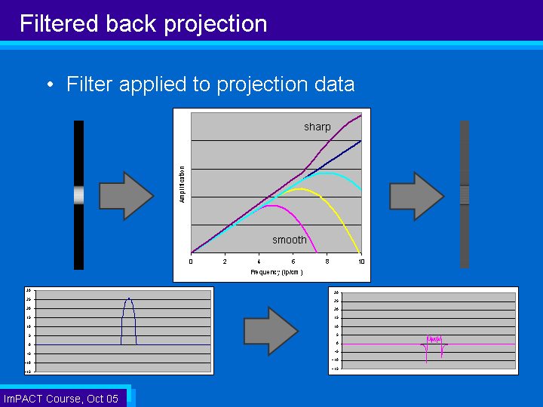
Filtered Back Projection

Slide 74
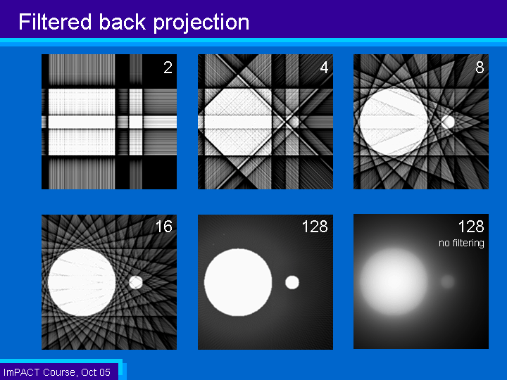
Filtered Back Projection

Slide 75
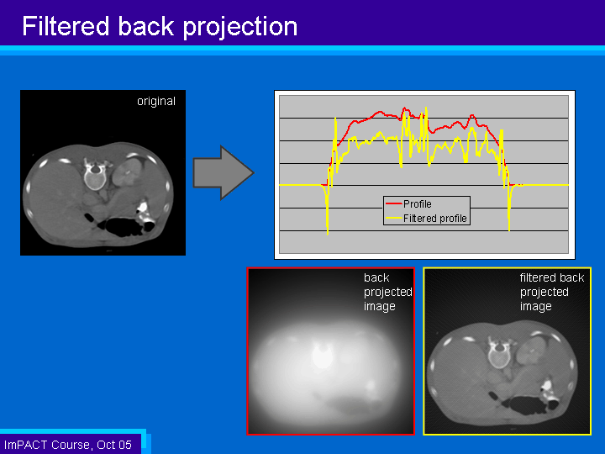
Filtered Back Projection

Slide 76
Summary and Key Points
A tomogram is an image of a cross-sectional plane or slice within or through the body
X-Ray computed tomography (CT) produces tomograms of the distribution of linear attenuation coefficients, expressed in Hounsfield units.
There are currently 7 generations of CT scanner design, which depend on the relation between the x-ray source and detectors, and the extent and motion of the detectors (and patient bed).
The basic imaging equation is identical to that for projection radiography; the difference is that the ensemble or projections is used to reconstruct cross-sectional images.
The most common reconstruction algorithm is filtered back projection, which arises from the projection slice theorem.
In practice, the reconstruction algorithm must consider the geometry of the scanner–parallel-beam, fan-beam,helical-scan, or cone-beam.
As in projection radiography, noise limits an image’s signal to noise ratio.
Other artifacts include aliasing , beam hardening, and – as in projection radiography – inclusion of the Compton scattered photons.

Slide 77
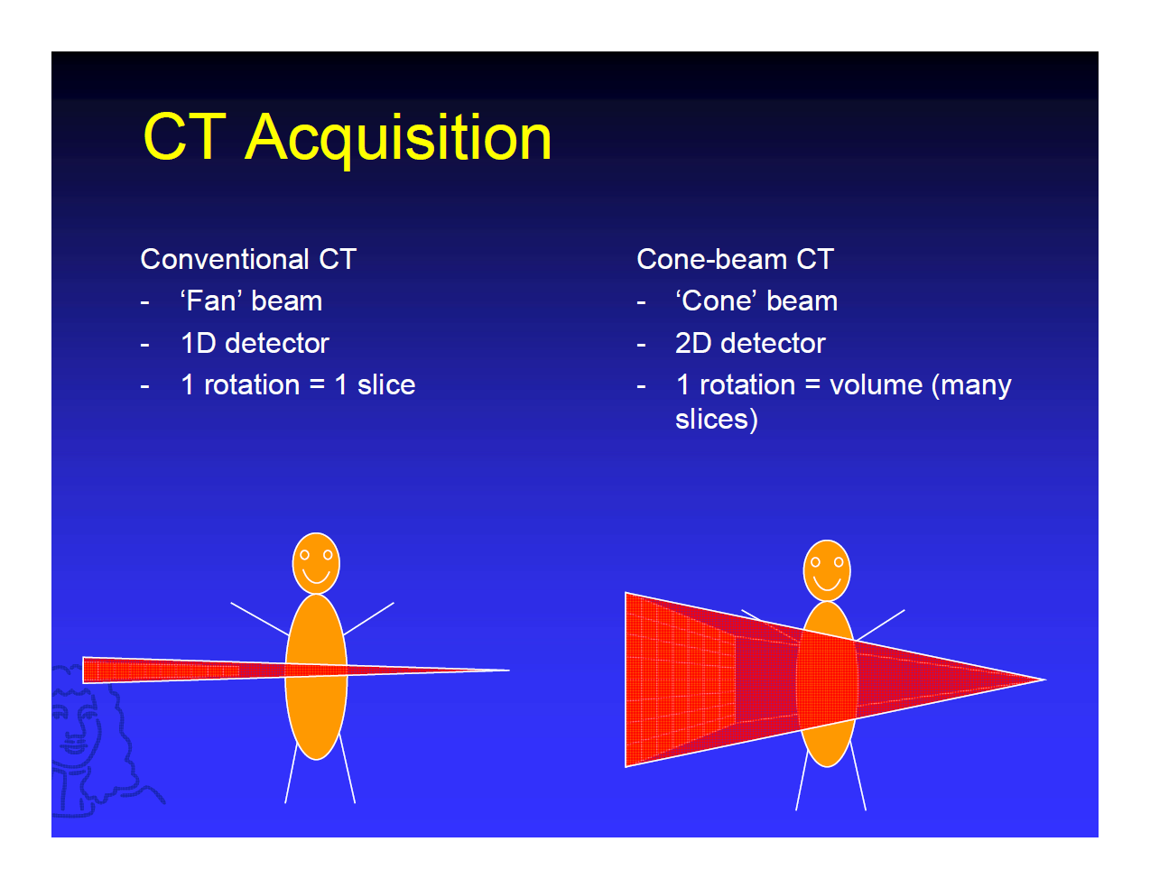
Cone Beam CT: Introduction

Slide 78
CT Basic Principle
Point 1: Purpose of CT and Basic principle
Point 2: The internal structure of an object can be reconstructed from multiple projections of the object
Point 3: Computerized Tomography, or CT is the preferred current technology

Slide 79
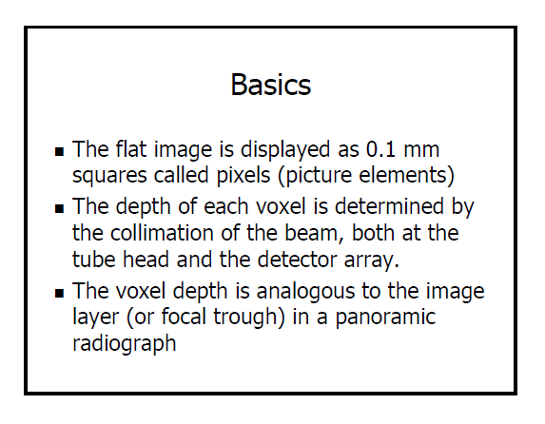
The Basics

Slide 80
Current Cone Beam Systems

Slide 81
Cone Beam Reconstruction

Slide 82
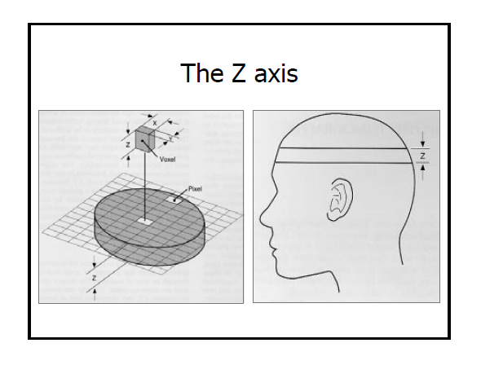
The ‘Z’ Axis

Slide 83
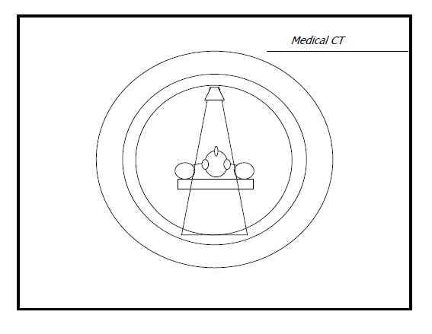
Medical CT Vs.
Cone Beam CT

Slide 84
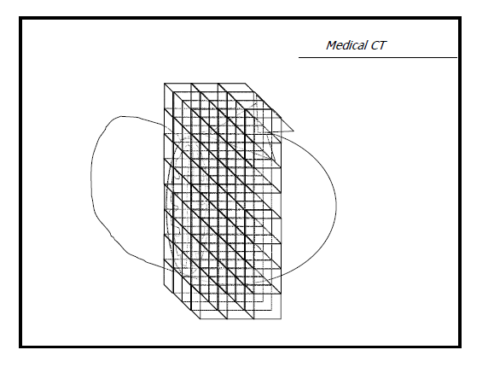
Medical CT Example

Slide 85
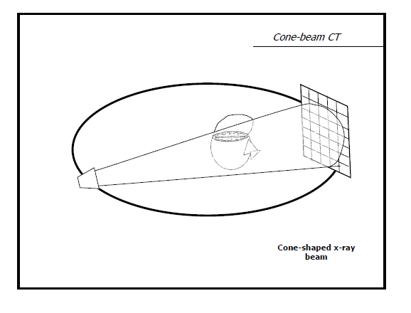
Cone Beam CT Example

Slide 86
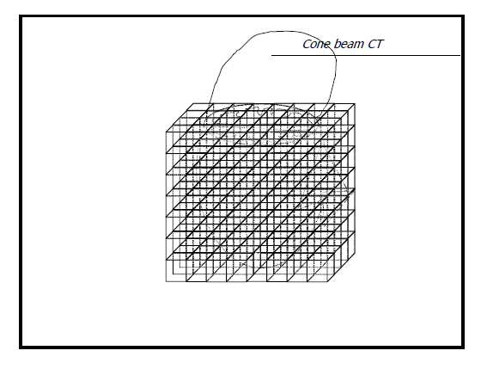
Cone Beam CT example

Slide 87

CBCT Advantages over Medical CT

Slide 88
References
University of Surrey: PH3-MI (Medical Imaging): David Bradley Office 18BC04 Extension 3771
Physical Principles of Computed Tomography
Basic Principles of CT Scanning: ImPACT Course October 2005

