Slide 1
Bi-clustering for Gene Expression Analysis with Micro-array
Alternate names in diverse areas: 2-mode clustering, coclustering, bidimensional clustering, and subspace clustering.

Slide 2
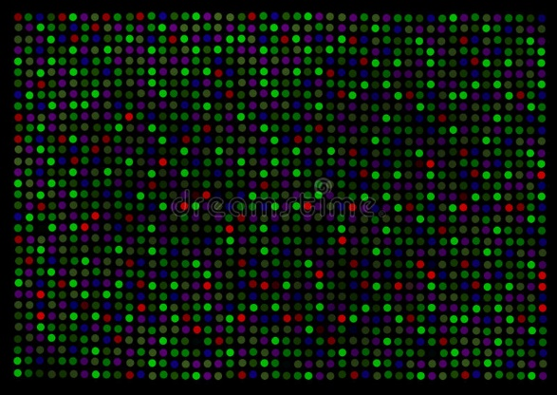
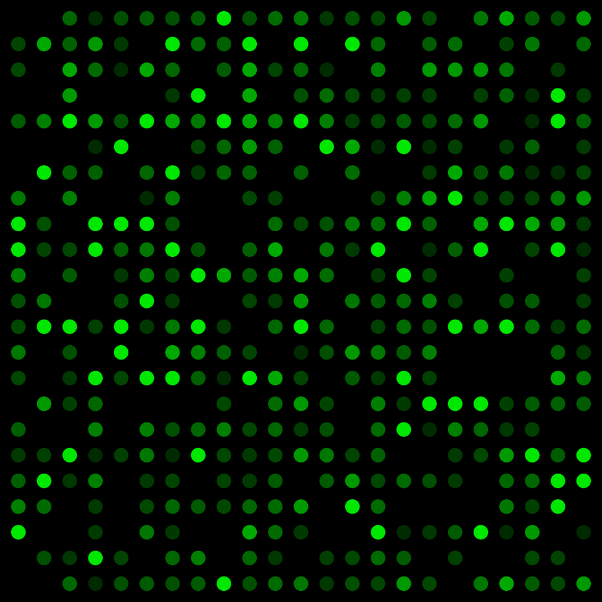
Gene Expressions on microarrays:

Slide 3
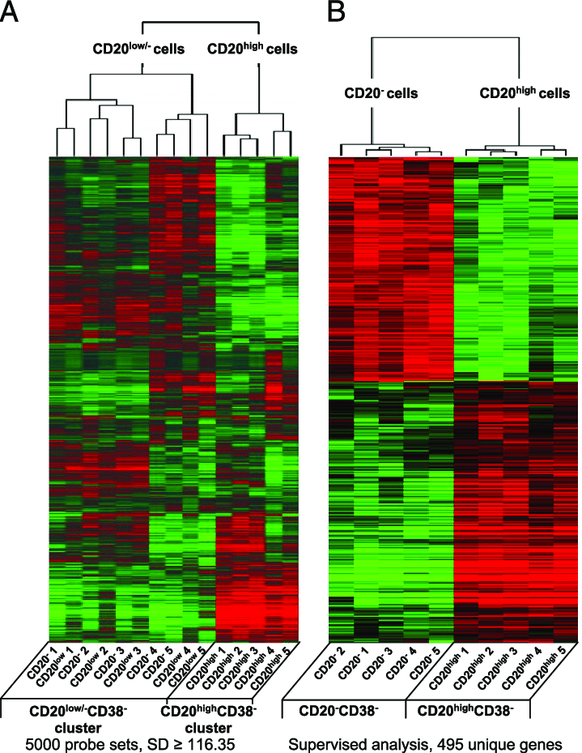
Bi-clustering:

Slide 4
Bi-clustering output:
Bicluster with constant values TRIVIAL
2.0 2.0 2.0 2.0 2.0
2.0 2.0 2.0 2.0 2.0
2.0 2.0 2.0 2.0 2.0
2.0 2.0 2.0 2.0 2.0
2.0 2.0 2.0 2.0 2.0
b) Bicluster with constant values on rows
1.0 1.0 1.0 1.0 1.0
2.0 2.0 2.0 2.0 2.0
3.0 3.0 3.0 3.0 3.0
4.0 4.0 4.0 4.0 4.0
5.0 5.0 5.0 5.0 5.0
c) Bicluster with constant values on columns
1.0 2.0 3.0 4.0 5.0
1.0 2.0 3.0 4.0 5.0
1.0 2.0 3.0 4.0 5.0
1.0 2.0 3.0 4.0 5.0
1.0 2.0 3.0 4.0 5.0
d) Bicluster with coherent values (additive)
1.0 4.0 5.0 0.0 1.5
4.0 7.0 8.0 3.0 4.5
3.0 6.0 7.0 2.0 3.5
5.0 8.0 9.0 4.0 5.5
2.0 5.0 6.0 1.0 2.5
e) Bicluster with coherent values (multiplicative)
1.0 0.5 2.0 0.2 0.8
2.0 1.0 4.0 0.4 1.6
3.0 1.5 6.0 0.6 2.4
4.0 2.0 8.0 0.8 3.2
5.0 2.5 10.0 1.0 4.0

Slide 5
Three key elements in machine learning:
Representation: Space in which data are located (distance measure)
Problem formulation: The “objective function” or error function between model and raw distances
Solving technique: Optimization algorithm

Slide 6
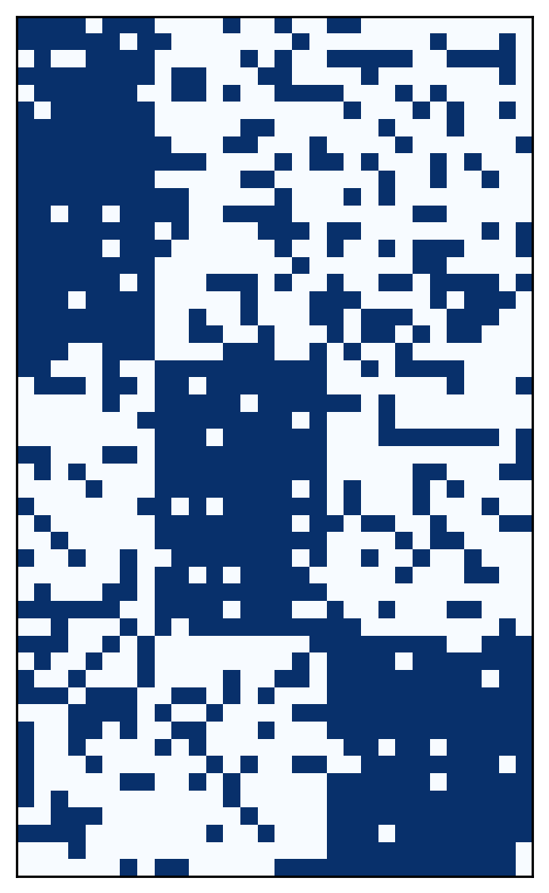
A Bi-clustering example:
Fifty guests
Thirty music albums
Divide them in three rooms
http://www.kemaleren.com/post/an-introduction-to-biclustering/

Slide 7
A Bi-clustering example:
Input matrix M, Boolean choices of albums, 50x30 ➔
Objective function to minimize
k =3 clusters / rooms, i row index, c column index
b, …later
r, c: row sums and column sums, as diagonal matrices

Slide 8
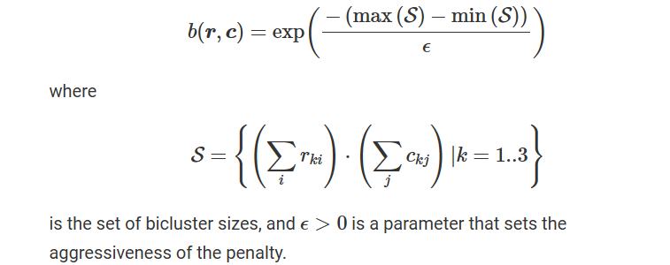
A Bi-clustering example:
Input matrix M, Boolean choices of albums, 50x30 ➔
Objective function to minimize
b is a penalty for unbalanced cluster sizes

Slide 9
A Bi-clustering example:
Input matrix M, Boolean choices of albums, 50x30 ➔
Objective function to minimize, s(M, r, c)
Optimization: M^ = argmin_{M} s(M, r, c)
Algorithm: your choice, e.g., exhaustive trial-error: 3⁸⁰ possibilities

Slide 10
A Bi-clustering example:
Input matrix M, Boolean choices of albums, 50x30
Objective function to minimize, s(M, r, c)
Optimization: M^ = argmin_{M} s(M, r, c)
Algorithm:
iterative, approximate, stochastic:
Simulated Annealing, Output ➔
Not everybody is happy,
But an “optimized” output

