Slide 1
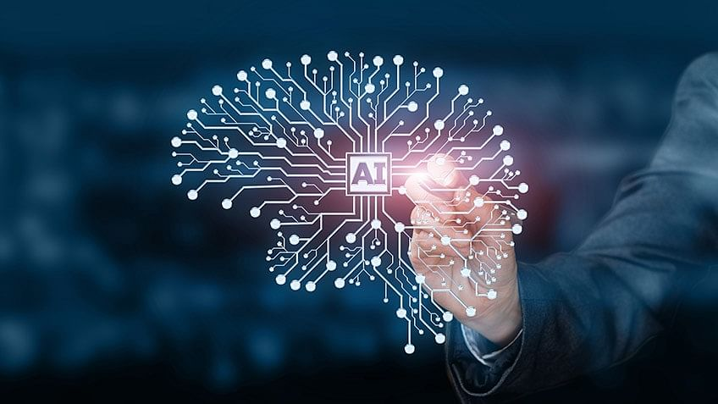
Artificial Intelligence Fall 2023 Florida Tech

Slide 2
Artificial Intelligence (AI) An introduction
What is AI?
What happened within AI, history?
Going deeper: What really is AI?

Slide 3
Introduction to AI: What is AI?
AI <IS> Computer Science!
Whatever is at the FRONTIER of computer science.
It is really about NEW challenges
that CURRENTLY appears “beyond” computing
Chasing elusive goals!

Slide 4
As soon as “it” is achieved –
“it” is no longer AI!
AI is more about a perception!
However, a pattern of topics,
problems and algorithms emerged/ emerges
as we pursue the dream of AI

Slide 5
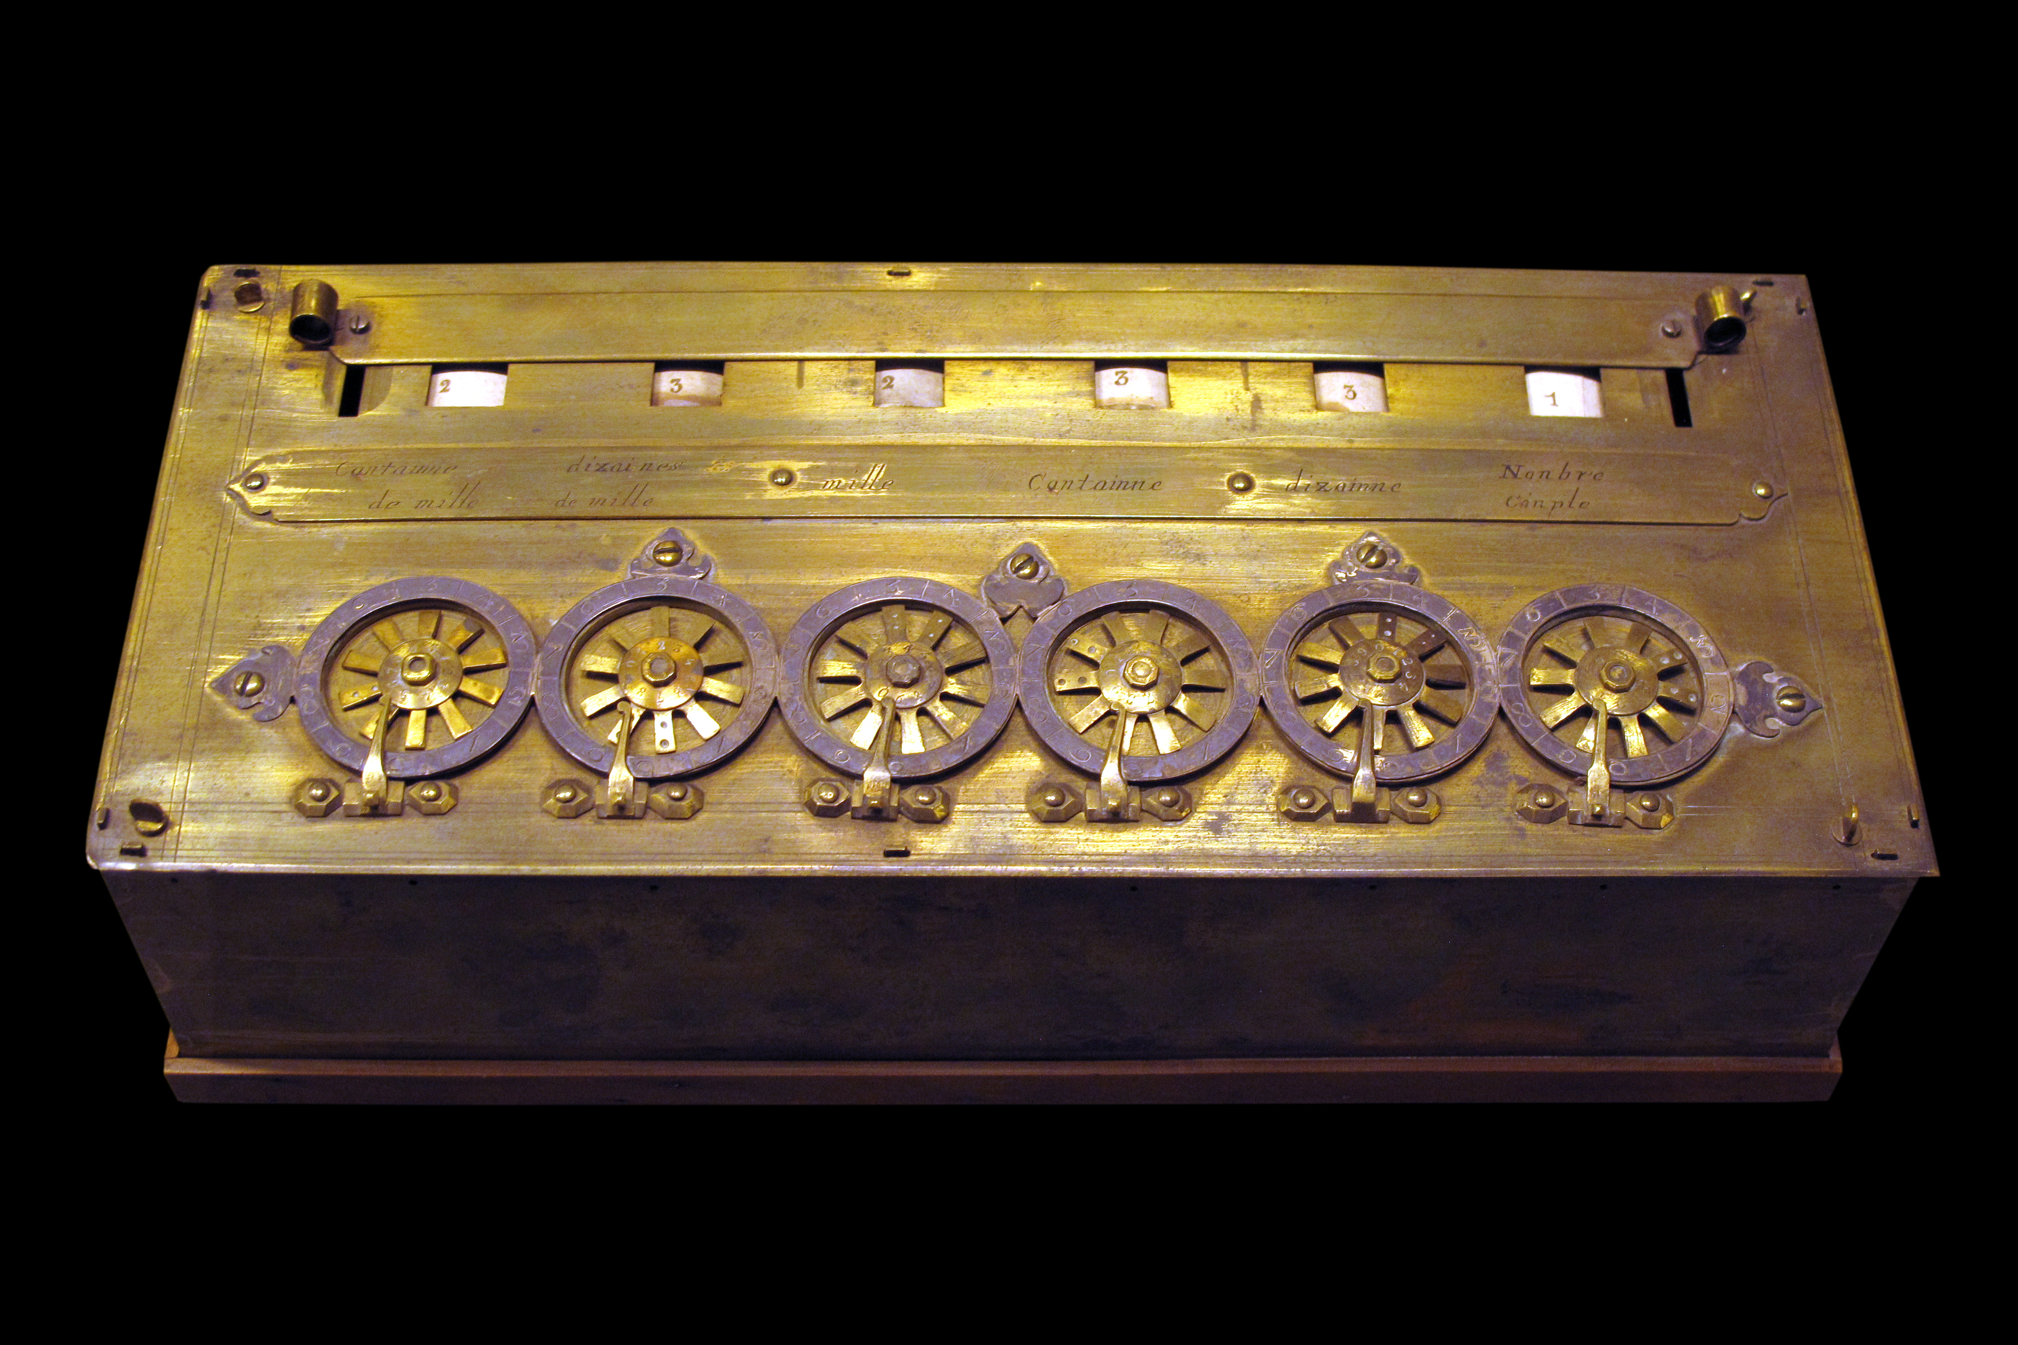
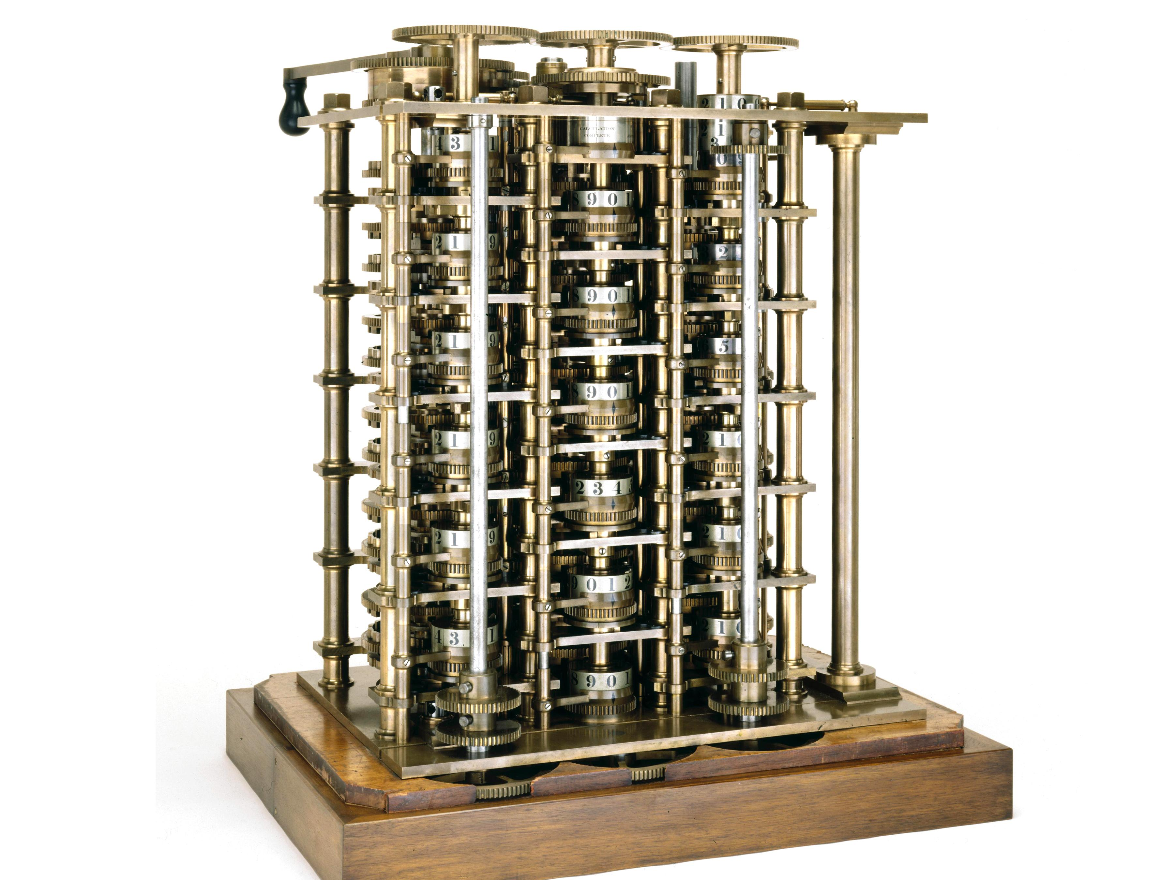
Introduction to AI: A Historical Journey
Early Computers = Calculator + Stored program
Pascal’s calculator (1642)
Charles Babbage’s machine (1837)
Lady Ada – first programmer

Slide 6
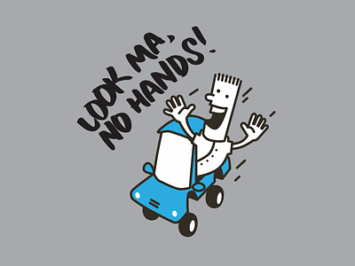
Introduction to AI: A Historical Journey
The Dream: Neuron model 1943, Turing thesis 1950
FIRST AI “SUMMER”
“Look Ma, No Hands” romanticism! 1952-69
Samuel’s checkers program: game playing
Newell-Simon’s Logic Theorist: proving math theorems
Geltner’s Geometry Engine: geometry theorems
“AI” the term: 1956 Dartmouth meeting

Slide 7
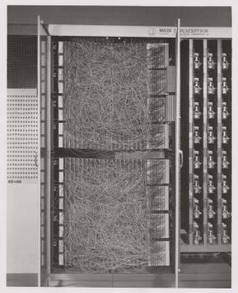
Introduction to AI: A Historical Journey
McCulloch and Pitts, 1943, Neural Model
based on visual cortex microscopy
Mark I, analog perceptron machine,
1958 by Rosenblatt at Cornell.

Slide 8
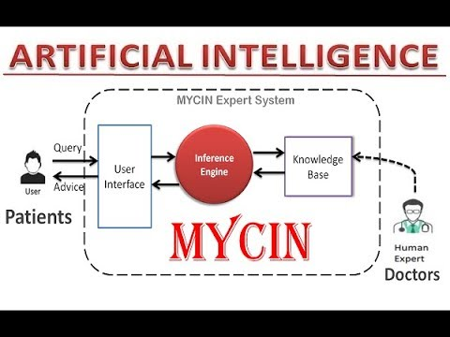
Introduction to AI: A Historical Journey
SECOND AI SUMMER
Knowledge is power: Knowledge-based Systems, 1960-80
Mycin, Dendral, and other expert systems
Expert systems boom, 1980-90
Fifth generation computing system (Japan), MCC (US), …

Slide 9
Introduction to AI: Journey continues
Challenges catche up, 1985-2000
Smaller niche areas flourish, e.g., Planning, …
Integrate: Agent view (our text)
Large knowledge bases, 1990-2000
MCC Cyc project / later IBM’s Watson
DARPA / SRI International /later Apple’s Siri
Data to Intelligence
Machine learning
Handwriting recognition, Speech recognition, by HMM 2000-10
“Smart-X” 2010-15
“Big data” 2013-2017
Neural net resurgence as “Deep learning”, 2015-present, GPU-fueled

Slide 10
Introduction to AI: Journey continues
THIRD AI SUMMER
Artificial Neural Network (ANN) Goes underground
Minsky-Papert, 1971, ANN cannot model XOR
But, multi-layer perceptrons can…
ANN best works: 1980+
GPU computing arrives for graphics: 1990s
ANN+ GPU a natural match: Deep ANN, 2010+
Convolutional Neural Net for object recognition
Exotic Generative model for images, borrows from Adversarial Search
Generative Language Model
Faking becomes major concern, PERVASIVE AI, 2017+

Slide 11
AI
ML
ANN
Deep Generative AI

Slide 12
Introduction to AI: What really is it?
Computers manipulate numbers (hardware)
Computers can map symbols internally to numbers (Unicode)
First AI question: Can programs manipulate symbols?
Symbolic AI: Expert systems, LISP, …
Second AI question: Is symbol manipulation enough?
No! Human intelligence is not just symbol manipulation
Symbol System is not efficient either, as was thought of initially
Third AI question: Should we go back to number crunching?
Optimization: Machine learning
…
Future of AI: Numbers + Symbols!
Data types: Real→Ordinal→Partial order→Categorical

Slide 13
Introduction to AI: Course content
<<It is all algorithms, dummy!>>
No “Intelligence!”
Because there is no clear definition of intelligence
Search Algorithms
Automated Reasoning
Probabilistic Reasoning
Machine Learning
Exam 1
Project
Exam 2
Exam 3
Exam 4
Final

Slide 14
Introduction to AI: Course content: Samples
Search Algorithms
Blind search
Guided search
Adversarial Search
Constraint Reasoning
Constraint Satisfaction algorithms
Consistency maintenance algorithm
Knowledge Representation and Automated Reasoning
Propositional logic
First order logic

Slide 15
Introduction to AI: Course content: Samples
Probabilistic Reasoning
Probabilistic knowledge representation
Bayesian network
Fuzzy and other uncertainty models
Machine Learning
Decision tree
Supervised training with samples – classification and regression
Neural networks
Unsupervised learning

