Slide 1
Number Theory
Presented by
Shrividya Shivkumar and George Frederick

Slide 2
Contents
Division Theorem
Modular Exponential
Prime Numbers
Fermat’s Little Theorem
Miller-Rabin
Primes Is In P
Relatively Prime numbers
Euclid’s algorithm
Extended Euclid algorithm
Chinese Remainder Theorem
RSA
Pollard’s Rho

Slide 3
Division theorem
For any integer a and a positive integer n
there are unique integers q and r such that 0 ≤ r < n and
a = qn + r
or
a = n + ( a mod n)
If (a mod n) = (b mod n) then
a is equivalent to b
a b (mod n)
Ex : 61 6 (mod 11)

Slide 4
Properties of modular addition and multiplication:
Let a a’ (mod n)
b b’ (mod n) then
a + b ( a’ + b’)( mod n)
ab (a’b’) (mod n)
Properties of common divisors:
If d | a and d | b d | (a + b)
If d | a and d | b d | ( a – b)
If d | a and d | b d | (ax + by)

Slide 5
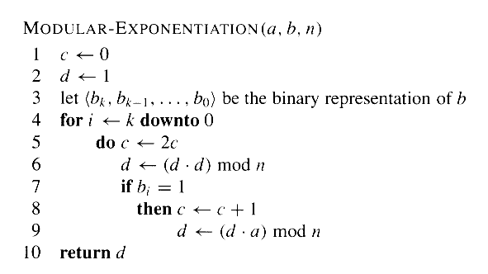
Modular Exponential
Gives an efficient way to calculate

Slide 6
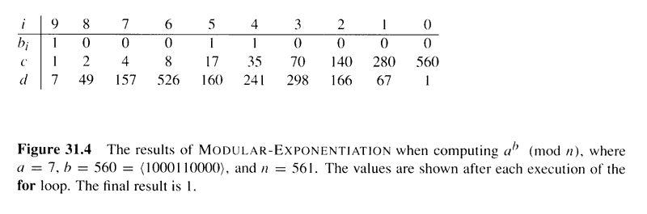
Modular Exponential

Slide 7
What are prime numbers?
An integer having only trivial divisors
( 1 and itself)
Ex : 2 , 3 , 5 , 7 , 11 ….
What are relative Prime Numbers ?
Numbers whose only common factor is 1 or the gcd(a,b) = 1.
Ex: 6 and 35 are relatively prime (gcd = 1)
Ways to Check If a number is prime :
1.Trial division
2.Fermat’s Little theorem
3.Miller Rabin primality test

Slide 8
Finding Prime numbers
Trial division – testing for divisibility of each integer starting from 2 … sqrt(n)
Even integers greater than 2 can be skipped.
Worst case complexity : O (sqrt(n))

Slide 9
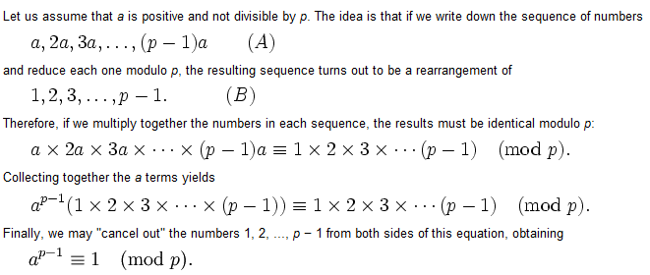
Fermat’s Little Theorem

Slide 10
Fermat’s Little Theorem
Disadvantages:
Does not work with Carmichael numbers.
Carmichael numbers - a Carmichael number is a composite positive integer n which satisfies the congruence
for all integers b which are relatively prime to n .
Ex : 561 = 11 * 3 * 17

Slide 11
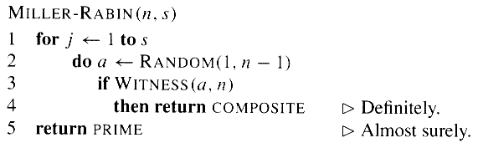
How to check if a number is prime?
Use the Miller-Rabin test
Uses several randomly chosen base values

Slide 12
Miller-Rabin Test contd…
Witness(a,n)
b(k),b(k-1)….b(0) .. Binary representation of n-1
D ← 1
For I ← k to 0
  Do x ← d
        D ← (d.d)mod(n)
        if d = 1 and (x not equal 1) and (x not equal n-1)
        return true
        if b(i) = 1
        d ← (d.a)mod n
        If ( d not equal 1)
        return TRUE
        Return FALSE

Slide 13
PRIMES is in P
Authored by Manindra Agrawal, Neeraj Kayal, and Nitin Saxena
Won the 2006 Gödel Prize
Produced an unconditional deterministic polynomial-time algorithm that determines whether an input number is prime or composite
Previous efforts were all conditional, randomized, or had exponential running times

Slide 14
PRIMES is in P
As with most primality tests, is based on Fermat’s Little Theorem (actually a generalization of)
Fermat’s Little Theorem: For any integer :
Generalization:
Let and . Then
is prime iff

Slide 15
What is a greatest common divisor?
The largest common divisor of a and b
      1 < = gcd( a,b) <= min ( |a| , | b|)

Slide 16

Euler’s Phi Function
The number of positive integers less than equal to n that are relatively prime to n
      where,
        P → Number of primes dividing n.
        Ex: if n = 45
        phi(45) = 45 ( 1-(1/3))(1-(1/5))
                = 24

Slide 17
Euler’s Phi Function
When p is prime, then
    Ø(p) = {1 , 2 , 3 , …., p-1} = p-1
    When n is composite
    Ø(n) < (n-1)

Slide 18
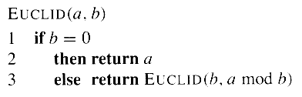
Euclid’s Algorithm for calculating gcd

Slide 19
What is Multiplicative inverse?
Multiplicative inverse is nothing but the reciprocal of the number.
How to calculate Multiplicative inverse?
Using Extended Euclid’s algorithm

Slide 20
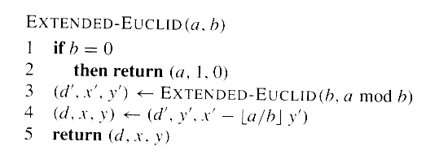
Extended Euclid’s algorithm
d = gcd ( a,b) = ax + by
i/p : random pair of integer a,b
o/p : triplet (d,x,y) which satisfies the above eqn.

Slide 21
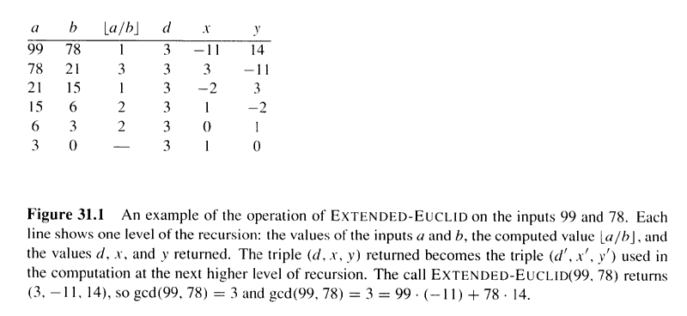
Extended Euclid’s algorithm

Slide 22
Multiplicative inverse using extended Euclid’s algorithm
Multiplicative inverse is nothing but the reciprocal of the number.
If 2 numbers a,n are relatively prime then
gcd ( a,n) = 1
→ ax + ny = 1
→ ax = 1(mod n)
→ x = inv(a) mod n
Where,
a and n are the inputs and x, y, and gcd(a,n) are the outputs for Extended Euclid’s algorithm

Slide 23
Chinese Remainder Theorem
Original form created by Chinese mathematician Sun Tzu
Relates to finding solutions to simultaneous congruences
i.e.
(m and s are relatively prime)

Slide 24
Chinese Remainder Theorem
Let where each is pairwise relatively coprime
Let denote the set of all integers,
,
ex. ,
Consider the correspondence , where and for

Slide 25
Chinese Remainder Theorem
Then, mapping is a one-to-one correspondence (bijection) between and the Cartesian product
If and then

Slide 26
CRT Example

Slide 27
CRT Proof
Transforming between the two representations is fairly straightforward
Going from requires only k divisions i.e. performing
for each

Slide 28
CRT Proof
Going from is somewhat more complicated
Begin by defining for and thus is the product of all other than
Next define for

Slide 29
CRT Proof
is always well defined
  Since and are relatively prime, guarantees that exists
Finally, can be computed as a function of as such:
This ensures that for

Slide 30
CRT Proof
If then , implying that
Also from
Thus we have the correspondence , a vector with all 0’s except for in the coordinate, which has a
Thus the form a sort of basis for the representation

Slide 31
CRT Proof
Therefore, for each we have
This produces a result that satisfies the constraints for
The correspondence is one-to-one, since we can transform in both directions

Slide 32
CRT Corollary 1
If are pairwise relatively prime and , then for any integers , the set of simultaneous equations for has a unique solution modulo for some unknown

Slide 33
CRT Corollary 2
If are pairwise relatively prime and , then for all integers and , for if and only if
Therefore we can work modulo by working modulo directly or by using separate modulo computations

Slide 34
CRT Corollary 2 Proof
Theorem
Proof

Slide 35
RSA - Introduction
Named after its creators Ron Rivest, Adi Shamir, and Leonard Adleman from MIT
Public-key cryptosystem
Relies on dramatic difference between ease of finding large prime numbers and difficulty of factoring the products of large primes

Slide 36
RSA – Public-Key Cryptosystems
Each participant has a public and a secret key
In RSA, each key is a pair of integers
For example, Alice’s and Bob’s keys can be denoted , and , respectively
Participants create their own keys, keeping the secret key secret while the public key can be published

Slide 37
RSA – Public-Key Cryptosystems
Encrypting a message with the recipient’s public key will ensure that only the recipient will be able to decode it, using his/her secret key
Additionally, a public-key cryptosystem allows for the use of unforgeable digital signatures, ensuring the integrity of the message as well as the identity of the sender

Slide 38
RSA – Public-Key Cryptosystems
The public and secret keys are used as functions that can be applied to messages
Let denote the set of allowable messages, e.g. the set of finite-length bit sequences
We require that the public and secret keys specify one-to-one functions from to itself.

Slide 39
RSA – Public-Key Cryptosystems
Alice’s public key function is denoted and her private key as
We assume that and are efficiently computable given their corresponding keys or
A participant’s public and secret key functions work as inverses of each other: for any message

Slide 40
RSA – Public-Key Cryptosystems
It is imperative that only Alice be able to efficiently compute in a practical amount of time, as it ensures Alice’s uniqueness and identity
The difficulty is that is the public inverse to , but the means to compute from should be impractical to determine

Slide 41
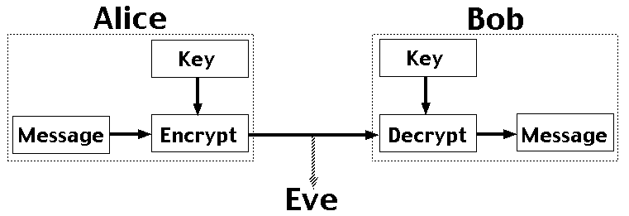
Non-Public-Key Cryptosystems

Slide 42
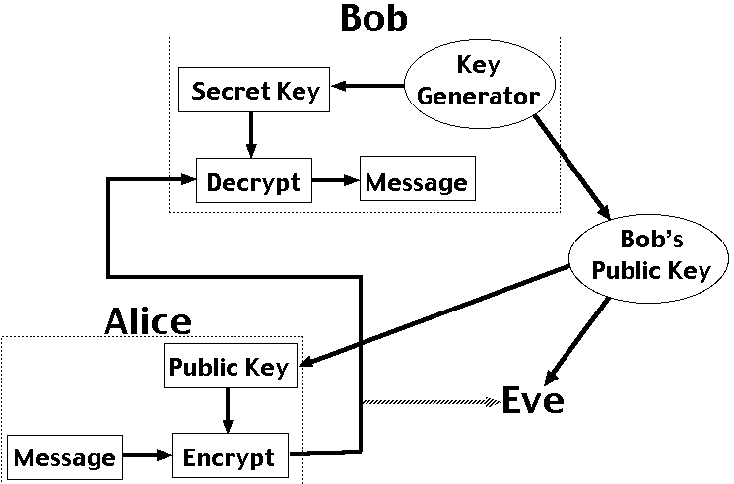
Public-Key Cryptosystems

Slide 43
RSA – Scenario 1
Bob wants to send a secret message to Alice
Bob obtains Alice’s public key either directly from Alice or from a public source
Bob computes the cyphertext and then sends to Alice
Alice receives and decrypts it with to get the original message:

Slide 44
RSA – Scenario 2
Alice wants to send a public digitally signed message to Bob
Alice computes her digital signature for using :
Alice sends the message/signature pair to Bob
Bob receives and uses the equation to verify that the message and signature are from Alice and have not been corrupted or forged

Slide 45
RSA – Scenario 3
Alice wants to send a secret digitally signed message to Bob
Alice computes her digital signature as in Scenario 2 and appends it to
Alice then encrypts with : and sends to Bob
Bob receives and decrypts it:
Bob then uses the equation to perform the same verification as in Scenario 2

Slide 46
RSA - Algorithm
Participants create their own public and secret keys as follows
Randomly selects two large primes and such that
Compute
Select a small odd integer relatively prime to , which by , equals
Compute as the multiplicative inverse of , modulo

Slide 47
RSA - Algorithm
Publish the pair as the participant’s public key
Keep the pair private as the participant’s secret key

Slide 48
RSA - Algorithm
For this scheme, the domain is the set
Encrypting a message is performed as with the equation
Decrypting a message is performed using the equation
Signing a message is done by using the equation
Verifying a signature is done by using the equation

Slide 49
RSA Example

Slide 50
RSA – Correctness Theorem
Theorem (Correctness of RSA): and define inverse transformations of satisfying equations and

Slide 51
RSA - Proof
From and , we have that for any ,
Since and are multiplicative inverses modulo , for some integer
Then if , we have

Slide 52
RSA - Proof
Also, if
Therefore, for all and similarly for all
Thus according to CRT for all

Slide 53
RSA - Decryption
Relies mainly upon the difficulty of factoring large integers
If an interceptor can factor the modulus in a public key, he can derive the secret key using knowledge of and in the same way as the keys’ creator used them
The statement that if factoring large integers is hard then breaking RSA is hard is unproven, but 20 years of research has found no easier method

Slide 54
Pollard’s Rho
Factoring large integers is currently computationally infeasible
Pollard’s rho is a useful tool for factoring large integers however
Pollard’s rho is a heuristic, not an algorithm, meaning its running time and success are not guaranteed
Very effective in practice though

Slide 55
Pollard’s Rho
Pollard-Rho(n)
i= 1
x₁= random(0,n-1)
y= x₁
k= 2
while TRUE
do i= i+1
x_{i}= (x_{i-1}²-1)mod n
d= gcd(y-x_{i},n)
if d!=1 and d!= n
then print d
if I == k
then y= x_{i}
k=2k

Slide 56
Pollard’s Rho
Pollard-Rho never prints an incorrect answer
Any number printed is a nontrivial divisor of n
However Pollard-Rho may not print anything at all
There is no guarantee that it will produce a result

Slide 57
Pollard’s Rho
There is good reason to believe that it will print a factor p of n after iterations of the while loop
If n is composite, we can expect Pollard-Rho to factor n completely after about n^{1/4} updates since every prime factor p of n except perhaps the largest is less than

Slide 58
Pollard’s Rho Example
n=8051
x=x²+1 mod 8051
y=f(f(x))
i | x_{i} | y_{i} | gcd(|x_{i}-y_{i}|,8051)
1 | 5 | 26 | 1
2 | 26 | 7474 | 1
3 | 677 | 871 | 97

Slide 59
Questions?

Slide 60
References
Cormen, Thomas H., et al. Introduction to Algorithms. 2nd ed. Cambridge, MA: MIT, 2001.
Agrawal, Manindra, Neeraj Kayal, Nitin Saxena. “PRIMES is in P.”Annals of Mathematics 160 (2004):781-793.

