Slide 1
DIVIDE & CONQUR ALGORITHMS
Often written at first as a recursive algorithm
Master’s Theorem:
T(n) = aT(n/b) + cn^{i}, for some constant integer i, and constants of coefficients a and c.
Three cases:
a = = b^{i}, the solution is T(n) = O(n^{i} log_{b} n);
a > b^{i}, the solution is T(n) = O(n^(log_{b} a));
a < b^{i}, the solution is T(n) = O(n^{i});

Slide 2
MSQS Algorithm 3
Complexity:
T(n) =
two recursive calls //lines 15-16
+ O(n) loop //lines 18-31
T(n) = 2T(n/2) + O(n)
T(1) = 1 //lines 8-12, 34-35
Solve:
a=2, b=2, i=1
a = b^{i}, the solution is T(n) = O(n^{i} log_{b} n);
T(n) = O(n log n)
Weiss, textbook, 1999

Slide 3
Sorting Algorithms
Early Easy ones with O(n²):
  Bubble sort
  Insertion sort
First O(n log n) algorithm:
  Shell sort: Theoretical
    Based on Insertion sort
Then came “practical” O(n log n) algorithm
  Heap sort
  Merge sort
  Quick sort
These are “comparison based” sorts
For given additional information one can have linear algorithm: Count sort

Slide 4
MERGESORT
Algorithm Mergesort (A, l, r)
// Complexity: T(n)
(1) if only one element in A then return it;
// recursion termination
(2) c = floor((r+ l)/2); // center of the array
(3) Mergesort (A, l, c); // Complexity: T(n/2), for half of input
// recursion terminates when only 1 element
(4) Mergesort (A, c+1, r);
(5) Merge (A, l, c, r); // shown in next slide, O(n)
End algorithm.
T(n) = 2*T(n/2) + O(n)
By Master’s theorem: a=2, b=2, i=1;
Case a=b^{i}: T(n) = O( n log n)

Slide 5
MERGE ALGORITHM:
O(n) time, but 2n space – still O(n)
1 13 24 26 2 15 16 38 40
* *
1 13 24 26 2 15 16 38 40 1
* * *
1 13 24 26 2 15 16 38 40 1 2
* * *
1 13 24 26 2 15 16 38 40 1 2 13
* * *
1 13 24 26 2 15 16 38 40 1 2 13 15
* * *
1 13 24 26 2 15 16 38 40 1 2 13 15 16
* * *
1 13 24 26 2 15 16 38 40 1 2 13 15 16 24
* * *
1 13 24 26 2 15 16 38 40 1 2 13 15 16 24 26
* * *
1 13 24 26 2 15 16 38 40 1 2 13 15 16 24 26 38
* * *
1 13 24 26 2 15 16 38 40 1 2 13 15 16 24 26 38 40
* * *

Slide 6
QUICKSORT
Algorithm QuickSort (A, l, r)
(1) if l = = r then return A[l];
(1) Choose a pivot p from the list; // many different ways,
// typically median of first, last, and middle elements
(2) [A, m] = QuickPartition(A, l, r, p); // O(n), m is new index of pivot
(3) A = QuickSort(A, l, m-1);
(4) A = QuickSort(A, m+1, r); // note: inline algorithm
(5) return A;
End Algorithm
Complexity: Space = same as input, no extra space needed
Time Complexity is tricky: T(n) = 2 T(n / ?)
+ O(n) for QuickPartition

Slide 7
QuickPartition
8 1 4 9 0 3 5 2 7 6 Starting picture: Pivot picked up as 6.
^ *
8>pivot: stop, pivot<7: move left…
8 1 4 9 0 3 5 2 7 6 Both the ptrs stopped, exchange(2, 8) & move ptr
^ *
2 1 4 9 0 3 5 8 7 6
^ *
2 1 4 9 0 3 5 8 7 6
^ *
2 1 4 9 0 3 5 8 7 6
^ *
2 1 4 5 0 3 9 8 7 6
^ *
Right ptr stopped at 3 waiting for Left to stop, but
2 1 4 5 0 3 9 8 7 6 Left stopped right of Right, so, break loop, and
* ^
2 1 4 5 0 3 6 8 7 9 // last swap Left with pivot, 6 and 9
That was QuickPartition(list, 6)
Then, again QuickSort(2 1 4 5 0 3) and QuickSort(8 7 9)

Slide 8
QUICKSORT ANALYSIS
Assume, pivot is chosen ALWAYS at the end of the input list:
  QuickSort([8 1 4 9 0 3 5 2 7 6]); Starting picture: Pivot picked up as 6.
  QuickPartition returns: 2 1 4 5 0 3 6 8 7 9;
  Then, QuickSort(2 1 4 5 0 3) and QuickSort(8 7 9).
  Next in each of those calls, QuickPartition([2 1 4 5 0 3], 3), & QuickPartition([8 7 9], 9)
  And so on…
Now, assume the list is already sorted:
  QuickSort([0 1 2 3 4 6 7 8 9]); Starting picture: Pivot picked up as 9.
  QuickPartition returns: 0 1 2 3 4 6 7 8 9;
  Then, QuickSort(0 1 2 3 4 6 7 8) and QuickSort(empty)
  And so on…
Complexity:
T(n) = n + (n-1) + (n-2) +…+2+1 // coming from the QuickPartition calls
= n(n+1)/2 = O(n²)
Insertion sort on sorted list is O(n)!!
Similar situation if (1) pivot is the first element, and (2) input is reverse sorted.
What is the best choice of pivot?

Slide 9
QUICKSORT ANALYSIS
Best choice for QuickSort is if the list is split in the middle after partition: m = (r-l)/2
T(n) = 2T(n/2) + O(n)
Same as MergeSort
T(n) = O(n log n) by Master’s Theorem
But such a choice of pivot is impossible!!
Hence,
  the choice of pivot is a random element from the list,
  Or, most popular: select some random elements and choose the median value,
  Or, chose the first, last, middle of the list and take median of three,
  Or, …
Embarrassing Case of Quicksort:
n
n-1
n-2
1

Slide 10
QUICKSORT ANALYSIS
Average-case
Suppose the division takes place at the i-th element.
T(N) = T(i) + T(N -i -1) + cN
To study the average case, vary i from 0 through N-1.
T(N)= (1/N) [ ∑_{i=0} ^{N-1} T(i) + ∑_{i=0} ^{N-1} T(N -i -1) + ∑_{i=0} ^{N-1} cN]
This can be written as,
NT(N) = 2∑_{i=0} (N-1) T(i) + cN²
[HOW? Both the series are same but going in the opposite direction.]
(N-1)T(N-1) = 2∑_{i=0} ^{N-2} T(i) + c(N-1)²
Subtracting the two,
NT(N) - (N-1)T(N-1) = 2T(N-1) + 2∑_{i=0} ^{N-2} T(i) -2∑_{i=0} ^{N-2} T(i) +c[N²-(N-1)²]
= 2T(N-1) +c[2N - 1]
NT(N) = (N+1)T(N-1) + 2cN -c,
T(N)/(N+1) = T(N-1)/N + 2c/(N+1) –c/(N²), approximating N(N+1) with (N²) on the denominator of the last term
-continued next column-
Telescope,
T(N)/(N+1) = T(N-1)/N + 2c/(N+1) –c/(N²)
T(N-1)/N = T(N-2)/(N-1) + 2c/N –c/(N-1)²
T(N-2)/(N-1) = T(N-3)/(N-2) + 2c/(N-1) –c(N-2)²
….
T(2)/3 = T(1)/2 + 2c/3 – c/2²
Adding all,
T(N)/(N+1) = 1/2 + 2c ∑_{i=3} ^{N+1}(1/i) – c ∑_{i=2} ^{N}(1/(i²)),
  for T(1) = 1,
T(N)/(N+1) = O(logN), note the corresponding integration,
the last term being ignored as a non-dominating, on approximation O(1/N)
Average case: T(N) = O(NlogN).

Slide 11
COMPARISON SORT Ω(n log n)
No orderings known
a < b
a >= b
Height= log₂ (N!)
One of the orderings achieved out of N! possibilities
Complexity of a decision algorithm:
how many comparisons are needed to get to the sorted list?
If only a path from root to a leaf is followed:
complexity is height of the tree
or, log₂n! ~ n log n
The best ANY comparison sort can do (in the worst case, not on lucky case!) is, Ω(n log n)

Slide 12
GOING BEYOND COMPARISON SORT:
COUNT SORT
Input: the list A to be sorted, AND , the largest number M in the list
A=[6, 3, 2, 3, 5, 6, 7], and given largest possible number in A is M = 9
(1) Create intermediate array of size M: I =[0 0 0 0 0 0 0 0 0]
(2) For each j do I[A[j]]++
So, after this loop: I=[0 1 2 0 1 2 1 0 0] // (O(?))
(3) Now scan over I: // (O(?)):
  j = 1; // index starts with 1
  for (k=1:M) if I[k] >0, for (p=1:I(k)) do A[j++] = k,
Output: A = [2 3 3 5 6 6 7]
Complexity, space and time, both: O(M+n) or linear, [why – there are 2 loops in (3)?]
What is the catch?
Knowledge of M: find-max in O(n) time, no problem, still linear
But, what if the numbers are not integer?

Slide 13
INTEGER MULTIPLICATION
Traditional way of integers-multiplication:
2 3 7
2 1 2
--------
4 7 4
2 3 7 -
4 7 4 - -
---------------
5 0 5 4 4
9 digit-digit multiplications: (2*7, 2*3, 2*2), (1*7, 1*3, 1*2), (2*7, 2*3, 2*7)
+
5 digit-digit additions
For n-digit integer to n-digit
integer multiplication:
What is the order of digit-digit mult?
What is the order of digit-digit add?
O(n²) multiplications
Integers-addition:
2 3 7
2 1 2
--------
4 4 9
O(n) additions

Slide 14
RECURSIVE INTEGERS MULT: Divide & conQuer STRATEGY
INTEGER MULTIPLICATION:
  Divide the digits/bits into two sets,
  X = XL*10^{(n/2)} + XR, and 2316 = 23*10² + 16
  Y = YL*10^{(n/2)} + YR 1332 = 13*10² + 32
X*Y = XL*YL*10^{(n)} + (XL*YR + XR*YL)*10 ^{(n/2)} + XR*YR,
  four recursive calls to problems of size=n/2, and
  three additions of size=n/2.
2316*1332 = (23*13)*10⁴ +(23*32 + 16*13)*10² + (16*32)
Note, multiplication by 10^{n} is only a shift operation by n digits/bits
  Performed in constant time on hardware
T(N) = 4T(N/2) + O(N)
  or a=4, b=2, and i=1, or, case of a>b^{i}.
  Solution, T(N) = O(N^ ^{log}_{b}ª) = O(N²).

Slide 15
INTEGERS MULT: IMPROVED D&C
Change the algorithm to 3 recursive calls, instead of 4!
X*Y = XL*YL*10^{(n)} + (XL*YR + XR*YL)*10 ^{(n/2)} + XR*YR
XL*YR + XR*YL = (XL - XR)*(YR - YL) + XL*YL + XR*YR
Now, 3 recursive calls: XL*YL, XR*YR, (XL - XR)*(YR - YL)
Each with input sizes n/2
T(N) = 3T(N/2) + O(N).
More additions, but the order (last term above) does not change
Same case in Master’s Thm 3>2¹, but solution is,
T(N) = O(N^^{log}₂³) = O(N^{1.59}).

Slide 16
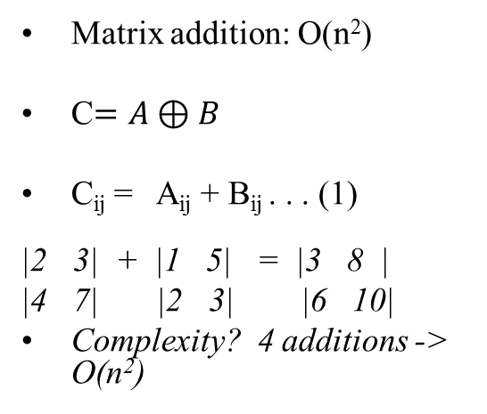
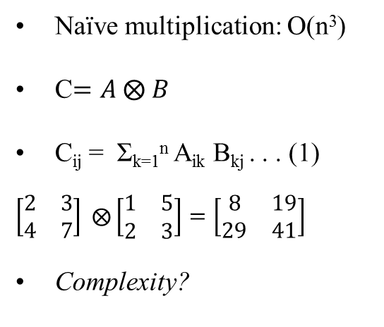
MATRIX MULTIPLICATION:
Naïve multiplication: O(n³)
C$=A ⨂ B$
C_{ij} = Σ_{k=1}^{n} A_{ik} B_{kj} . . . (1)
$\left[\begin{matrix}2 & 3 \\ 4 & 7\end{matrix}\right] ⨂{\left[\begin{matrix}1 & 5 \\ 2 & 3\end{matrix}\right]=\left[\begin{matrix}8 & 19 \\ 29 & 41\end{matrix}\right]}$
Complexity?
Matrix addition: O(n²)
C$=A⊕B$
C_{ij} = A_{ij} + B_{ij} . . . (1)
|2 3| + |1 5| = |3 8 |
|4 7| |2 3| |6 10|
Complexity? 4 additions -> O(n²)
For each element on right side,
O(n) additions as in eq 1: one for loop
How many elements are in matrix C?
n²
Total complexity = O(n³)

Slide 17
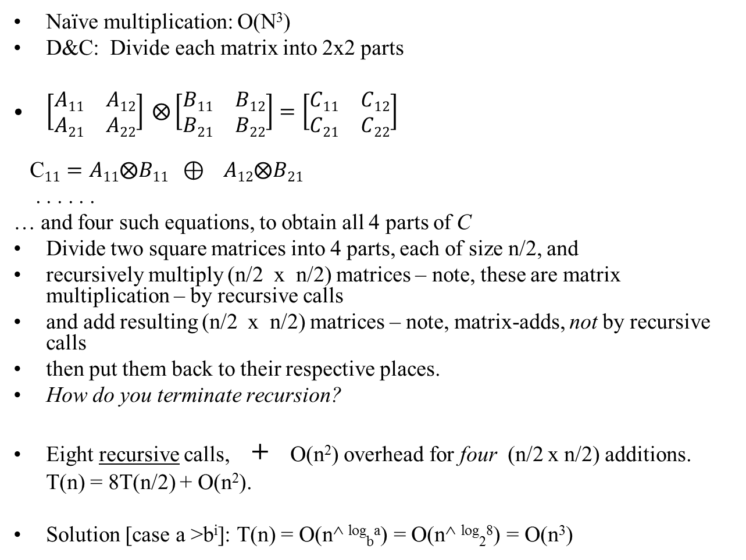
MATRIX MULTIPLICATION: D&C STRATEGY
Naïve multiplication: O(N³)
D&C: Divide each matrix into 2x2 parts
$\left[\begin{matrix}A11 & A12 \\ A21 & A22\end{matrix}\right] ⨂{\left[\begin{matrix}B11 & B12 \\ B21 & B22\end{matrix}\right]=\left[\begin{matrix}C11 & C12 \\ C21 & C22\end{matrix}\right]}$
C$11=A11⨂B11 ⊕ A12⨂B21$
. . . . . .
… and four such equations, to obtain all 4 parts of C
Divide two square matrices into 4 parts, each of size n/2, and
recursively multiply (n/2 x n/2) matrices – note, these are matrix multiplication – by recursive calls
and add resulting (n/2 x n/2) matrices – note, matrix-adds, not by recursive calls
then put them back to their respective places.
How do you terminate recursion?
Eight recursive calls, + O(n²) overhead for four (n/2 x n/2) additions.
T(n) = 8T(n/2) + O(n²).
Solution [case a >b^{i}]: T(n) = O(n^ ^{log}_{b}ª) = O(n^ ^{log}₂⁸) = O(n³)

Slide 18
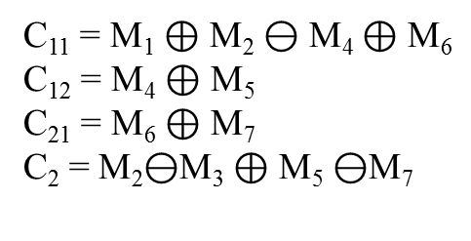
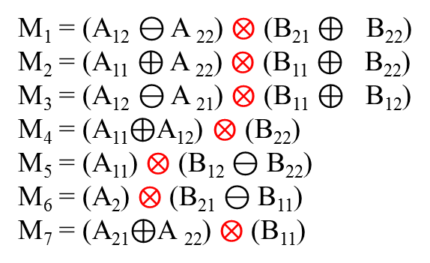
MATRIX MULTIPLICATION: new D&C STRATEGY
Strassen’s algorithm;
  rewrite multiplication formula reducing recursive calls to 7 from 8.
M₁ = (A₁₂ $⊖$ A ₂₂) $⨂$ (B₂₁ $⊕$ B₂₂)
M₂ = (A₁₁ $⊕$ A ₂₂) $⨂$ (B₁₁ $⊕$ B₂₂)
M₃ = (A₁₂ $⊖$ A ₂₁) $⨂$ (B₁₁ $⊕$ B₁₂)
M₄ = (A₁₁$⊕$A₁₂) $⨂$ (B₂₂)
M₅ = (A₁₁) $⨂$ (B₁₂ $⊖$ B₂₂)
M₆ = (A₂) $⨂$ (B₂₁ $⊖$ B₁₁)
M₇ = (A₂₁$⊕$A ₂₂) $⨂$ (B₁₁)
C₁₁ = M₁ $⊕$ M₂ $⊖$ M₄ $⊕$ M₆
C₁₂ = M₄ $⊕$ M₅
C₂₁ = M₆ $⊕$ M₇
C₂ = M₂$⊖$M₃ $⊕$ M₅ $⊖$M₇
Complexity
  T(n) = 7T(n/2) + O(n²)
  Solution: T(n) = O(n^^{log}₂⁷) = O(n^{2.81})

Slide 19
Binary Search Algorithm
BinSearch (array a, int start, int end, key) // T(n)
if start=end // Θ(1)
if a[start] = = key then return start else return failure;
else // start ≠ end
center = (start+end)/2;
if a[center] < key
BinSearch (a, start, center, key)
else BinSearch (a, center+1, end, key); //only 1*T(n/2)
end if;
End BinSearch. // T(n) = O(1) + 1*T(n/2) = O(log n)

